Slide 1
Sustainability lectures
WATER
DR KEITH SKENE

Slide 2
Water: a simple molecule, a complex relationship with humans
The Māori view water as a taonga, a gift, passed down from the higher powers,
Consequently, Māori people treasure and respect it
Lake Taupo, New Zealand

Slide 3
The Sami view lakes as sentient beings

Slide 4
The Washoe tribe of Lake Tahoe
Water is quite simply seen as life—not only does it sustain life, but also it is a life force itself
Far beyond an ecosystem service provider

Slide 5
Dreamtime stories
The role of spirits in creating sources of water
and the ongoing supply and control of these watercourses by ancestral spirits and creation beings

Slide 6
Marker trees and bird species have been used to find water sources
Ecological mapping, combining storytelling, landscape and other species

Slide 7
The rainbow serpent as protector of water

Slide 8
“Water is the life for us all. It’s the main part. If we are gonna loose that I don’t know where we gonna stand. If that water go away, everything will die. That’s the power of water. He connect with the land. Pukarrikarra (the dreaming) put ‘em all together. One life.”
John ‘Dudu’ Nangkiriyn
Karajarri people.

Slide 9
Indigenous and non-Indigenous perspectives of water and its management differ greatly
Indigenous thinking views land and water as one
An idea now emerging in modern sustainability policy
This creates difficulties as non-Indigenous laws and management plans separate land from water and generally regard water as a resource available for economic gain.

Slide 10
Celts and water
Water bodies were venerated
Ritual sacrifices into lakes and rivers
Such as at La Tène
Gateway to the Other World
Tír fo Thuinn – land under the sea

Slide 11
Celts and water
Remember the Voyage of Bran?
The Otherworld as below the ocean
Possibly a reference to the ice age lands now covered
The world of the ancestors

Slide 12
Danu
Goddess of the Earth, rivers and wells
Great mother of all other gods and goddesses
The people of the Goddess Danu.
The Riders of the Sidhe by John Duncan (1911)

Slide 13
The great purveyor of life and death

Slide 14
Why is water such an important molecule? So simple yet so complex?

Slide 15
Biology is based on chemistry Chemistry is based on physics

Slide 16
Polarity:

Slide 17
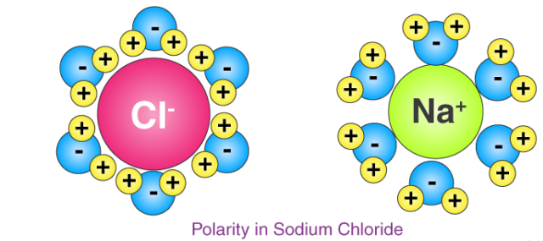
Polar solvent
Able to dissolve ionic molecules

Slide 18
Polar solvent
Membranes are essential for life
Membranes can remain intact (they are made of special lipids with polar heads) where reactions within the cell membranes can occur
They allow compartmentalization and protection

Slide 19
High melting and boiling points
High specific heat (energy needed to raise temperature of 1 kg by one degree C)
Allows maintenance of temperatures
Important for consistent enzyme rates
Important in heat transfer around the body

Slide 20
Latent heat of vaporization
Heat required to move from liquid to gas phase
High because of need to break hydrogen bonds
Allows evaporative cooling
E.g. sweating – do not wipe sweat away, let it evaporate!

Slide 21
Water as a reaction medium and a reactant
Water as reaction medium due to polarity
As a reactant, water can be formed or split
Water splitting reaction is extremely important

Slide 22
Water as habitat
High surface tension
Reactant
Dilutant
Buoyancy
High specific heat capacity (slow to change temperature)

Slide 23
Water at 4 degrees centigrade is denser than ice

Slide 24
Thermal Stratification

Slide 25
The Blue Planet
A symbiotic relationship exists between water, weather, climate and all life on Earth
As recognized by all indigenous people.

Slide 26
Water vapour as the major greenhouse gas
Through its properties as a greenhouse gas, water vapour determines the Earth's temperature, making the planet habitable
It allows the oceans to exist in liquid form so that they can transport heat and nutrients around the Earth system

Slide 27
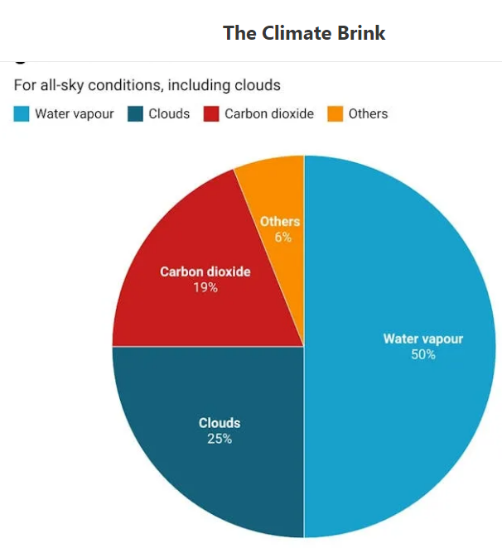

Slide 28
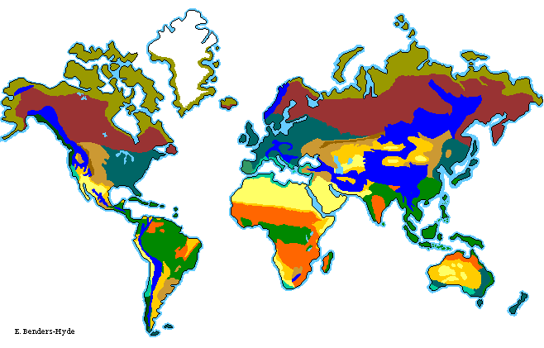
Tundra
Boreal
Deciduous
forest
Alpine
Grassland
Desert
Tropical rainforest
Savanna
Mediterranean

Slide 29
The equator receives more
energy per unit area than
higher latitudes

Slide 30
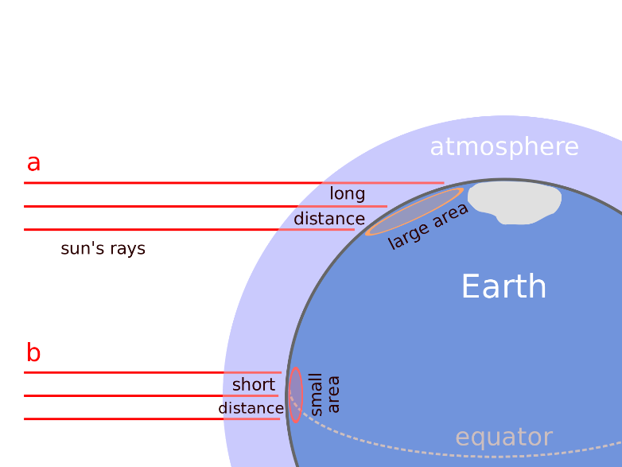

Slide 31
Note: Thicker layer of jam (more yummy)

Slide 32
As a result…
Warm moisture-laden air rises at
the equator…

Slide 33
And cools as it rises…

Slide 34
The moisture condenses
and provides the rain that
nurtures tropical rain forests.
Rainforest

Slide 35
The birth of circulation
The cool air now above the equator is pushed towards the poles by rising air below.
As it moves, it radiates more heat into space, and descends at around
30 degrees N and S.
Rainforest

Slide 36
The equator gives birth to the deserts
At the surface, this cold,
dry air draws moisture
From the land,
creating desert regions
Centred at 30º N and S
Desert
Rainforest
Desert

Slide 37
And the deserts feed the rainforest
The descending air now divides
at the surface, part returning
To the equator and part
Heading towards the
poles,
Both laden with moisture.
Desert
Rainforest
Desert

Slide 38
If we consider the desert and
equator section,
it can be seen that a circular
pattern of airflow occurs.
This is called the
HADLEY CELL.
This cell results in moisture
being moved from desert
areas to the equator
in a giant conveyor.
Desert
Rainforest
Desert

Slide 39
Six rotating belts of air cells surround the planet…
Polar cell
Ferrel cell
60N
30N
Hadley cell
equator
Dry air
descending, low
precipitation
30S
60S
Moist air rising,
high
precipitation

Slide 40
Six belts of cells

Slide 41
The relationship between the cells and the biomes
Tundra and Taiga
Sparce precipitation
all year
Temperate forests/grasslands
Ample precipitation
All year
Savanna and Scrubland
Winter wet, summer dry
Deserts
Dry all year
Tropical seasonal forest and savanna
Summer wet/winter dry
Tropical rainforest
Ample precipitation all year
90 N
Polar
Cell
60 N
Ferrel
Cell
30 N
Hadley
Cell
0

Slide 42
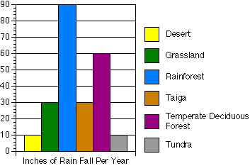

Slide 43
The soil-forest-water-civilization nexus
Forests are major contributors to rainfall, with the Amazon rainforest producing some 70% of precipitation in the Rio de Plata river basin
This is through evapotranspiration and the production of microbes and organic compounds which act as condensation nuclei for cloud formation and rain events.

Slide 44
It is estimated that deforestation may account for as much as 18% of current global warming
Deforestation also reduces soil structure and organic carbon content
negatively impacting the water-holding capacity

Slide 45
The biotic pump
Forest releases water
which supplies the aerial
or flying river
Allowing rainfall further inland
Self-sustaining…
until the forest is chopped down

Slide 46
Deforestation and water relations
Deforestation has three significant impacts in terms of hydrology:
- soil erosion
- eutrophication
- soil salinization.

Slide 47
1. Soil erosion
Since water is no longer escaping into the atmosphere through plant leaves
It now runs along the ground, moving the soil into nearby streams and lakes. This leads to eutrophication.

Slide 48
2. Eutrophication
Soil carries large amounts of nutrients into the water
This alters the aquatic ecosystem massively as nutrients are a key limiting factor to population of growth

Slide 49
3. Soil Salinization
Currently, 25% of the world’s cropland is affected
In Africa, this figure is 50%
By 2050 it is estimated that some 50% of cropland will have productivity halved due to build-up of salt in the surface soil
Soil salinization is very difficult to reverse.

Slide 50
Two routes to salinized soil
1. Irrigation in semi-arid zones
Each drop of water contains a tiny amount of salt
Over time, this salt accumulates in the soil.

Slide 51
2. Soil salinization through deforestation

Slide 52
Discussion and Break

Slide 53
WATER Part Two

Slide 54
Origin of water on Earth
Where did all of this water come from?
Two theories:
Endogenous theory – water from within
Exogenous theory – water from outwith
Izidoro et al., 2013.

Slide 55
1. Endogenous theory
Local adsorption of water vapor onto dust grains in the primordial nebula
delivery through planetesimal accretion.

Slide 56
2. Exogenous theory
Comets brought water to Earth

Slide 57
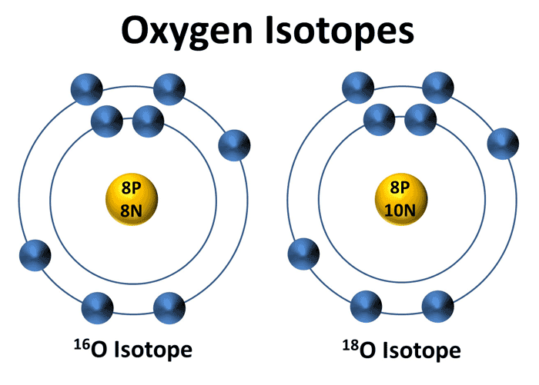
Reality: combined model
Large part endogenous
Some exogenous
Base on stable isotopes of oxygen

Slide 58
Water: the perfect storm
It is an irony that on a planet whose surface area is 73% water
And only 2.5% of that is fresh water
We face a significant threat to water security
Water is essential for all life, and central to many important business sectors including the food and beverage industry, which accounts for over 70% of global fresh water consumption

Slide 59
Water: a depleting resource
There will be an 18% reduction in the availability of worldwide water for agriculture by 2050,
leading to increasing competition between food supply and other business sectors.

Slide 60
Water in energy supply
Water Requirements for Energy Production by Different Processes
Process litres H₂O/MWh
Geothermal 20
petroleum extraction 40
oil refining 80-150
oil shale surface retort 680
nuclear power plant, closed loop cooling 950
nuclear power plant, open loop cooling 94,600-227,100
corn ethanol 2,270,000-8,670,000
soybean biodiesel 13,900,000-27,900,000

Slide 61
Glacial melt in the Himalayas threatens water flow in the Indus, Ganges, Brahmaputra, Irrawaddy, Mekong, Yangtze, and Yellow rivers, all of which have their sources in the Himalayan range.

Slide 62
It is estimated that by 2100 AD, there will be a 30% decline in the Indus, the most important river in Pakistan.

Slide 63
Water security
Vörösmarty et al. (2010) found that nearly 80% of the world’s population is exposed to high levels of threat to water security
2.4 billion people (more than earth’s population in 1940) lack sanitation services equivalent to that experienced in the Roman Empire (Gleick, 2002).

Slide 64
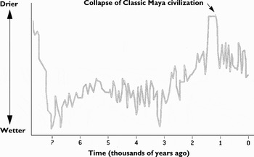
Drought and the Mayan Collapse

Slide 65
“When the well runs dry we know the worth of water.”
Benjamin Franklin

Slide 66
“Water, water, every where,
Nor any drop to drink.”
The Rime of the Ancient Mariner (1834)
By Samuel Taylor Coleridge

Slide 67
Irrigation contributes most to surface water withdrawals on the global scale and is the most important driver of quantity-induced scarcity in most regions including China, India and South America.

Slide 68
However, this differs in Europe, where irrigation contributes to less than 30% of water withdrawals. The most important water withdrawal is the industrial sector in Europe.

Slide 69
In North America, industry takes almost 50% of the continental water withdrawal due to the large water demand for energy production (e.g., thermoelectric power plant) and manufacturing.

Slide 70
Nitrogen pollution is a significant issue
However, many other indicators (e.g., salinity, dissolved oxygen, biological demand, pH, temperature, and heavy metals) and newly emerging pollutants (e.g., pathogens, antibiotics, plastics, and pesticides)
will likely cause severe water degradation in the future.

Slide 71
Water contamination
In less economically developed countries nearly 50 % of its diseases are due to the use of contaminated water

Slide 72
Planetary warming
The progressive warming of water bodies,
depletion of dissolved oxygen,
and increase of nutrient concentrations in deep layers
have already been observed in numerous lakes worldwide.

Slide 73
Virtual water
defined as water used in the production of imported goods
Water is exported and imported as part of international trade
Represents water footprint

Slide 74
The water footprint
of a product is an empirical indicator of how much water is consumed, when and where, measured over the whole supply chain of the product
The water footprint of an individual, community or business is defined as the total volume of freshwater that is used to produce the goods and services consumed by the individual or community or produced by the business
See: http://www.waterfootprint.org

Slide 75
Water Footprints
The average consumer in the United Kingdom has a WF of 1695 m³/y,
whereas the average citizen in China has WF of 1,071 m³/y
Hoekstra and Mekonnen (2012) have calculated that the global annual average WF in the period 1996–2005 was 9,087 Gm³/y
of which agricultural production contributes 92%.

Slide 76
The groundwater footprint (GF)
The land area required to supply sufficient rainwater to underground aquifers in order to replace use of this water, divided by the area of the aquifer
Globally, 131 billion km² is required to offset groundwater use
which is 3.5 times more area than is available
Thus we are unsustainably using groundwater.

Slide 77
SDGs and Water
Water impacts on basically all of the SDGs
One particular goal, SDG 6, stands out

Slide 78
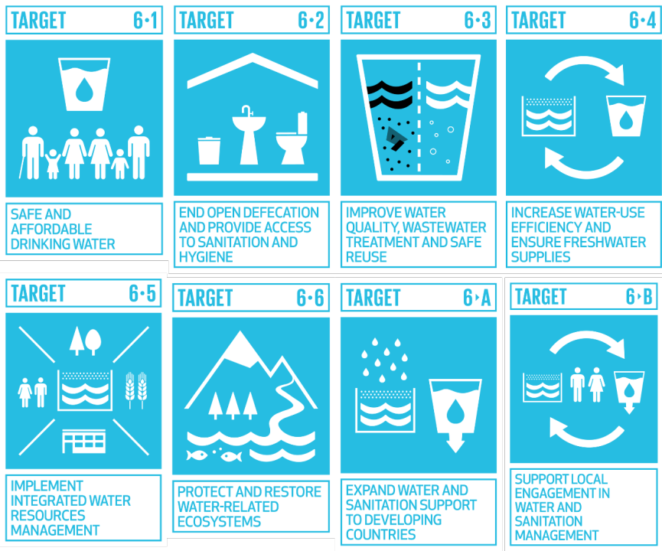

Slide 79
Increased emphasis on water engineering
Twentieth century: move water long distances use and then discharge back to the environment – a LINEAR model
Twenty-first century, recycling water, differentiating between different water types, robustness and flexibility in an increasingly uncertain future
Trade-offs and complexity across the SDGs
New emphasis on the environment

Slide 80
The WEFE Nexus
Water-energy-food-ecosystems
the repurposed realization that acting from the perspective of individual sectors cannot suffice to tackle the challenges threatening our sustainable and secure futures
Agriculture is the most disruptive activity of the human race

Slide 81
Dramatic shift in agriculture needed
Increase water holding capacity with more organic matter
Remove high water consuming species e.g. cotton
Prevent soil impaction
Reduce pollution of aquifers

Slide 82
WEFE
The WEFE Nexus is a novel cross-thinking concept, meaning that answers to current environmental hazards must follow a multisectoral approach rather than a traditional unidirectional vision
Escape from the silo

Slide 83
Examples
Obtaining bioenergy from crops (e.g., biofuels) under irrigated agriculture
can increase overall water withdrawals
affecting food security.

Slide 84
Pressurized irrigation
Converting surface irrigation into high-efficiency pressurized irrigation may save water
but at expenses of a higher need for energy consumption
Therefore, every single action over one of such WEFE resources will affect at least to one or even all of the others.

Slide 85
Integrated management
An integrated management of the natural resources, as proposed by the WEFE Nexus thinking, seems to be also the key to simultaneously achieve several of the Sustainable Development Goals (SDGs)
The actions are universal ones aimed to end poverty, protect the planet, and ensure food, water and energy security for all people by 2030

Slide 86
Indeed, if we consider all the trade-offs and synergies linked in the WEFE Nexus approach
it could be possible to effectively work accross different interdependent SDGs
such as SDG 6 (clean water),
SDG 7 (clean energy),
SDG 2 (zero hunger),
SDG 14 (life below water),
and SDG 15 (life on land).

Slide 87
GLOCAL Approach: the pluriverse
Developing an effective WEFE Nexus approach is important in order to recognize and validate an array of options and measures to adapt to specific local sites and conditions,
but also some others could be used in a wider sense for applying to more global needs

Slide 88
Joined-up thinking
Therefore, it is a priority for policy makers, administrations, stakeholders and the common society to overwhelm the traditional view on natural resources as merely individual and disconnected assets.

Slide 89
Local, traditional and indigenous ecological knowledge
Local ecological knowledge: people’s site-specific ecological knowledge that can be practically applied
Traditional ecological knowledge: knowledge, innovations and practice of local communities around the world developed from experience gained over the centuries and adapted to the local culture and environment
Indigenous ecological knowledge: a cumulative body of knowledge, practice and belief, evolving by adaptive processes and handed down through generations by cultural transmission regarding the relationship of living beings, including humans, about one another and their environment.

Slide 90
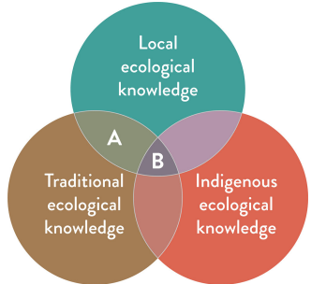

Slide 91
Steffen et al. (2020) write that: “For tens of thousands of years, indigenous cultures around the world have recognized cycles and systems in the environment, and that humans are an integral part of these”.

Slide 92
Gaelic tradition of Dùthchas
The Celtic sustainability philosophy
Dùthchas in Scottish Gaelic (Dùchas in Irish Gaelic)
From the Gaelic word “dù/dùth”, meaning “earth” or “land”
An intrinsic part of the Gaelic worldview.

Slide 93
Seán Ó Tuama (1985):
“There is a sense in which place finally becomes co-extensive in the mind, not only with personal and ancestral memories, but with the whole living community culture
Community becomes place, place community.”

Slide 94
Crofter and world-renowned knitwear designer Alice Starmore describes dùthchas as:
“a feeling of belonging, of where everything is linked, completely linked. Where you belong to the land, and the land belongs to you – there is no distinction.
It’s like a hand in a glove.
Everything fits in, and your culture is part of that as well, and everything you know that’s around you;
every part of life that’s around you is all interlinked and interdependent, and it’s all about ancestry, knowing where you’ve come from and that you are a continuation of all that.”

Slide 95
Key point: One size does not fit all
Recognizing the environmental pluriverse
Recognizing existent local resilience
Respecting local and traditional voices as being most knowledgeable.

Slide 96
An embedded economy
Skene, K.R. (2022). How can economics contribute to environmental and social sustainability? The significance of systems theory and the embedded economy. Frontiers in Sustainability, p.107

