Slide 1
Sustainability
An Introduction
Dr Keith Skene
University of Dundee and
Biosphere Research Institute

Slide 2
Webpage
https://biosri.org/sustainability2024.html

Slide 3
Michel Foucault’s conceptualization of the history of ideas
Foucault (1984) proposed that histories of ideas should be genealogical
Foucault’s history relies on the telling of descent which traces the myriad events through which—thanks to which, against which—they were formed
A creative tension
Sustainability is a case in point.

Slide 4
Etymology of sustain
Latin: sub "up from below" + tenere "to hold“
Old French sustenir: "hold up, bear; suffer, endure“
In law: sense of "admit as correct and valid, uphold the rightfulness of"

Slide 5
Sustainable
1610s: "bearable"
1845: "defensible, capable of being upheld
1965: "capable of being continued or maintained at a certain level"

Slide 6
Plastic words
Development
Civilization
Progress
Conservation
Ecological
Rewilding
Sustainability

Slide 7
Maintaining some status quo?
Human-centric in its focus
management of the environment in such a way that we can continue to exist in our present state
Where ecosystems can continue to service our needs and greed,
and those of our children and grandchildren.

Slide 8
So many green technologies replace existent technologies
Same behaviours
Different ways of doing the same thing
Fundamental issues here
REDUCE not REPLACE

Slide 9
Agenda 30: “The future we want”
It’s all about us
Ecosystem services – serving us
Masters of all we survey
How dare the planet work against us?
Neocolonial sustainability theory.

Slide 10
The Mantra of Sustainable Development

Slide 11
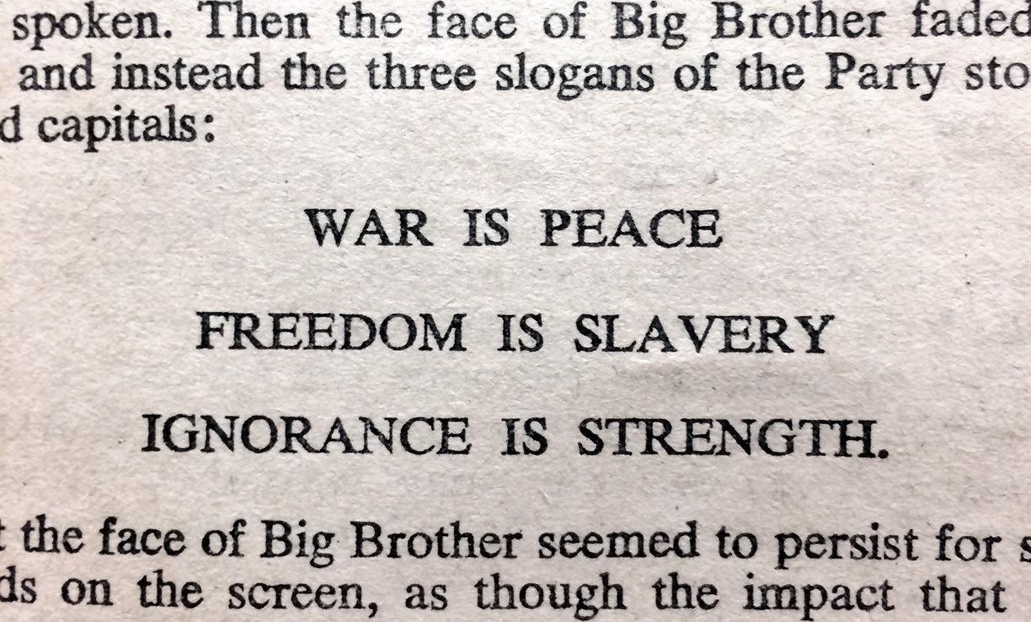
Sustainable development: an Orwellian doublethink?
AND DEVELOPMENT IS SUSTAINABLE ….
George Orwell, Nineteen Eighty-Four (1949)

Slide 12
The true meaning of sustainability
The Biosphere, as a system, is emergent, surprising and creative
Unleashing nature rather than suffering from the Garden of Eden Complex.

Slide 13
The Garden of Eden Complex
We’ve got to get ourselves back to the Garden…
Yet emergence of the new is essential for sustainability
The garden is not a place of static equilibrium and a fixed destination
Rather, it is a journey
A laboratory of creativity, of death and renewal
A process not a form.

Slide 14
Joni Mitchell
“And we've got to get ourselves back to the garden”

Slide 15
Il faut cultiver son jardin…
“Peace means an unending fight against disease and slums, ignorance and economic injustice, against deforestation and waste of natural resources; peace means, both concretely and figuratively, that everyone must cultivate his garden”
Patrick Geddes
Cities in evolution, 1915

Slide 16
Il faut cultiver son jardin…
Voltaire’s (aka François-Marie Arouet) radically enlightened critique of professional academic philosophy as abstract, world-alienated, self-alienating, sanctimonious theorizing
Akin to modern neoliberalism
Call to real or field philosophy – a working philosophy
1694 – 1778

Slide 17
Henry David Thoreau: Walden (1854)
“To be a philosopher is not merely to have subtle thoughts, nor even to found a school, but so to love wisdom as to live according to its dictates, life of simplicity, independence, magnanimity, and trust.
It is to solve some of the problems of life, not only theoretically, but practically.”

Slide 18
Function not form
Sustainable function?
Earth System functionality
The process of diversification, not diversity itself
Unleashing the healing power and creativity within the system

Slide 19
D’Arcy Thompson (1860-1948)
"we rise from the conception of form to an understanding of the forces which gave rise to it."
On Growth and Form. 1917

Slide 20
Laboratory not museum

Slide 21
Issues around sustainability
Not a constraint or selection but a liberation and diffusion
Not a destination but a journey
Learning for Sustainability should empower the next generation to flourish and grow not continue our erroneous path forward…
But does it?

Slide 22
Environmental education became tied to the sustainable development concept
“development that meets the needs of the present without compromising the ability of future generations to meet their own needs”
1987

Slide 23
Paper on critique of SDGs
Skene, K.R. (2021). No goal is an island: the implications of systems theory for the Sustainable Development Goals. Environment, Development and Sustainability 23: 9993–10012.

Slide 24
Not the maintenance of forms nor lifestyles
Embracing functionalism and the essence of function
The creative force within
1. Ecological succession

Slide 25
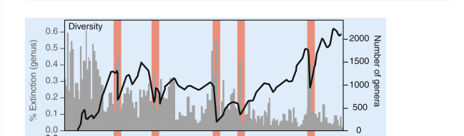
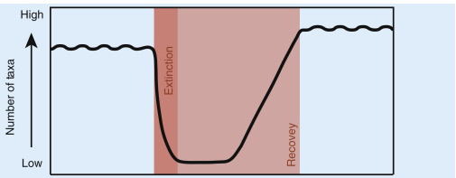
2. Post-extinction recovery

Slide 26
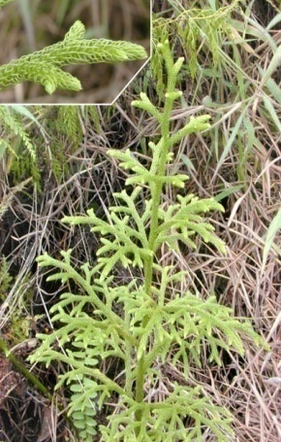
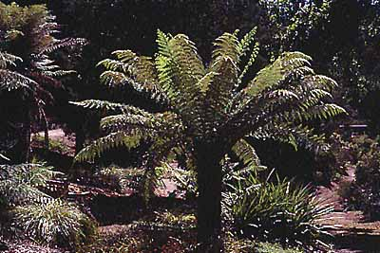
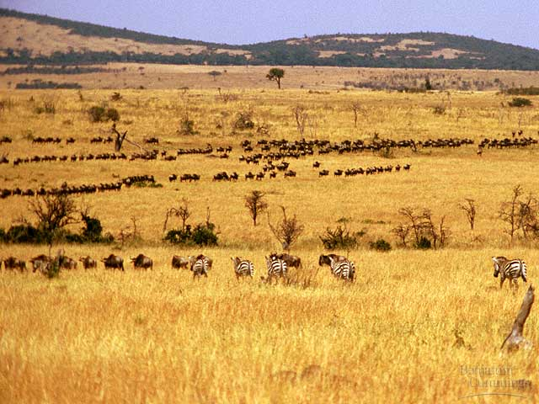
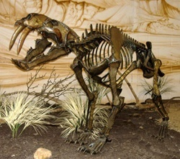
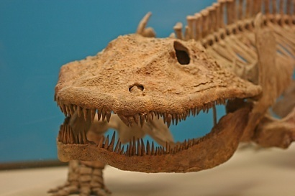
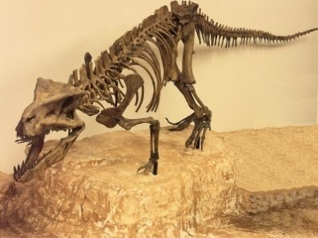
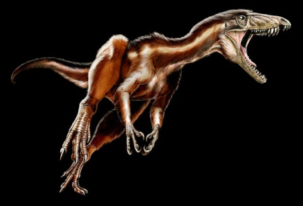
Mass Extinctions
FUNCTION
FORM
Lycopoda Glossopterids Magnolia Poaceae
Eryops Postosuchus Tawa Smilodon

Slide 27
Shakespeare Analogy
The actors may change through time, but the play stays the same
It is the play that drives the players
And the play is FUNCTION, not FORM

Slide 28
Diversity is function
It is the functional role that lies at the heart of the matter
By reducing diversity we reduce function
By impacting upon function, we impact on ourselves
Don’t ask for whom the bell tolls
It tolls for thee
John Donne Meditation 17 Devotions upon Emergent Occasions

Slide 29
CONNECTED
RESPONSIVE
NON-LINEAR
SELF-ORGANIZING
EMERGENT
SUBOPTIMAL
SELF-ASSEMBLING

Slide 30
Functionality, system theory and sustainability
Papers/Chapters for further reading (see web page)
Skene, K.R. (2024). Systems theory, thermodynamics and life: Integrated thinking across ecology, organization and biological evolution. Biosystems, p.105123.
Skene, K.R. and Oarga-Mulec, A. (2024). The circular economy: the butterfly diagram, systems theory and the economic pluriverse. Journal of Circular Economy, 2 (3).
Skene, K.R. (2023). Biosphere Evolution, Ecology and Sustainability: Why Thermodynamics and System Theory Matter. In: B. Veress and J. Szigethy, eds. Horizons in Earth Science Research Volume 24 pp. 1-46. Nova Science Publishers.
Skene, K.R. (2022). How can economics contribute to environmental and social sustainability? The significance of systems theory and the embedded economy. Frontiers in Sustainability, p.107.

Slide 31
Spatial Issues
A Sustainability Pluriverse
Not a global approach
One size cannot fit all
Local landscapes, ecosystems and biomes

Slide 32
Temporal issues
The Earth System is not a Lego kit
Cyclical changes defy rectilinear logic
Ripples of interacting timescales pervade a system
Non-linear time – a fundamental aspect of indigenous knowledge
A temporal pluriverse

Slide 33
The Canute School of Conservation

Slide 34
The importance of Place: Genius Loci

Slide 35
Genius loci
The protective spirit of a place
It was often depicted in religious iconography as a figure holding attributes such as a cornucopia, a snake or a unicorn.

Slide 36
Genius loci: the protective spirit of a place
The deification of Nature
Places of inspiration and sacredness
That mythical meaning of the notion genius loci from a deep spiritual bond with nature was broken in the Middle Ages
Gardens became enclosed,
the commons diminished.

Slide 37
Genius loci: the protective spirit of a place
Genius loci. Edward Ende, 1936.

Slide 38
The method of Loci
Memories linked to landscape, where landscape acts as a mnemonic
The landscape is intertwined with stories and memories
Seen in the Sami of Northern Scandinavia

Slide 39
Indigenous cosmologies – system thinking
Most indigenous cosmologies perceive everything in the Universe as interconnected and interdependent
Nature and the human realm are experienced with a sense of unity and mutual belonging

Slide 40
The importance of landscape in traditional life
A landscape represents a multidimensional, multitemporal meeting place
Nature as a bridge, a communicator, a celebrant and a record
The oral tradition is set in this complex dynamic environment

Slide 41
The physical and the metaphysical as one
A beautiful, monistic approach, where all is intertwined with all else
A powerful theme repeated across indigenous oral traditions
Complexity, multidimensionality and integrity are emphasised

Slide 42
The English philosopher Lord Shaftesbury (1671 –1713)
The English philosopher Lord Shaftesbury (1671 –1713) emphasised that landscapes are personalities that derive meaning from their being itself
Natural rockeries, systems of streams and flower meadows represent the outpouring of the genius in forms and in dynamic forces
The adoration of these ‘unrestrained’ or ‘natural’ forms, have been seen as the factory of the genius loci.

Slide 43
Ecology of mind: Dùthchas
The Celtic sustainability philosophy
Dùthchas in Scottish Gaelic (Dùchas in Irish Gaelic)
From the Gaelic word “dù/dùth”, meaning “earth” or “land”
An intrinsic part of the Gaelic worldview
(Deirdre Ní Mhathúna (2021). Traditional ecological knowledge and the relevance of Dùthchas in Gàidhealtachd environmental futures. Scottish Affairs 30(2): 251-261.

Slide 44
Seán Ó Tuama (1985):
“There is a sense in which place finally becomes co-extensive in the mind, not only with personal and ancestral memories, but with the whole living community culture
Community becomes place, place community.”

Slide 45
A socio-environmental approach
Not a silo approach
But, as the Earth system, integrated
Process not destination
Function not form
Systemic not structural

Slide 46
Crofter and world-renowned knitwear designer Alice Starmore describes dùthchas as:
“a feeling of belonging, of where everything is linked, completely linked. Where you belong to the land, and the land belongs to you – there is no distinction.
It’s like a hand in a glove.
Everything fits in, and your culture is part of that as well, and everything you know that’s around you;
every part of life that’s around you is all interlinked and interdependent, and it’s all about ancestry, knowing where you’ve come from and that you are a continuation of all that.”

Slide 47
Transition from:
Isolation to connectivity
Less-than-human to more-than-human
Individual to community to ecology
Contextless to contextual
Lesser wellbeing to greater wellbeing
Reductionism to holism

Slide 48
An imagining of a different world
where we think and act
in unison with the Earth system

Slide 49
Steffen et al. (2020) write that: “For tens of thousands of years, indigenous cultures around the world have recognized cycles and systems in the environment, and that humans are an integral part of these”.

Slide 50
Ethical environmental behaviour
Humans have been practicing ethical environmental sustainability within the context of their landscapes for millennia.
Recent research points to current sustainable indigenous practices as a blueprint for sustainable behaviour (Kupa'a et al., 2021; Ferguson et al., 2022; Reeder-Myers et al., 2022).

Slide 51
Examples of community regulation: how to live in the commons without tragedy
Many indigenous people today still have strong community regulation of resource use
The Ogiek people of Kenya cannot cut down a tree without permission from the elders

Slide 52
The Sami of Northern Europe each had access to a number of lakes, allowing a rotation, where each lake would have 1 or 2 years of fallow.

Slide 53
The Shona
The Shona of South Africa have taboos regarding the harvesting of wild fruit only at a particular point of ripening
with limitations as to when hunting can occur and what age of prey may be hunted
Gathering marula fruit

Slide 54
Beyond Borders
Zhang, J, Skene, K.R., Wang, S., Ji, Q., Zheng H., Zhou, C., Pradhan, P., Meadows, M.E. and Fu, B. (2024). Beyond borders: assessing global sustainability through interconnected systems.
Sustainable Development.

Slide 55
Beyond Borders paper
The many complex interconnections among countries have a crucial impact on regional and global sustainability, yet a robust and systematic way to quantify this impact is lacking
We present a new sustainability index capable of systematically considering pertinent indicators of interdependencies and spillovers between countries.

Slide 56
Beyond borders
We measure dimensions of interdependence and spillovers, along with buffer and multiplier effects
enabling us to distinguish and gauge the impact of spatial interconnections on regional and global sustainability
Overall, the two approaches applied in tandem reinforce the joint principles of ‘one Earth’ and ‘leaving no one behind’.

Slide 57
Discussion and coffee/tea break

