Slide 1
A History of Sustainability Through Cartoons It’s a fair COP, or is it? aka what have fifty years of climate conferences actually achieved?
Dr Keith Skene
Director, Biosphere Research Institute
www.biosri.org

Slide 2
Cartoons and the environment
A unique art form
employed to educate and enlist the public in reversing the deterioration of the living world
Often found in widely read newspapers and magazines

Slide 3
“A good cartoon can be far more effective at transmitting a deep and complex message to a wide audience than most scientific articles.”
Gary Rogers, Professor of Geography, Columbia University

Slide 4
“Grand ball given by the whales in honour of the discovery of oil wells in Pennsylvania”
Vanity Fair, 1861)

Slide 5
UNFCC: United Nations Framework Convention on Climate Change
Came into force on 21 March 1994
Stemmed from the Rio Earth Summit in 1992
Ultimate aim: Prevention of “dangerous” human interference with the climate system
Two sister conventions:
Convention on Biological Diversity and the Convention to Combat Desertification.

Slide 6
What is a Conference of the Parties (COP)?
A generic term for the supreme governing body of any international convention
Lots of different COPS
Specifically, a yearly meeting of all nations signed up to the UNFCCC to review, assess and implement the Convention and to review emissions inventories

Slide 7
A brief history of COPs

Slide 8
A brief history of COPs

Slide 9
It all began with Rio…
United Nations Conference on Environment and Development (June 1992)
Aka The Earth Summit
Most costly diplomatic meeting in history
Bruce Babbitt: “A chaotic process more akin to a street brawl than a diplomatic meeting”
Output: Agenda 21, costing US$300 billion
No cash and no targets meant it was without legs or teeth.

Slide 10
Berlin, Germany, 25th March 1995: The first COP meeting

Slide 11
COP 3 Kyoto 1997
Addressed lack of targets in Agenda 21
Each party to reduce its greenhouse gas levels below that of an agreed date, mostly 1990
Carbon trading, false accounting, issues with what was a forest
China, India and 100 other nations exempt as developing nations
Developed nations were expected to contribute to resilience fund

Slide 12
Seppo Leinonen

Slide 13
Kyoto: A fair COP?
Russia and Ukraine each calculated sink credits based on forestry in the whole of the former USSR
Czech energy giant CEZ awarded 30% of the nation’s carbon credits, sold them when price was high, bought them back when low and invested profits to expand coal mining!
The ‘Australia clause’ allowed inclusion of cleared forests in emissions for 1990.

Slide 14
COP 6 The Hague 2000
Summit collapses when USA demands special concessions
George Bush states he is against the Kyoto protocol
Matt Wuerker

Slide 15
USA, Canada and Kyoto
USA left the Kyoto Protocol in 2001
Canada withdrew from Kyoto Protocol in 2011
Prime minister Stephen Harper denounced the Kyoto Protocol as a "socialist scheme to suck money out of wealth-producing nations"

Slide 16
COP 10 Buenos Aires 2004
Russia finally ratifies, allowing Kyoto Protocol to pass into force.

Slide 17
COP 15 Copenhagen 2009
All-time low point?
Danish text leaked – plan from ‘Circle of Commitment’ to double allowable CO2 emissions for developed countries
USA, Brazil, China, India and South Africa meet separately and agree an accord without consulting the other 187 nations present
Summit collapses
Samir Abdl-Fatah Ramahi

Slide 18
Rio +20
45 000 participants and 100 heads of state
USA, UK and Germany leaders refuse to attend
Joel Pitt

Slide 19
COP 21 Paris 2015
Ben Jennings
Paris Agreement or Paris Accord
Zero net emissions by 2050
Less than 2 degrees C rise
Build climate resilience
Nationally Determined Contributions by 2020

Slide 20
Steve Stegelin

Slide 21
Martyn Turner

Slide 22
And so to Glasgow for the joint UK-Italian COP26

Slide 23
COP26 Goals
1. Countries to set emissions targets for 2030
2. Build resilience and restore ecosystems
3. Find 100 billion per year
4. Finalise Paris rulebook

Slide 24
Four key messages for COP

Slide 25
1. The Earth system is a complex, interactive entity
Emergence – properties belong to system, not components
Non-linearity – regime shifts and tipping points
Trade-offs (sub-optimality) are a sign of a working system
Real time feedback is key
Alexander Magnin

Slide 26
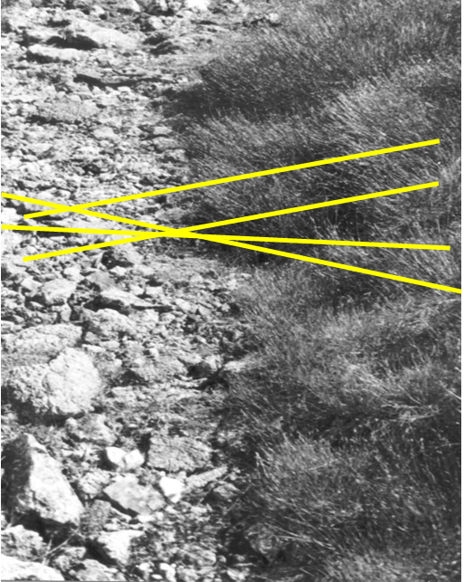
Ecotones as tipping points
Ammonium
Phosphate
Mg
Ni
pH

Slide 27
2. Functionality, not form, is key
Diversification, not diversity
Bio-participation, not biomimicry
An embedded economy valued by its contribution to nature and society (the opposite of ecosystem service valuation).
Scott Adams

Slide 28
3. Individual decisions matter: we are individually accountable
Ethical decision-making requires transparency and empathy
Connectivity between individual, society and ecology essential
Wellbeing stems from such connectivity
Geddes gardening analogy (borrowed from Voltaire)…

Slide 29
Il faut cultiver son jardin…
“Peace means an unending fight against disease and slums, ignorance and economic injustice, against deforestation and waste of natural resources; peace means, both concretely and figuratively, that everyone must cultivate his garden”

Slide 30
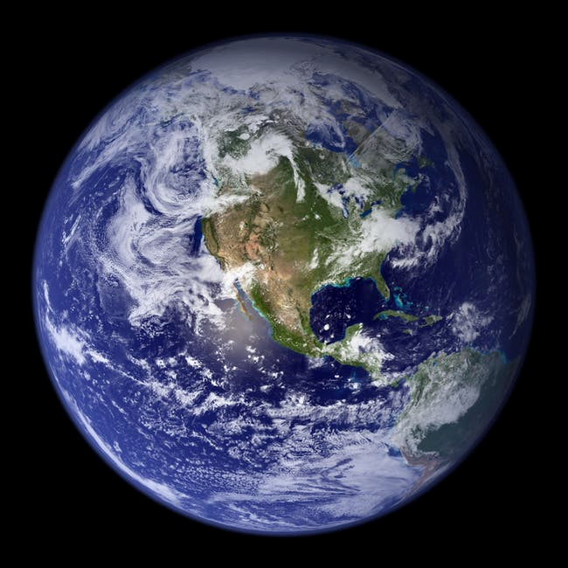
4. It’s Not Just Carbon, Stupid!!!
SOIL EROSION
CLIMATE
DESTABILIZATION
SALINIZATION
GLOBAL
BIODIVERSITY
COLLAPSE
EUTROPHICATION

