Slide 1
Indigenous thinking and our search for a sustainable future Week Three IIIb: Indigenous Empowerment
Dr Keith R. Skene
Biosphere Research Institute

Slide 2
Nehiyawak and Cree people
The largest indigenous people in Canada. Central to their philosophy are the concepts of power and place
They see power and place as being the living energy that inhibits and/ or composes the Universe, and place being the relationship of things to each other.

Slide 3
This immediately can be seen to be a completely different conceptualization to Western thinking
Here power is not something that is to be possessed, but, rather, it is an organizational force underpinning and flowing through all.

Slide 4
Little Bear (2000) reflects that “In this realm of energy and spirit, interrelationships between all entities are of paramount importance, and space is a more important referent than time”.
Power flows through the relationships, both between humans and non-humans.

Slide 5
Studying the indigenous people of the Malay Archipelago, Rugebregt (2015: 1323) observes that:
“Nature of Maluku Islands community is "cosmic", i.e., everything becomes a unity. Man in the cosmic sense is a part of nature, and cannot be separated from his field.”

Slide 6
Kwara’ae People of the Solomon Islands
In their view, the most critical change brought by colonialism was that their lives changed:
from tua lalifu‘anga (living in rootedness)
and tua ‘inoto‘a‘anga (living in dignity),
to tua malafaka‘anga (living in imitation of life brought by the ships).

Slide 7
This rootedness, interconnectivity and flow of energy and power are shared concepts throughout the indigenous world
Example: the Dogon, an indigenous people in Mali and Burkina Faso.

Slide 8
Dogon beliefs
“A perpetual exchange goes on between humans, an unceasing movement of invisible currents.
And this must be so if the universal order is to endure.
The Word is for everyone in this world; it must come and go and be interchanged, for it is good to give and to receive the forces of life” (Marcel Griaule, 1965).

Slide 9
Village and bush: the Dogon
Not only does this exchange continue unceasingly between human beings, but between the ‘ana’ (village) and ‘oru’(bush)
There are natural resources in the bush which the village relies on (firewood, timber, meat, fruit, and more)
but the dependence goes deeper than this: the bush is seen as the source of life itself, and with it of all knowledge, wisdom, power and healing.

Slide 10
Ujamaa
The East African Swahili concept of Ujamaa promotes an ‘African socialism’ based on harmony rather than power struggle
This is significant in that it contradicts the post-development approach of empowerment as born out of conflict

Slide 11
Ubuntu
the term ’ubuntu’ stems from the Southern African Nguni-Bantu elements:
‘ubu’ meaning potency or enfolded being,
and ‘ntu’ meaning unfolded being.
This enfolding and unfolding is key

Slide 12
Ubuntu
Here, the conceptualization of power previously encountered in the Nehiyawak people,
as underpinning the organization of the Universe,
And our own wellbeing,
Is again embraced in indigenous thinking in Africa.

Slide 13
Autopoiesis
In a similar way that the Biosphere self-organizes and self-assembles through the process of autopoiesis (literally self-creation), driven by its energetic context
so all of life is visualized as enfolded and unfolding, driven by the flow of the power throughout the system,
and facilitated by our interactive relationships across our ecology
Thus, the integrity of humanity within the Earth system is seen as essential in terms of us unfolding and realizing our enfolded potential.

Slide 14
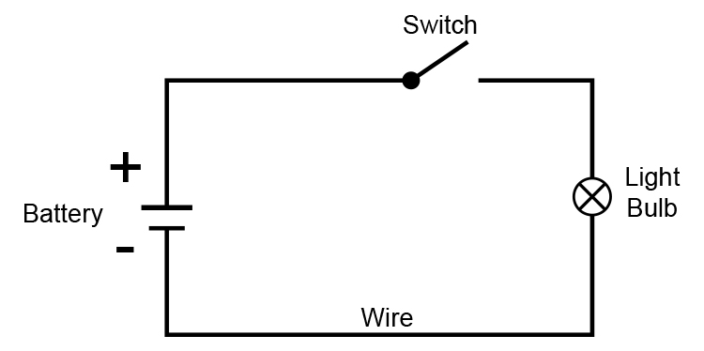
Completing the circuit

Slide 15
The Akan – Ghana and the Ivory Coast
Interestingly, the original meaning of the word ‘evolution’ refers to the unfolding of a scroll (evolue)
For the Akan, personhood is the reward for contributing to the community and the basis of the individual’s moral worth is located in an independent source – a common humanity

Slide 16
Bantu people
For the Bantu people of Central and Southern Africa, power lies at the heart of the essence of being,
where being is defined as ‘the power that is’.
Here, this cycling of power and empowerment is both a physical (food and water) and metaphysical (the unknown, emergent Earth system) concept
Reflects the dynamic atemporal essence of much indigenous thinking.
Power is not possessed but rather it flows through all.

Slide 17
The relational self
‘I am what we are’ is a concept underpinning so many indigenous worldviews,
from ubuntu to Confucianism

Slide 18
Relational power
The concept of relational power,
flowing through all and providing the real-time feedback so central in any complex system,
underpins the functioning, resilience and evolution of the Earth system and of the individual.

Slide 19
The invisible hand
Relational power can be seen as a form of the invisible hand,
in the way Adam Smith envisaged it,
ameliorating extremes and informing our decision-making,
but reaching across the individual, community and environment, as a triple embrace.

Slide 20
Mauri
The concept of Mauri in Aotearoa (New Zealand) represents an internal energy or life force derived from whakapapa (an emergent property resulting from meaningful connectivity through space and time and between all actors)
Mauri is a binding force, flowing through all, and here we can see the similarity with much of the other indigenous philosophies already mentioned.

Slide 21
Shona philosophy
Mungwini (2019) observes that “All beings, whether organic or inorganic, living or animate, personal or impersonal, visible or invisible, constituted one whole which the Shona were taught to respect and maintain,
since upsetting one component of this totality had the ultimate effect of undermining human existence and harmony in the community.”

Slide 22
Ethics
Ethics emerges from this holistic approach
African environmental ethics being defined as the ethics of nature-relatedness
Or eco-bio-communitarianism.

Slide 23
African Environmental ethics
Furthermore, in terms of adherence to this approach there is an emphasis on duty and trade-off,
rather than individual empowerment as a right

Slide 24
African Environmental ethics
Ifeanyi Menkiti (1984: 180) observes that:
“African societies tend to be organized around the requirements of duty while Western societies tend to be organized around the postulation of individual rights.
In the African understanding, priority is given to the duties which individuals owe to the collective, and their rights, whatever these may be, are seen as secondary to their exercise of their duties”.
I. A. Menkiti (1984) Person and Community in African Traditional Thought

Slide 25
Relational power and energy
relational power, flowing through environment, society and individuals, can be seen to shape the processes and forms of each of these
Much as the energetic relationships in the biosphere determine functioning, structure and the character of the emergent whole, governed by the laws of thermodynamics.

Slide 26
We are, fundamentally, not just a social mind, as set out by Mead (1934)
But rather a socio-ecological mind
resonating and tapping into the power of relationships
contextualized by our local interactions with landscape, nature and each other.

Slide 27
Empowerment as flow
Empowerment then, as an indigenous conceptualization, emerges from the intact connectivity of all,
we find ourselves, maximizing our wellbeing and actuating our full potential through bio-participation
This is in stark contrast to the neo-liberal obsession with individual empowerment, and goes far beyond social empowerment.

Slide 28
Empowerment as process, not possession
Flow
Intact, integrated circuitry
Contextual animation
Bio-participation
Validation
Unfolding through enfolding - Ubuntu

Slide 29
Implications of indigenous concepts of empowerment

Slide 30
We are all being modernized, whatever our starting points, but buried within us still remains the wonder and awe of the emergent and non-linear Earth system
The vast, dynamic, powerful, consuming and provisioning aspects of nature merit such a response, and it is not only within indigenous thinking that we find reference to these things.

Slide 31
Zusammenhang
Some Western thinkers have explored such ideas
Von Humboldt’s expressed goal in Cosmos is to “grasp nature as one great whole, moved and animated by internal forces”
He called this interconnection of the physical and the cultural world ‘Zusammenhang’, the idea of hanging together.
Carl Ritter further explored this concept as the harmony of interconnectedness.

Slide 32
Von Humboldt referred to the living breath of nature (lebendiger hauch der Natur)
Nature as an organic whole born out of the harmonious interrelationship between all living and non-living objects.

Slide 33
The chain of connection
Von Humbolt wrote, in Cosmos, that:
“In considering the study of physical phenomena, not merely in its bearings on the material wants of life, but in its general influence on the intellectual advancement of mankind; we find its noblest and most important result to be a knowledge of the chain of connection, by which all natural forces are linked together, and made mutually dependent upon each other; and it is the perception of these relations that exalts our views and ennobles our enjoyments”.

Slide 34
True empowerment
The flow of energy through the Earth system allows the unfolding of the enfolded
through connectivity
This is the true outworking of Indigenous knowledge
Simultaneously delivering individual, community and environmental wellbeing
The basis of an emergent sustainability.

Slide 35
DISCUSSION TIME

