Slide 1
Indigenous thinking and our search for a sustainable future Week One Ib:
Dr Keith Skene
Biosphere Research Institute

Slide 2
Why this course?
To fundamentally explore who we are
To explore the solution space for major issues confronting us in terms of social and environmental integrity
To understand what “indigenous thinking” represents
To challenge ourselves

Slide 3
What does it mean to be indigenous?

Slide 4
Ulster folk museum

Slide 5
Emain Macha (Navan Fort)

Slide 6
Museum approach

Slide 7
Cruise ship entertainment

Slide 8
Movies

Slide 9
The Folly River, Armagh

Slide 10
Caddis fly larvae

Slide 11
More than Ecology (or Ecology is more than)
Wellbeing
Peace
Continuity and flow
Meaning
Transendance
Directionality – the river was coming from somewhere and going somewhere

Slide 12
Is ‘indigenous’ a state of mind?
Can you become indigenous or are you just born that way?
Is there an indigenous gene?
Is there a membership fee?

Slide 13
Indigenous core values
• Attitude of giving focused not only on taking away from nature, even if in a regulated fashion.
• Reciprocity and caretaking, promoting a two-way relationship between people and nature.
• Sense of interconnectedness and interdependence with nature, perceiving an intimate kinship between people and nature. Everything is interconnected and no element has real chance of existing by itself.

Slide 14
The significance of indigenous people
Eighty percent of the world’s remaining forest biodiversity is located within Indigenous peoples’ territories, with evidence suggesting that lands managed by Indigenous communities emit at least 73% less carbon than lands managed by other groups (IUCN 2019).
Indigenous peoples speak two-thirds of humankind’s 7,000 known spoken languages

Slide 15
Unseen forces
For Indigenous people there is a recognition that many unseen forces are at play in the elements of the Universe and that very little is naturally linear
Importance of storytelling

Slide 16
Indigenous cosmologies – system thinking
Most indigenous cosmologies perceive everything in the Universe as interconnected and interdependent
Nature and the human realm are experienced with a sense a unity and mutual belonging

Slide 17
This human–nature relationship is usually depicted as symbiotic and based on reciprocity:
indigenous people attain their subsistence and autonomy from the natural environment
At the same time contributing to its safeguarding.

Slide 18
Indigenous characteristics
Michael Davis suggests a number of characteristics that are common to indigenous knowledge systems:
- Indigenous people often hold communal rights and interests in their knowledge;
- There is a close interdependence between knowledge, land, and spirituality in indigenous societies;
- Knowledge, innovations and practices are often transmitted orally in accordance with customary rules and principles.

Slide 19
Arts, Craft and knowledge-sharing
The Ogiek tribe of Kenya use dressmaking as a means of passing on indigenous knowledge, with the leaders acting as instructors to the young
Beading patterns are particularly important
Many other tribes also utilize this means of knowledge transmission.

Slide 20
The Menominee people
Memominee (Michigan) thinking built around respect for the land, water, and air; partnership with other creatures of the Earth;
A way of living and working that achieves a balance between use and replenishment of all resources.

Slide 21
Foundations of futurity
Key indigenous concepts of the Menominee include:
Redundancy or buffering – based on diversity
enhanced solution space due to non-optimized functionality
Builds foundations of futurity.

Slide 22
Jose Martinez Cobo (1983):
1. Historical continuity within a particular landscape, from pre- colonial times;
2. Distinctive from mainstream, colonial societies;
3. Non-dominance within their surrounding politico-geographic locations;
4. A desire to defend their cultures, landscapes, philosophies and conventions.

Slide 23
But…
Many indigenous populations are nomadic, without an historical continuity with a particular landscape.
Although land ownership has impacted on this right to roam, it is deeply ingrained and a key characteristic in terms of adapting to seasonal and longer-term climatic change (Gordon 2005).

Slide 24
Early Human movement

Slide 25
870 000 years ago:

Slide 26
Climate-driven movement
During the glaciations of the Quaternary, over the last 1.6 million years, significant migrations of both humans and non-human species were central to survival.

Slide 27
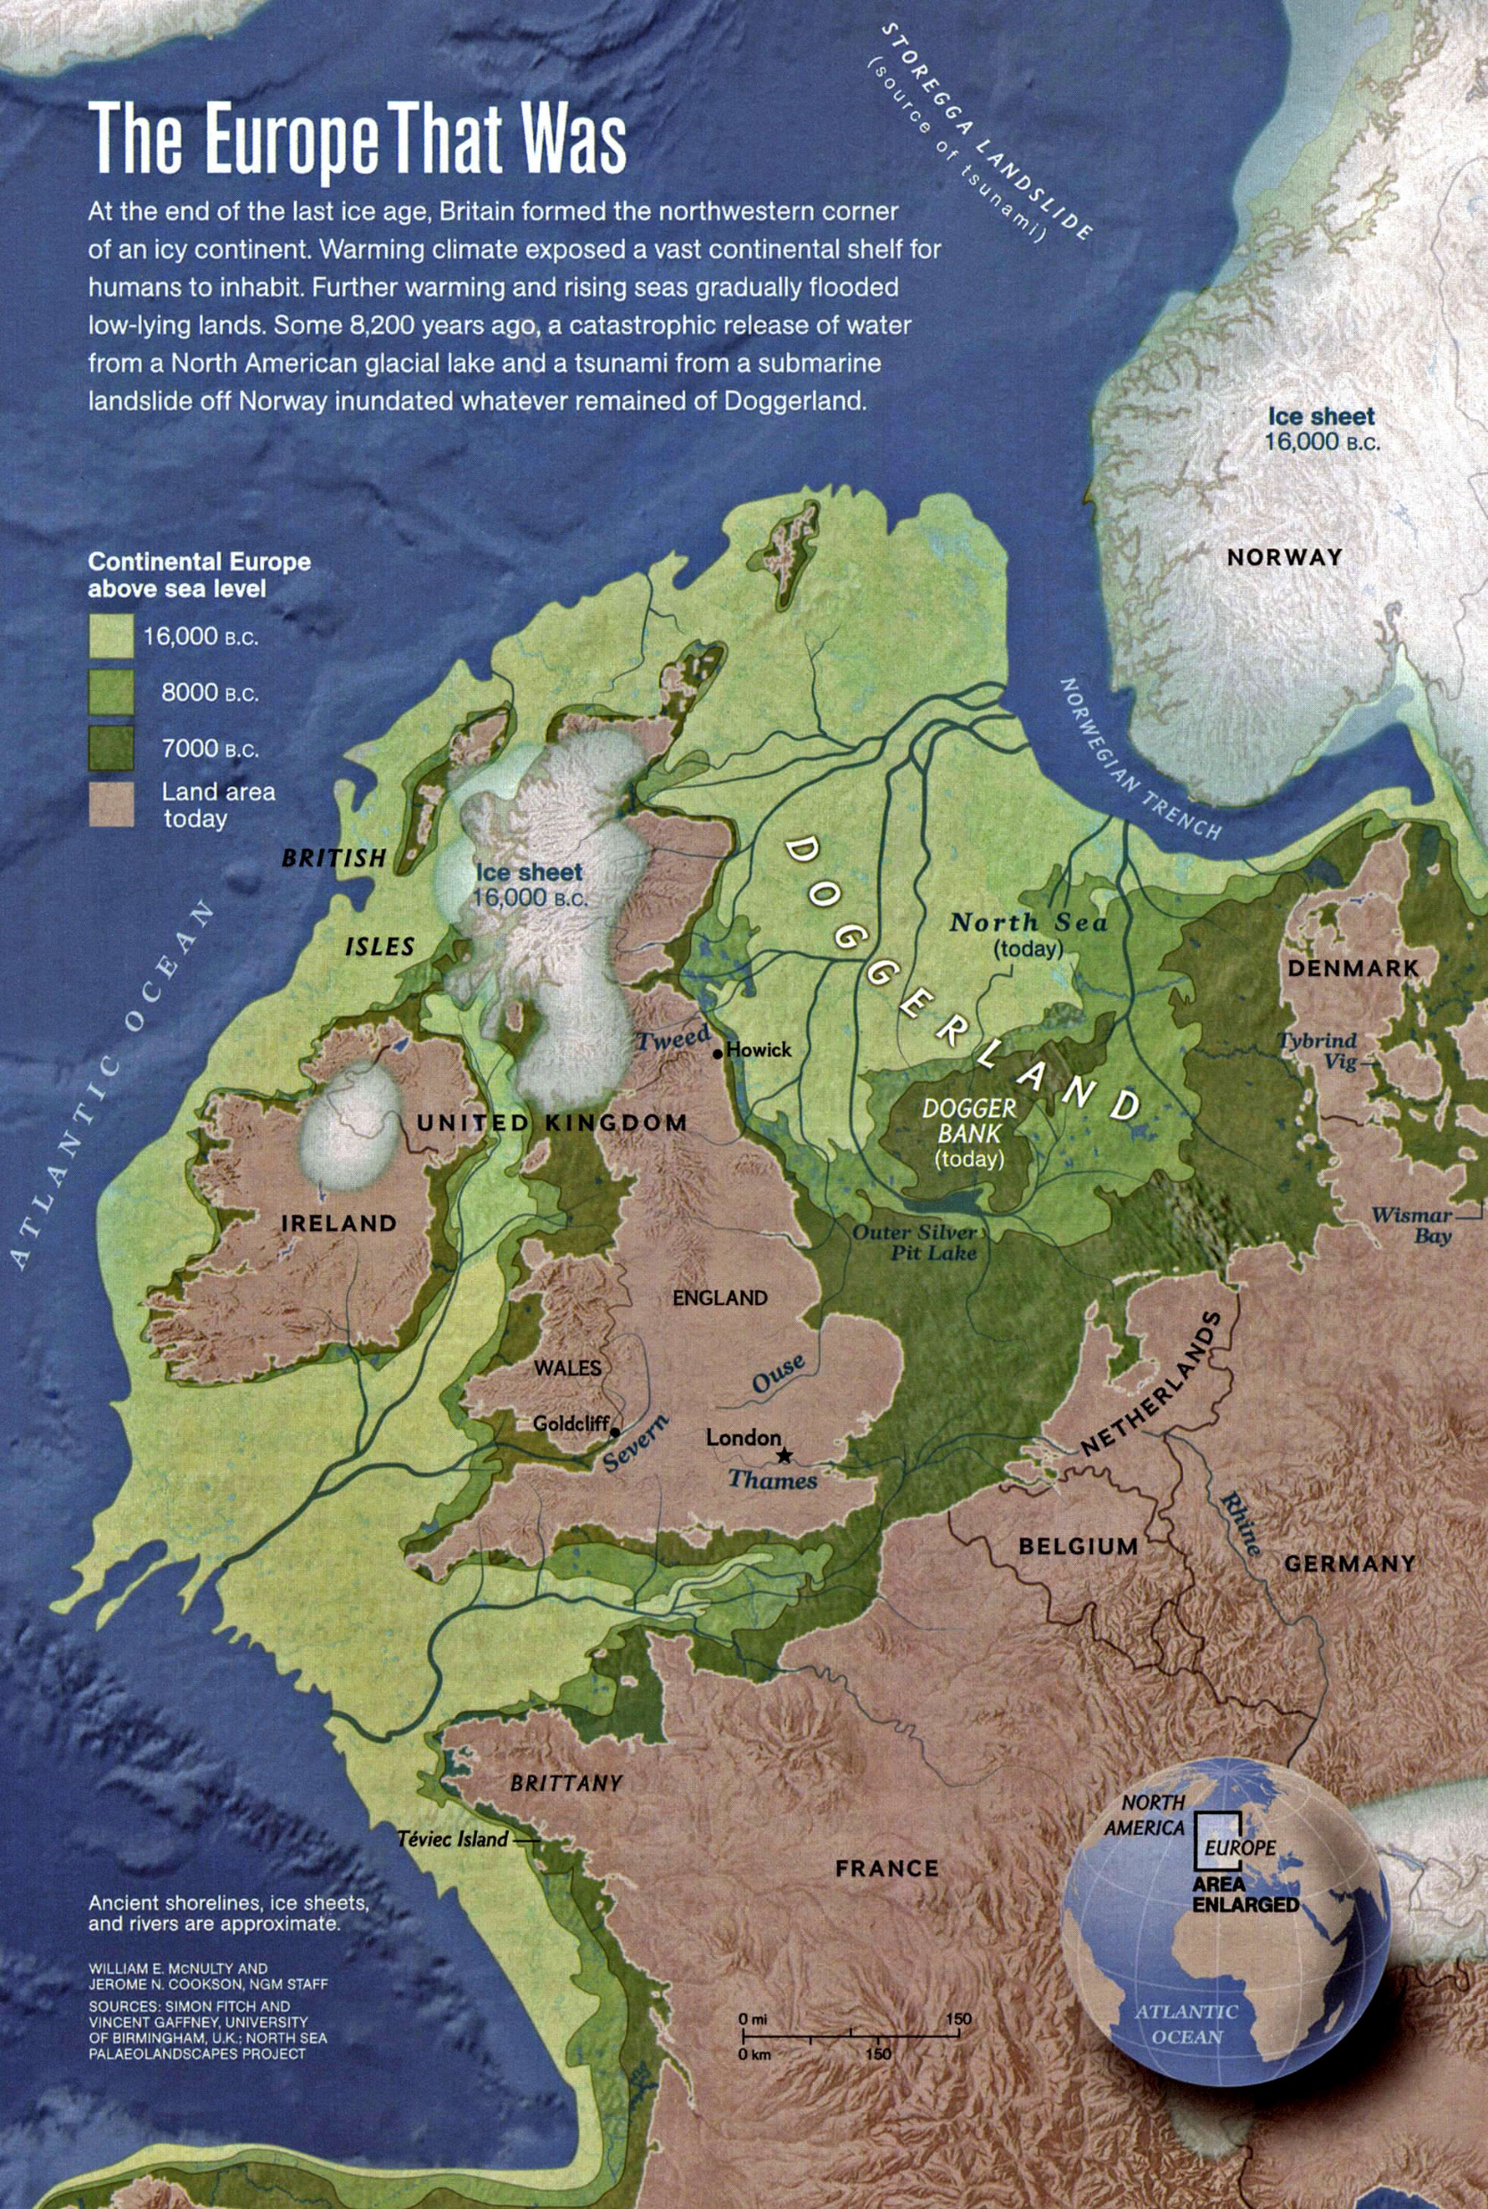
Orkney land bridge 7000 BC
Scotland/Ireland land bridge
7000 BC
Dogger Bank
Continental land bridge
7000 BC
Ireland/Europe land bridge
16 000 BC

Slide 28
Indigenous people of the British Isles
Celts
(Dalriadans, Irish and Britons)
Picts
Saxons, Angles and Frisians

Slide 29
Transhumance
Even today, a number of communities move seasonally (transhumance)

Slide 30
The Hadza from Tanzania
such as the Hadza from East Africa

Slide 31
The reindeer-herding Sami

Slide 32
The pastoralists of France

Slide 33
Dynamic relationship
Home is a stopping point, for there is no sense in the migration story that there will be only one home for only one people forever
A dynamic relationship with an ever-changing planet.

Slide 34
The meaning of place
Place is seen as contextualizing our very identity, rather than as a commodity and this is another fundamental difference in comparison with Western modernity
The emphasis is on process, not ownership
It is not necessarily one place, but a continuity of niche.

Slide 35
Future climate migration

Slide 36
Particular impact on transhumance

Slide 37
Nice paper on website:
Piguet, E., 2013. From “primitive migration” to “climate refugees”: The curious fate of the natural environment in migration studies. Annals of the Association of American Geographers, 103(1), pp.148-162.

Slide 38
Chukchi people
and the Chukchi people from North-eastern Russia (the closest relatives to indigenous Americans)
The Chukchi People’s physical, cultural and spiritual well-being relies primarily on reindeer herding

Slide 39
Climate change is causing irregular freeze-thaw events that lock-up the reindeer’s principal winter food, lichen, beneath a layer of ice, as well as the melting of permafrost and other impacts that are causing changes in reindeer migration patterns.
Maintaining the transhumance way of life that the Chukchi People have traditionally operated is becoming more and more challenging.

Slide 40
Many other species move with conditions

Slide 41
2. Not all indigenous populations are non-dominant
66% of Bolivians are indigenous
Shizha writes that “all the formerly colonized societies in the continent that have ancestral roots in the continent are considered indigenous regardless of their marginalization status”.

Slide 42
Wildcat and Pierotti (2000) set out the following four characteristics shared by all indigenous people:
1. Respect for non-human entities;
2. The existence of bonds between humans and non-humans, particularly relating to ethical codes of behaviour;
3. The importance of local places;
4. Recognition of humans as part of the ecological system, rather than as separate from that system.

Slide 43
Resilience
Indigenous populations have survived their attempted genocide at a physical, landscape and cultural level
Tested beyond anything modern humanity has experienced…yet
Experienced in apocryphal situations
Akin to what humanity faces in the century ahead
Counsellors for catastrophe survival.

Slide 44
United Nations Declaration on the Rights of Indigenous Peoples (UNDRIP)
“Respect for indigenous knowledge, cultures and traditional practices contributes to sustainable and equitable development and proper management of the environment”.

Slide 46
What is the unit of organization?
Gene? Individual? Population? Ecosystem? Earth system?
Western philosophy focuses on the gene as the unit of organization and selection
Indigenous thinking focuses on the Earth system as the unit of organization.

Slide 47
Earth system thinking
Interconnectedness
Trade-offs
Emergence
Non-linearity
Self-organization

Slide 48
Recent thinking on identity
Mead – the social whole
Others – feminist ethic of care
and Scottish thinker MacIntyre – the relational self
More-than-human/beyond human
See Skene, K.R. 2020. Artificial Intelligence and the Environmental Crisis. Routledge.

Slide 49
Rose (2005) sums up the system-based understanding at the heart of indigenous thinking as follows:
“Rather than humans deciding autonomously to act in the world, humans are called into action by the world
The result is that country, or nature, far from being an object to be acted upon, is a self-organizing system that brings people and other living things into being, into action, into sentience itself.
The connections between and among living things are the basis for how ecosystems are understood to work, and thus constitute law in the metaphysical sense of the given conditions of the created world.”
See website reading list for link.

Slide 50
Life affirmation
Nature is recognized as life-giving and life affirming. This gift of life deserves respect and giving in return. Here, wellbeing is not seen as an individual property but as an emergent outcome of being situated within the Earth system
Michell (2005), writing on the Nēhîthâwâk (Woodland Cree) of Canada, observed that: “To live properly includes the goal of living in harmony with nature for the sake of the community’s survival”.

Slide 51
Buen Vivir
A similar understanding can be seen in buen vivir, the South American post-modern philosophy, rooted in indigenous thinking.
Buen vivir means to live in a good way, or in a way that is in resonance with the Earth system, encompassing human and non-human actors.

Slide 52
Sub-optimality
These ideas of wellbeing do not optimize for the human condition
They involve active, ecologically intelligent participation within the greater whole
in such a way as to enhance and protect the life-giving capacities of an interactive, complex environment.

Slide 53
Connectivity and emergent well-being
The sense of ‘connectedness’ to both one’s community and the environment is a distinguishing aspect of indigenous natural philosophy, with no clear demarcation between where one’s community ends and so-called ‘Nature’ begins (the essence of buen vivir)
‘Connectivity’ is integral to a sense of well-being, where ‘well-being’ is emergent from one’s sense of connectedness (meaning, there is no well-being without interconnection).

Slide 54
The currency of connectivity
How connected a human population feels to each-other and their environment can be revealed in their culture, art, modes of organizing, natural philosophy, language, conservation strategies and their treatment of each-other and other non-human actors.

Slide 55
Discussion

