Slide 1
Indigenous thinking and our search for a sustainable future Week One I: Introduction
Dr Keith Skene
Biosphere Research Institute

Slide 2
Housekeeping
Each week, outlines of the lectures, suggested books, papers and websites will be added to the following site (password protected). You should have been sent an email detailing this.
Website: www.biosri.org/indigenous
Password:
Contact: krskene@gmail.com

Slide 3
Course Overview
Week 1
Week 2
Week 3
Week 4

Slide 4
A brief history of humanity and the rest of life on Earth

Slide 5
J. B. S. Haldane (1892-1964)
“God has an inordinate fondness for stars and beetles”

Slide 6
Defining diversity
Defining Diversity
Morphological?
Genetic?
Functional?
Species?
Cultural?

Slide 7
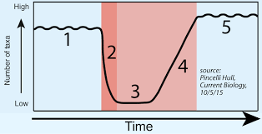
The creative force of the planet: The Diversification Engine
Diffusion, not competition

Slide 8
The empty market place

Slide 9
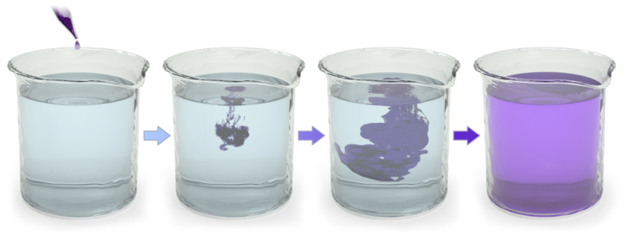
Diffusion, driven by thermodynamics

Slide 10
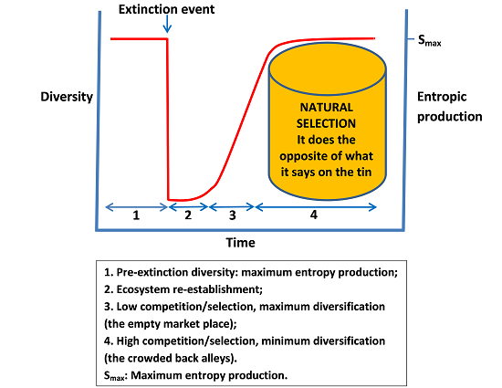

Slide 11
Diversity doesn’t save the world… Diversification does
It is the ability to re-create that provides a sustainable future
Sustainability is not some static destination
But a constantly unfolding scroll
The Earth System

Slide 12
Diversification: what is this creative process?
The relationship between an organism, its population and its broader ecology
Opportunity
Landscape heterogeneity
Diffusion
Knowledge: hard-earned, observation-based, long-term cross-generational.

Slide 13
Hard-earned?
Fatal consequences of failures
Extinctions occur all of the time, either from catastrophic global disasters or from local issues:
Food chain breakdown
Environmental events
Disease
Reproductive failure (e.g. extinction of specialist pollinator)
Population issues (inbreeding/outbreeding)

Slide 14
Observation-based?
Recording of changes, flows and fluxes
Deduction of links, specific and generic drives
Natural and supernatural
Plato’s universal forms and shadows on the cave wall.

Slide 15
The role of the supernatural
Allows unexplainable concepts to be included
Inclusion means better integration within the whole
The power of the allegory, simile and metaphor
Storytelling as an essential intergenerational thread.

Slide 16
Art and language as narrative
Early cave paintings
Moai statues and the birdman cult

Slide 17
Long-term observations
Because natural cycles are often longer than our own life cycle
Narrative intelligence acts as a telescope through space and time

Slide 18
The rise of the mammals
Pre K/T?
Latest research places placental mammals as arising just after the K/T – the diffusion model
– very minor nocturnal squirrel-sized creatures
Released from reptilian dominance
K/T changed everything – emptied the market place
Warm blooded mammals and birds thrived
Rise of the grasses

Slide 19
The rise of the primates
Post K/T
We owe our lineage to a giant comet
Opportunity, not selection
Space to spread

Slide 20
Out of Africa: diffusion in space and time

Slide 21
Key drives
Energy – essential in a thermodynamic universe (which it is)
Forges intimate relationship between organism and its environment
Drives diffusion
Creates mutations
Reproduction – essential for continuance of lineage but no physical prerogative: a numbers game
Anything from simple cell division (bacteria) to complex, ritualized events (lekking)
– can be parasitic and extremely complex

Slide 22
Lancet Liver Fluke
Reproduction involves 3-4 different species
Snail
Ant
Cow
Human

Slide 23
Greater, systemic drives: universal functions
Earth system
Feedback
Constraints
More-than-human
Population, ecosystem and biosphere levels of organization
Ultimate arbiter: laws of physics at cosmic through sub-atomic levels
Above, below, beyond, within: transductionism

Slide 24
The known and the unknown
Clear evidence should not be denied
Science has its place but so does art and storytelling
Reductionist issues: real-world v experimental world
surrealism and romanticism

Slide 25
The invisible and the unknown
The drivers may be invisible e.g. entropy, gravity, electromagnetism, system theory
Or be unknown: e.g. what came before the first Big Bang? Where did the original energy and matter come from?
Traditional ecological knowledge leaves space for these unknowns.

Slide 26
Big events in our more recent history
Agricultural surplus
- Food as a given rather than a key driver
Trade (economics)
-monetization, power, commoditization (of nature and humanity) and inequality
Hunter-gatherer to settler
- urbanization
Specialization and division of labour
- not all about food: military, builders, planners, extractors, exploiters, exploited

Slide 27
The rest is merely a building upon these foundations
Agricultural revolution
Industrial revolution
Technological revolution
All represent increased efficiency and accelerated rates, rather than giant leaps forward
(Skene K.R. and Murray, A. (2017). Sustainable Economics. Routledge).

Slide 28
Why this course?
To fundamentally explore who we are
To explore solution space for major issues confronting us in terms of social and environmental integrity
To understand what “indigenous thinking” represents
To challenge ourselves

Slide 29
Discussion time

