Slide 1
RAINFORESTS
CRAIGIEBARNS PRIMARY SCHOOL
DR KEITH SKENE

Slide 2
WHAT IS A RAINFOREST?
It’s a forest…

Slide 3
WHAT IS A RAINFOREST?
It’s a forest…
Where it rains a lot!!!

Slide 4
Where is it?????
Is it near here????????

Slide 5
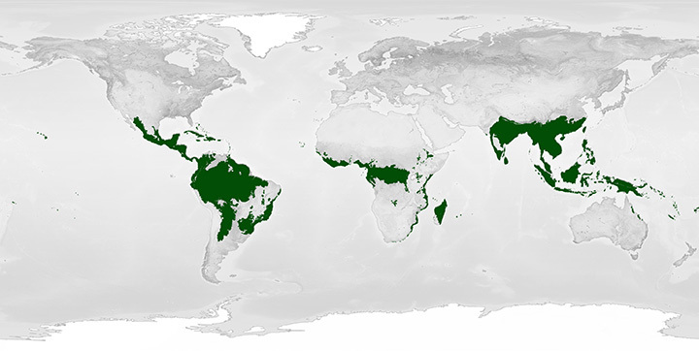
CRAIGIEBARNS
PRIMARY
SCHOOL!
AMAZON
RAINFOREST
Nearest
Rainforest
Senegal
6000km
71 hour drive!

Slide 6
Why are rainforests so important???

Slide 7
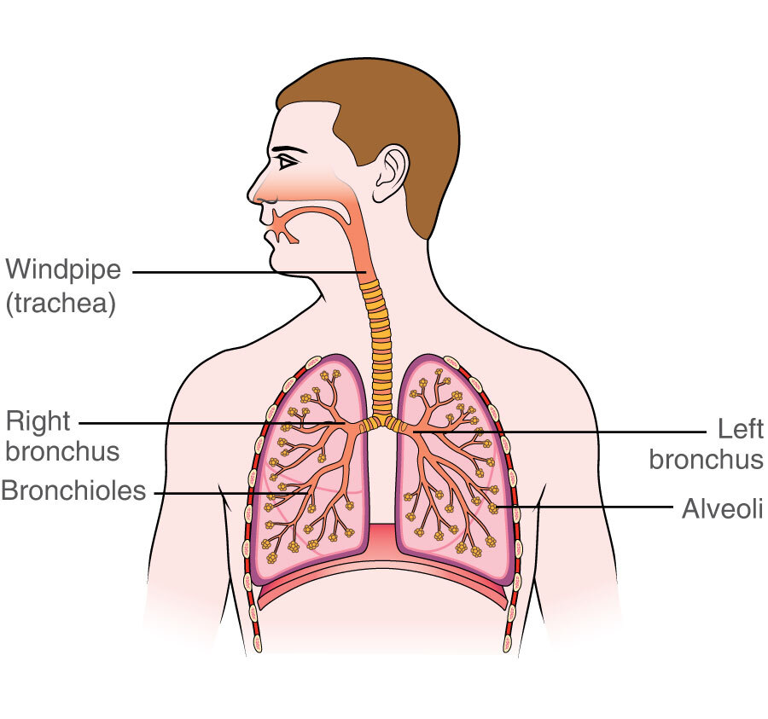
OXYGEN
CARBON
DIOXIDE

Slide 8
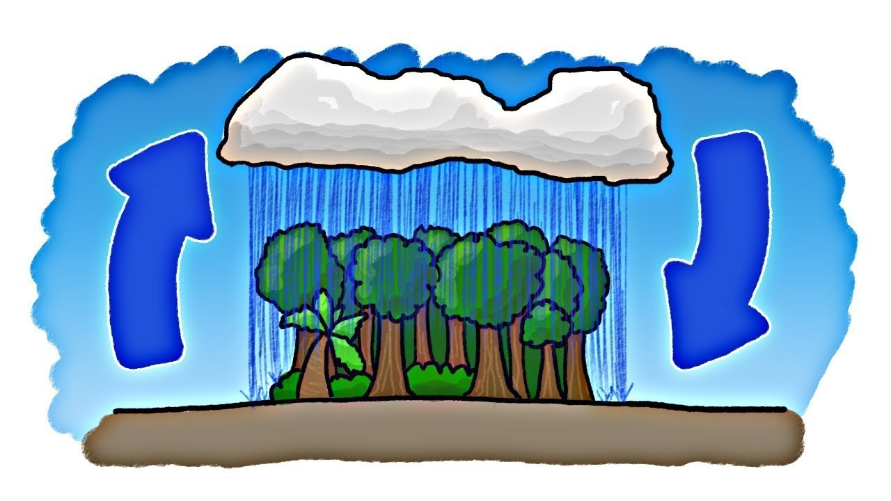
RAINMAKERS

Slide 9
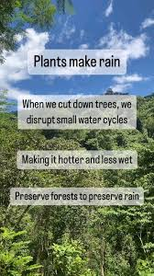

Slide 10
Huge diversity of life
WHAT DOES DIVERSITY MEAN?

Slide 11
Huge diversity of life
WHAT DOES DIVERSITY MEAN?
LOTS AND LOTS AND LOTS AND LOTS
OF DIFFERENT PLANTS AND ANIMALS

Slide 12
THREE MILLION DIFFERENT SPECIES IN RAINFORESTS!!!!

Slide 13
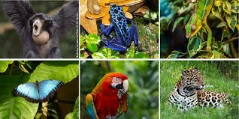
HALF OF ALL PLANTS AND ANIMALS LIVE IN THE RAINFORESTS!!

Slide 14
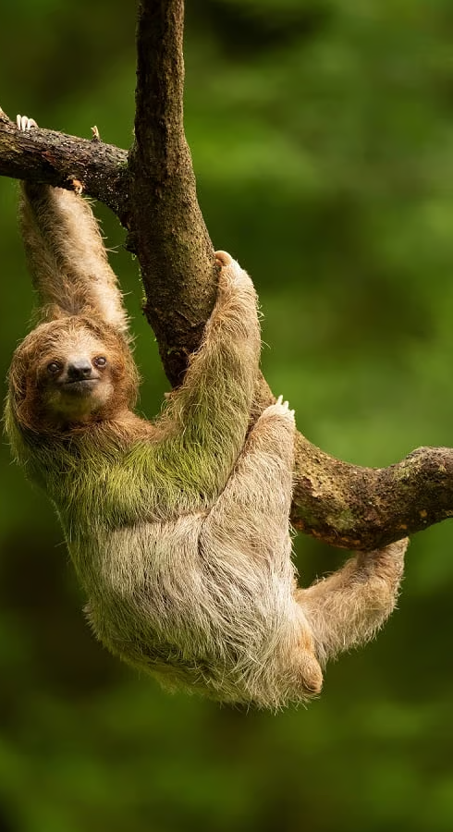
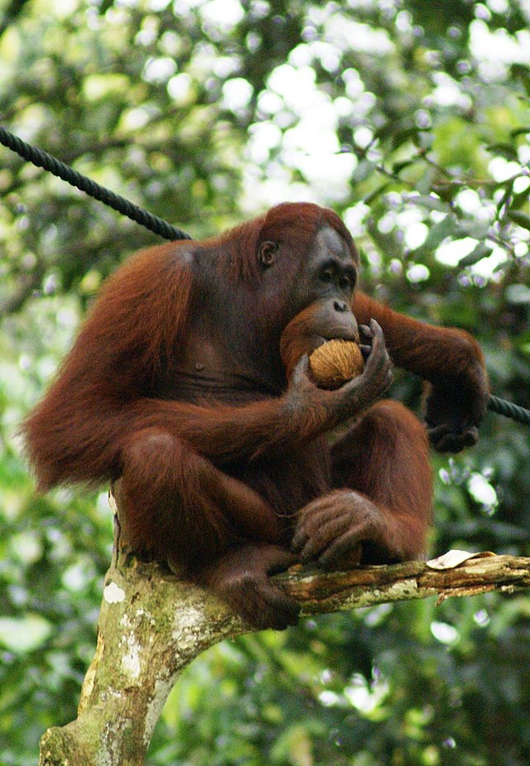
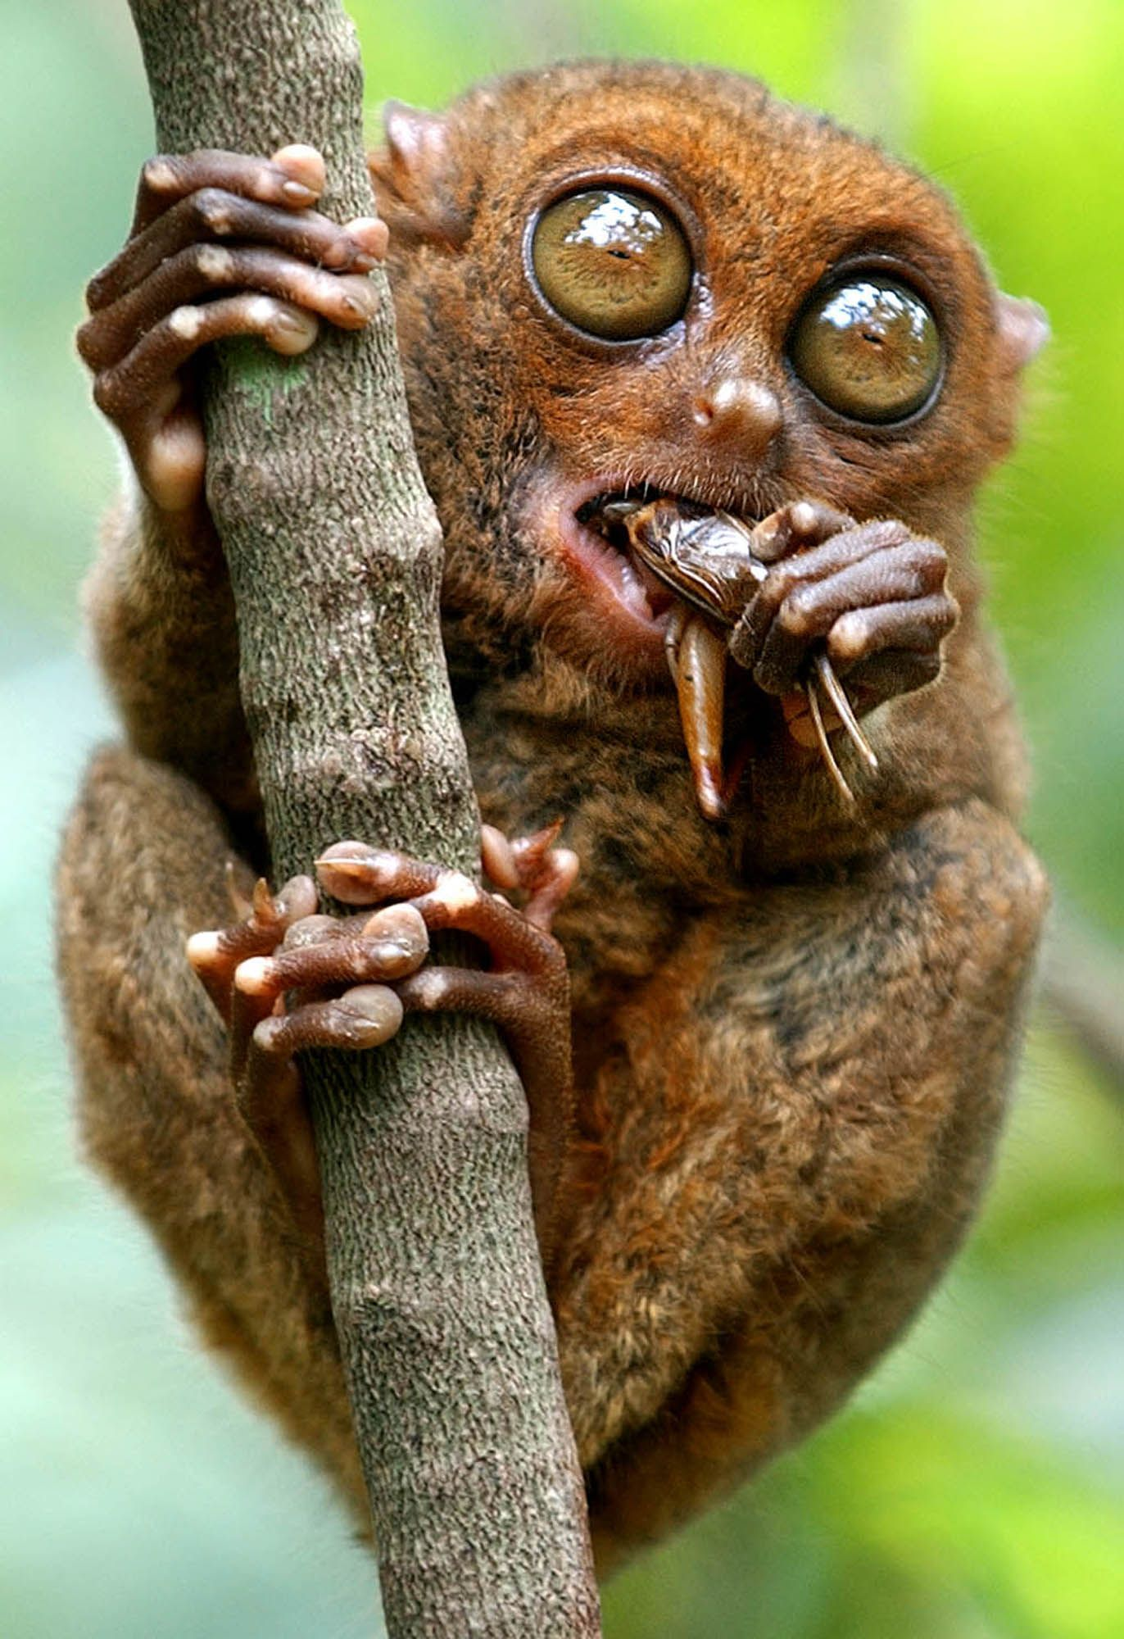

Slide 15
WHY ARE THERE SO MANY SPECIES???

Slide 16
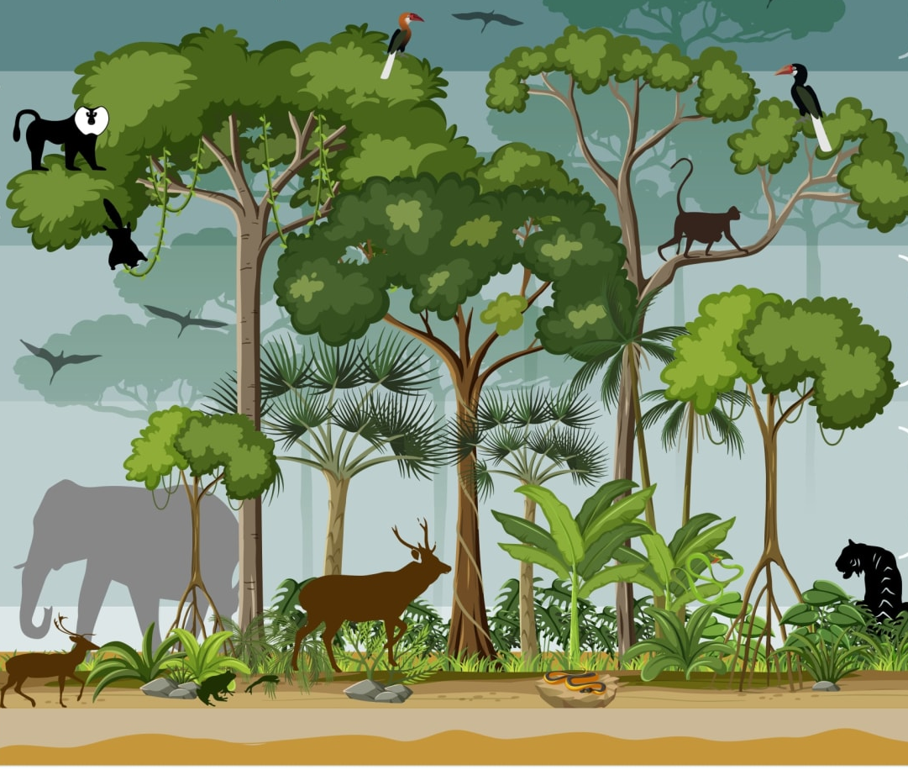
CANOPY
BRIGHT
UNDERSTORY
FOREST FLOOR
SHADE

Slide 18
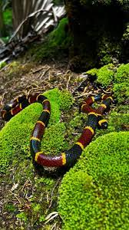
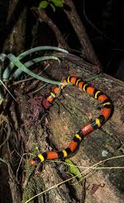
SNAKES
CORAL SNAKE
CANE SNAKE
RED ON YELLOW
KILL A FELLOW
RED ON BLACK
FRIEND OF JACK

Slide 19
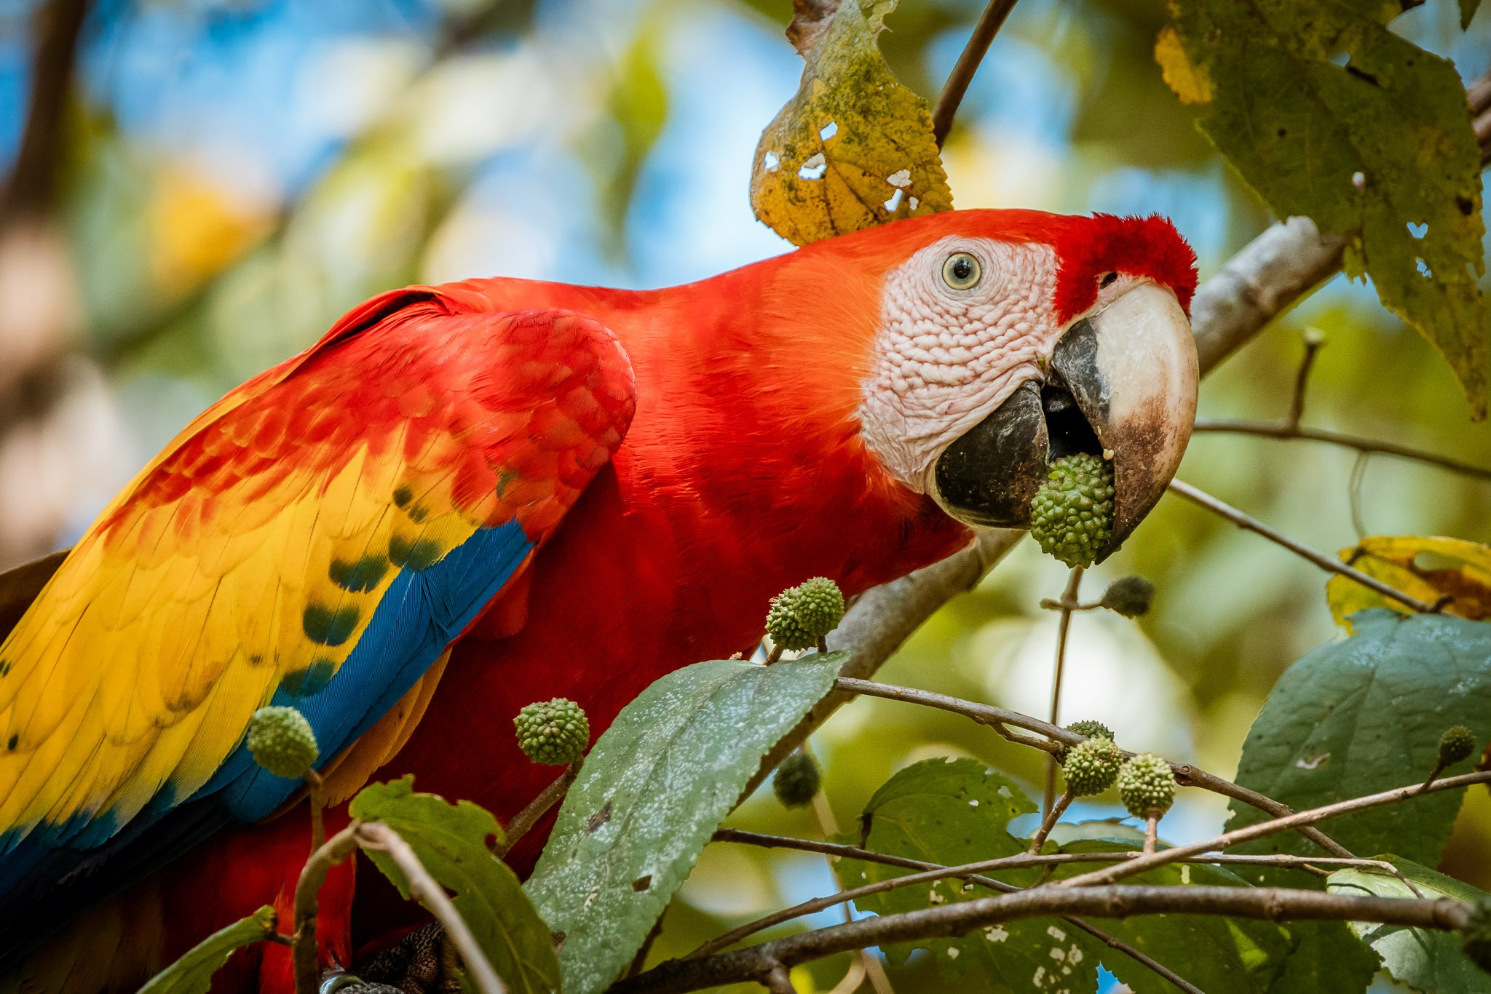
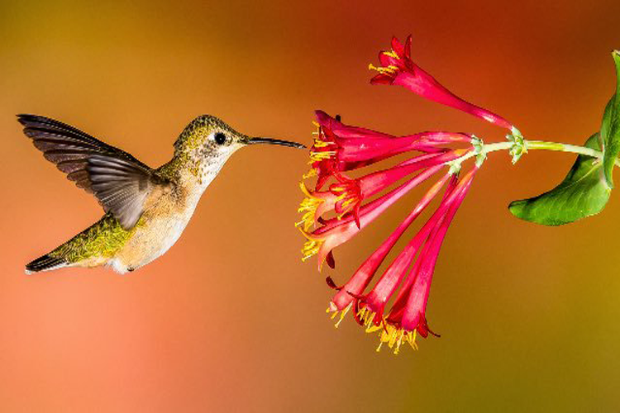
BIRDS
SCARLET MACAW
HUMMINGBIRD

Slide 20
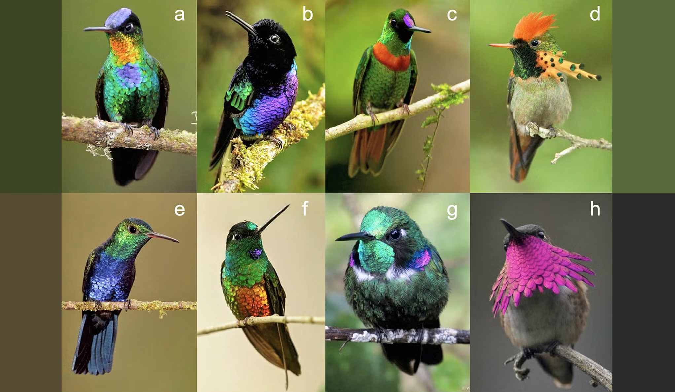
HUMMINGBIRDS

Slide 21
Why the long beaks???

Slide 22
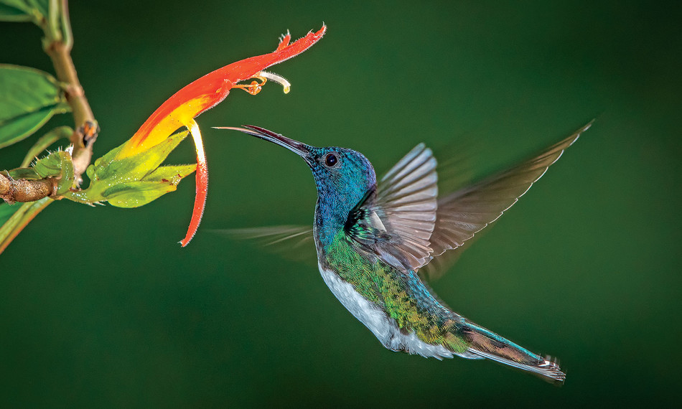
Why the long beaks???

Slide 23
The hummingbird and the Big Mac
A Bic Mac has 44g* fat
If a huMmingbird ate a Big Mac, it could fly for 21120 km
If it had a BM, regular fries and coke,
It could fly for 47186 km, Around the world with some to spare.
Earth’s circumference:
40075 km
* Based on MacDonald’s data

Slide 24
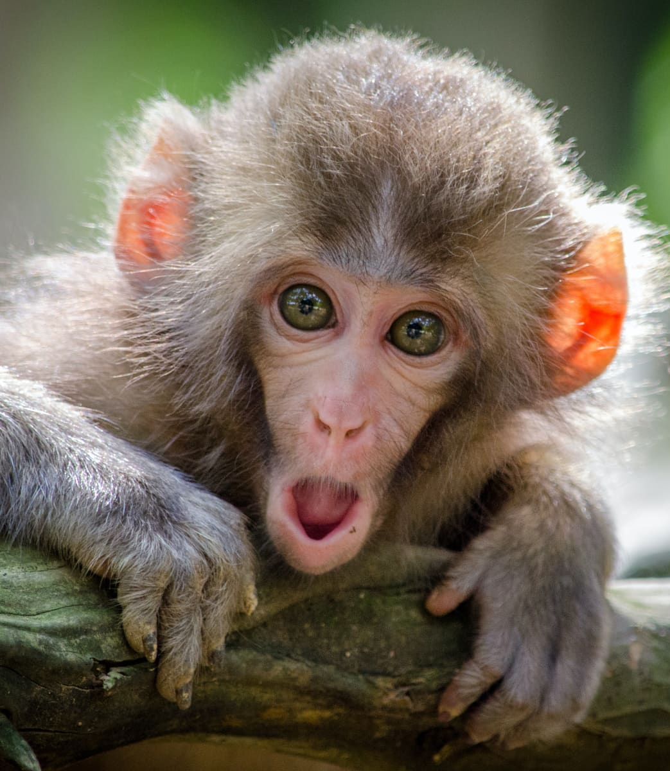
MONKEYS AND APES
Kings and queens of the rainforest
Brilliant climbers
Extremely intelligent
Can make and use tools

Slide 25
THREE TIMES I WORKED WITH MONKEYS…
My adventures with monkeys on expeditions
Trinidad
Thailand
Kenya

Slide 26
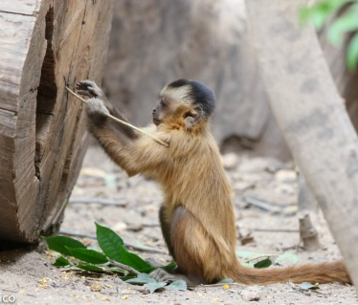
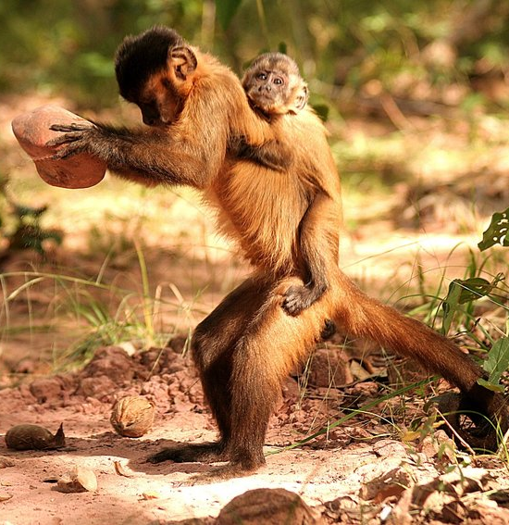
CAPUCHIN MONKEY, TRINIDAD

Slide 27
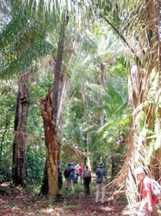

Slide 28
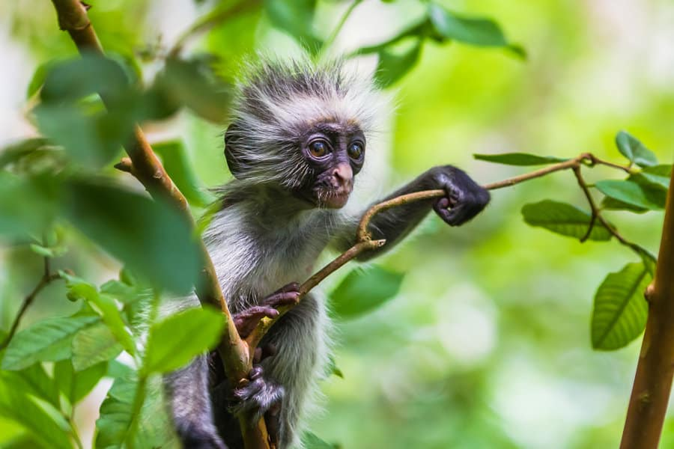
RED COLOBUS MONKEY,
KENYA

Slide 29
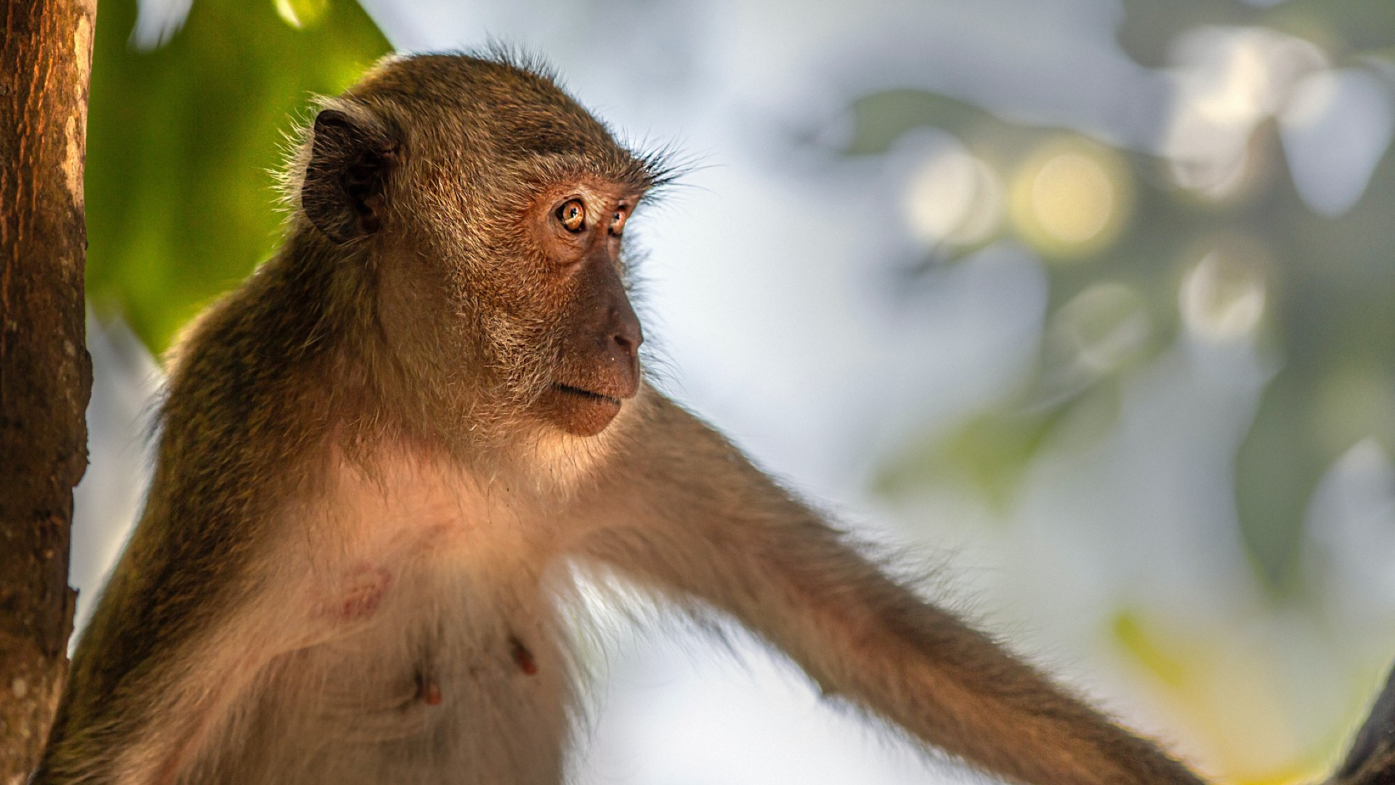
LONG-TAILED
MACAQUE, THAILAND

Slide 30
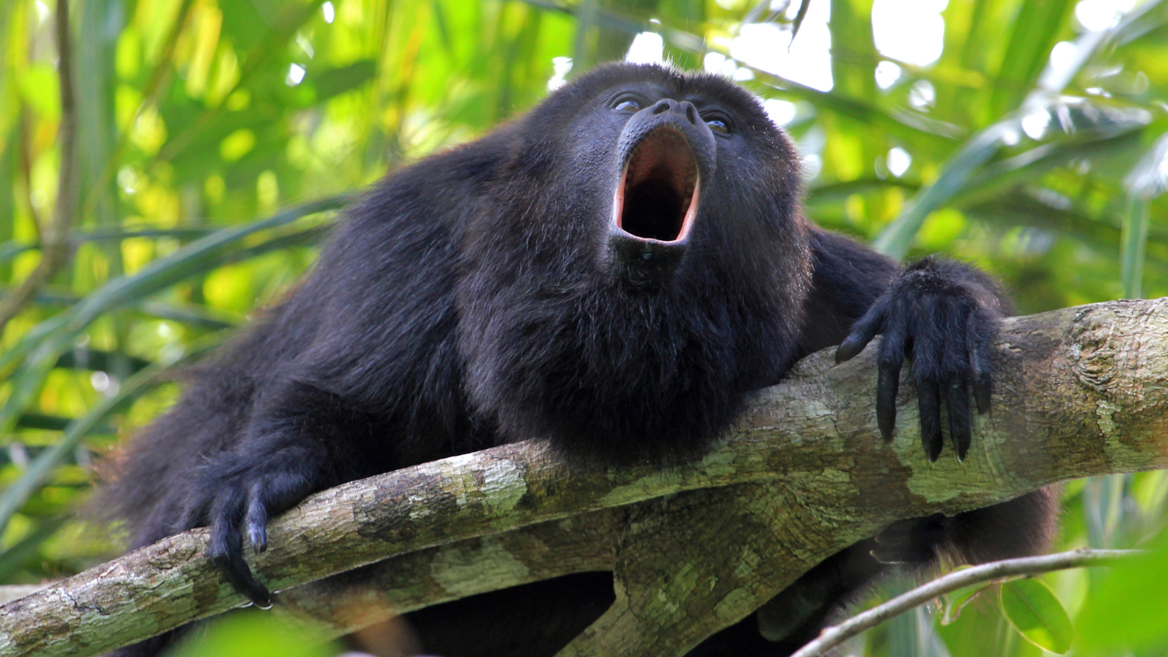
Howler Monkey Sound: the loudest monkey!!
https://soundcloud.com/georgevlad/dawn-costa-rica-jungle-howler-monkey

Slide 31
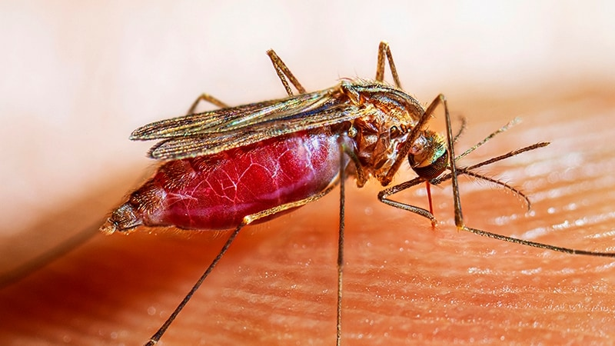
INSECTS

Slide 32
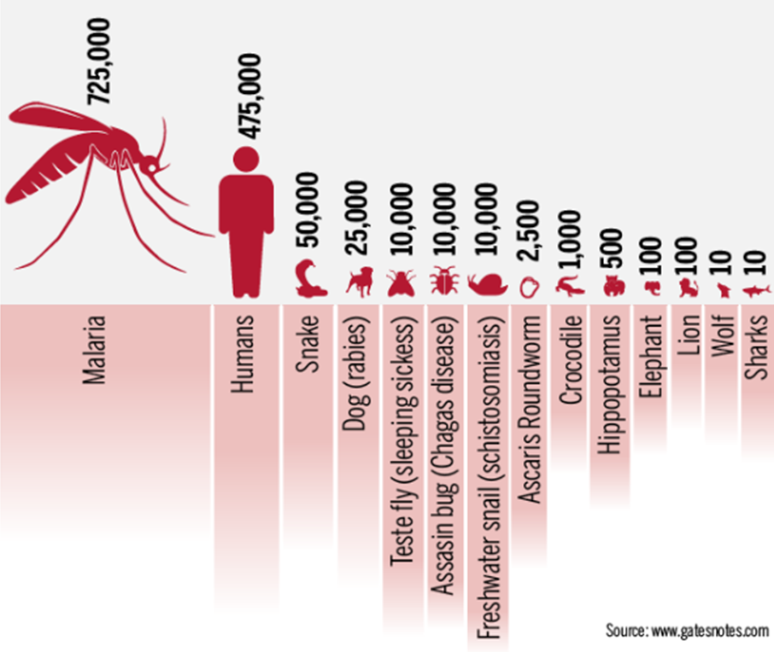

Slide 33
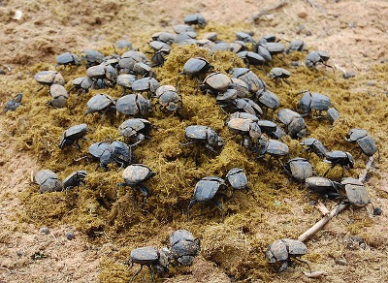
DUNG BEETLES

Slide 34
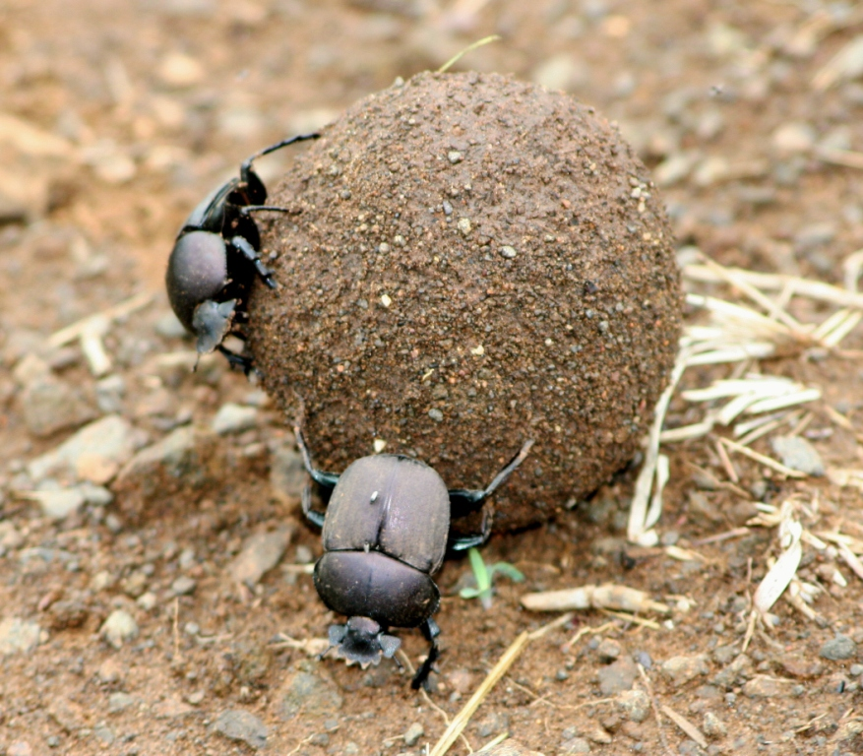
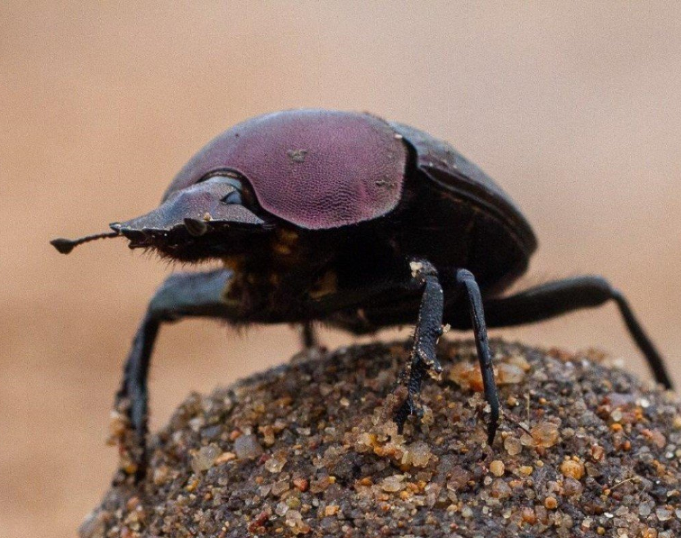

Slide 35
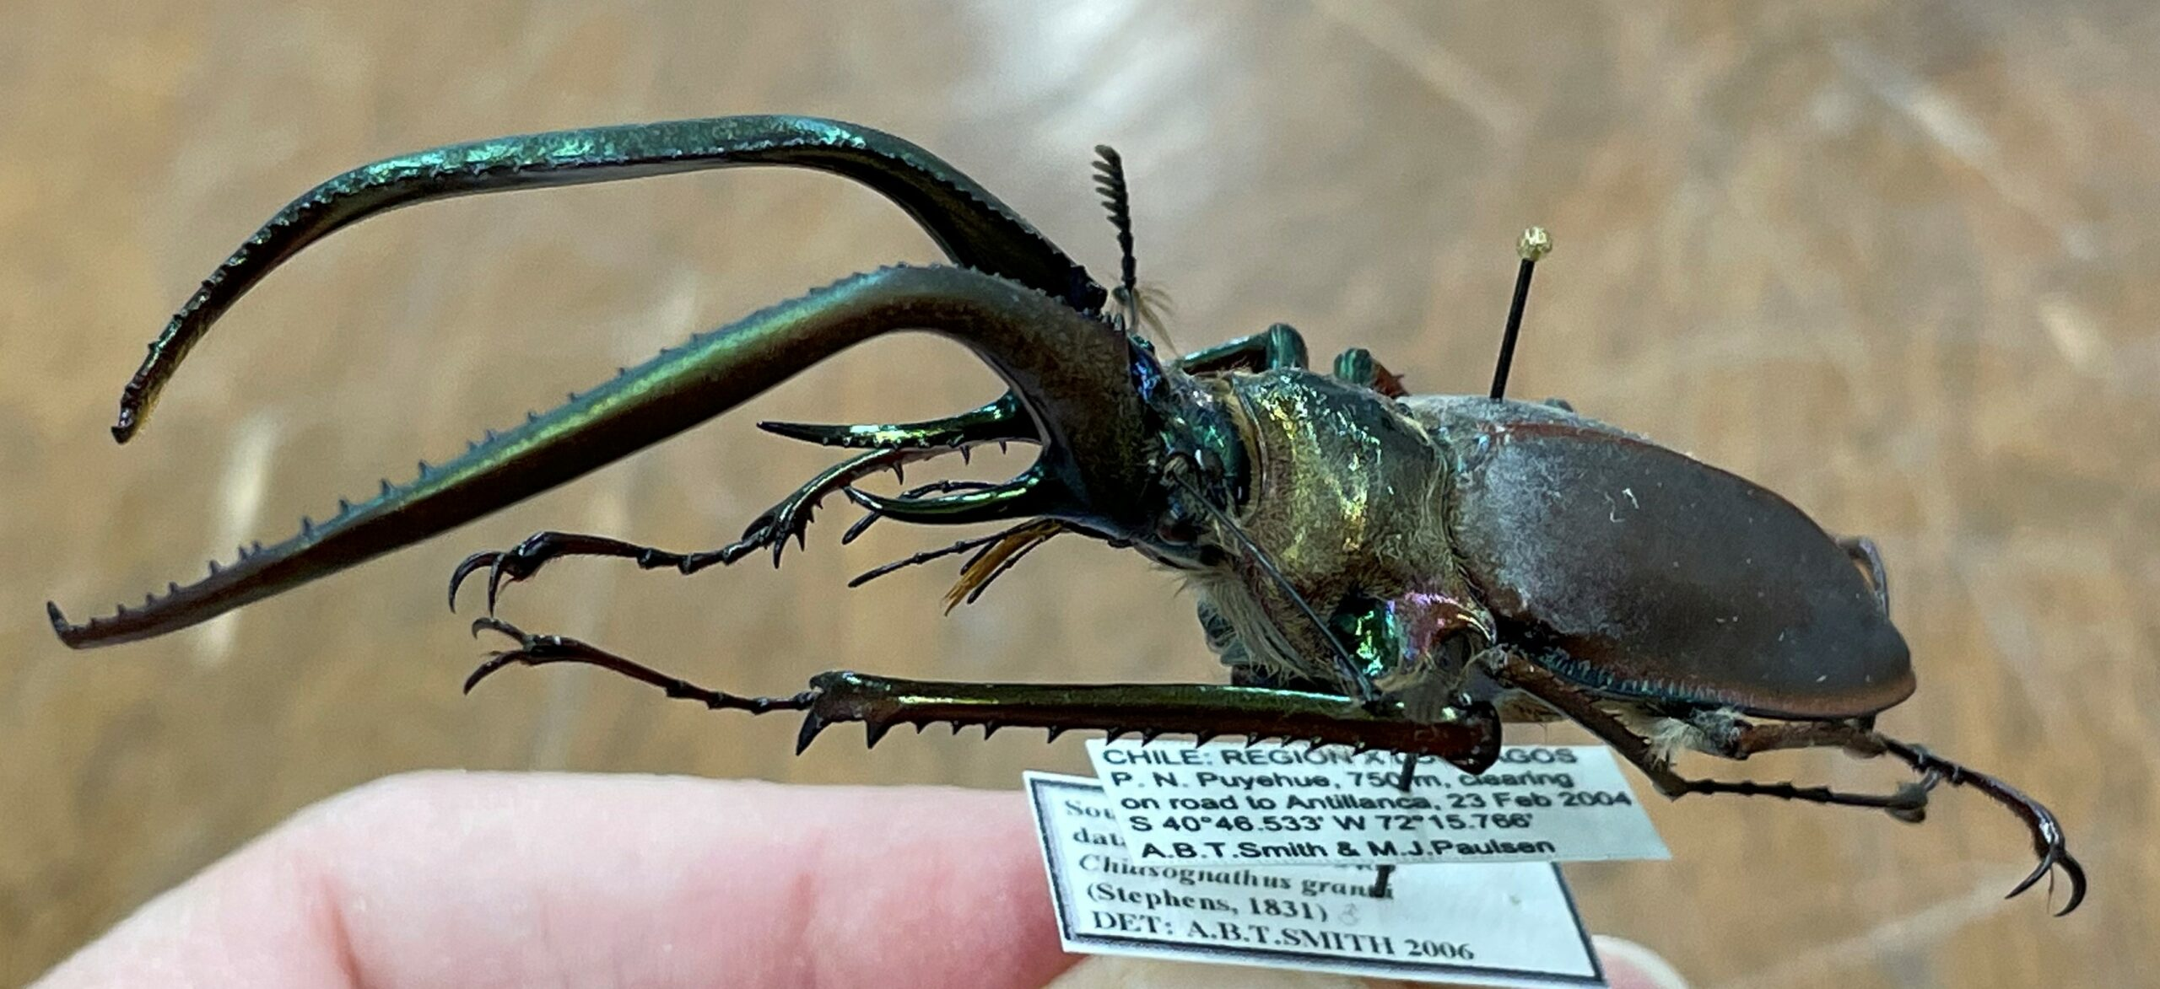

Slide 36
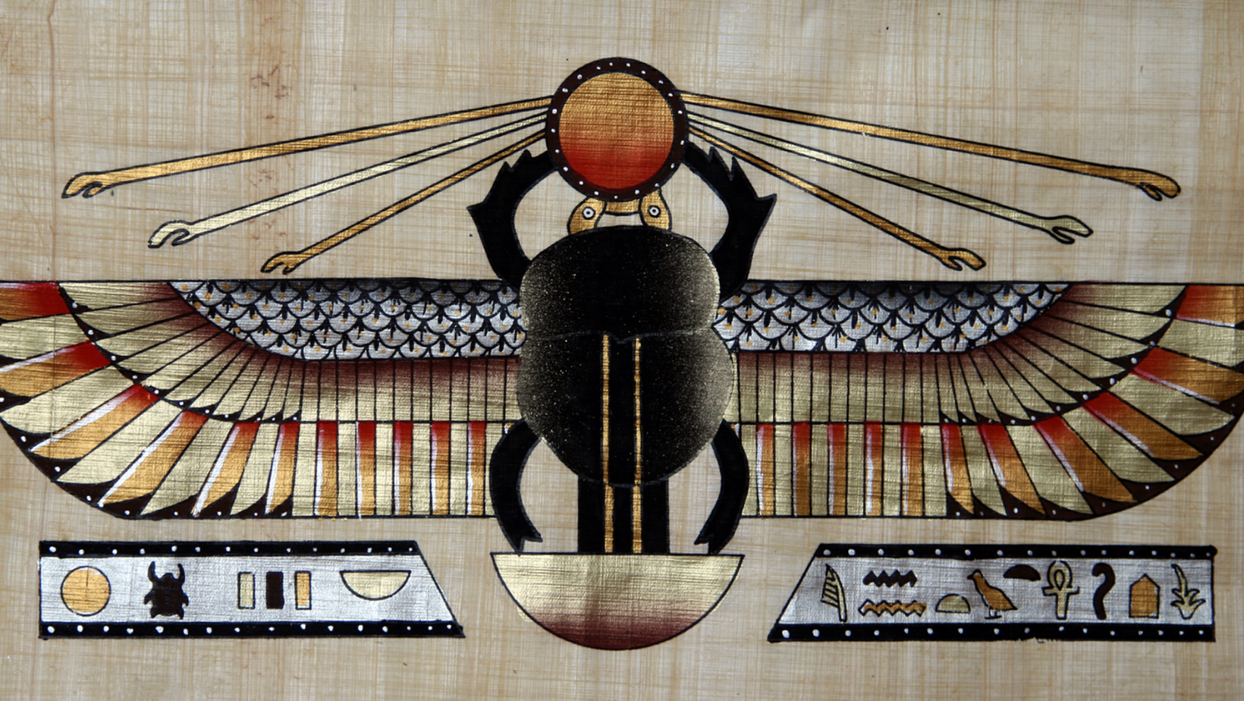

Slide 38
But hold on…

Slide 39
But hold on…
THERE IS A RAINFOREST MUCH CLOSER TO CRAIGIEBARNS PRIMARY SCHOOL…

Slide 40
CALEDONIAN RAINFOREST!
CRAIGIEBARNS
PRIMARY
SCHOOL!
AMAZON
RAINFOREST

Slide 41
THE
CALEDONIAN
FOREST
(2 hours away!!)
CRAIGIEBARNS
PRIMARY SCHOOL

Slide 42
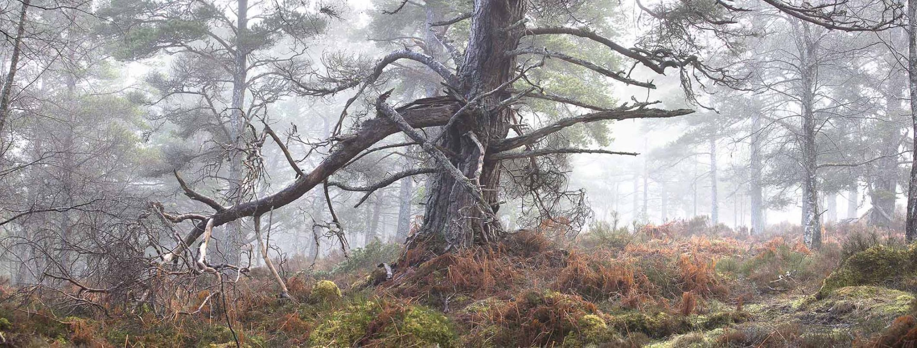
400 year old trees!!!

Slide 43
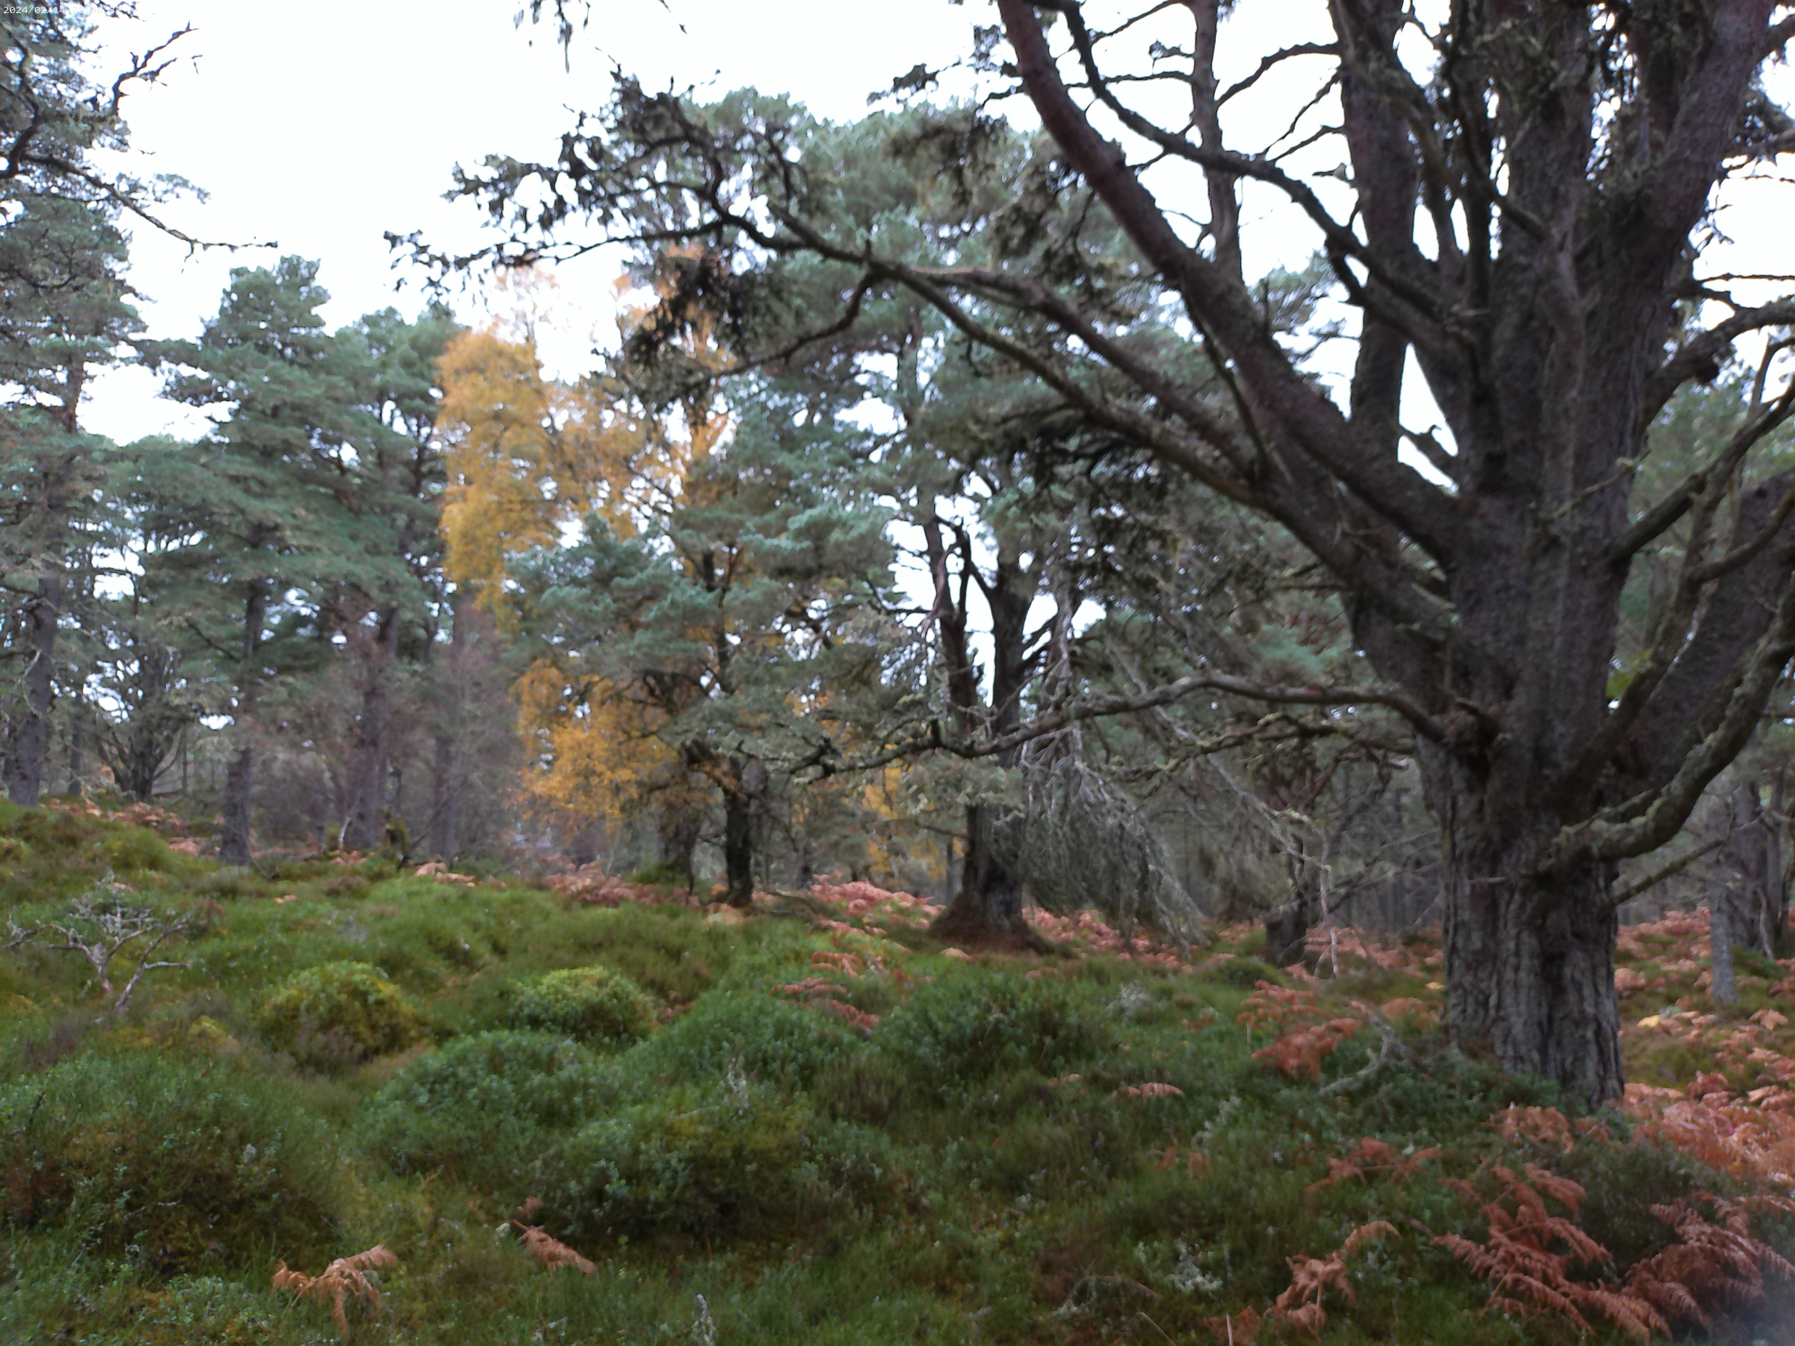

Slide 44
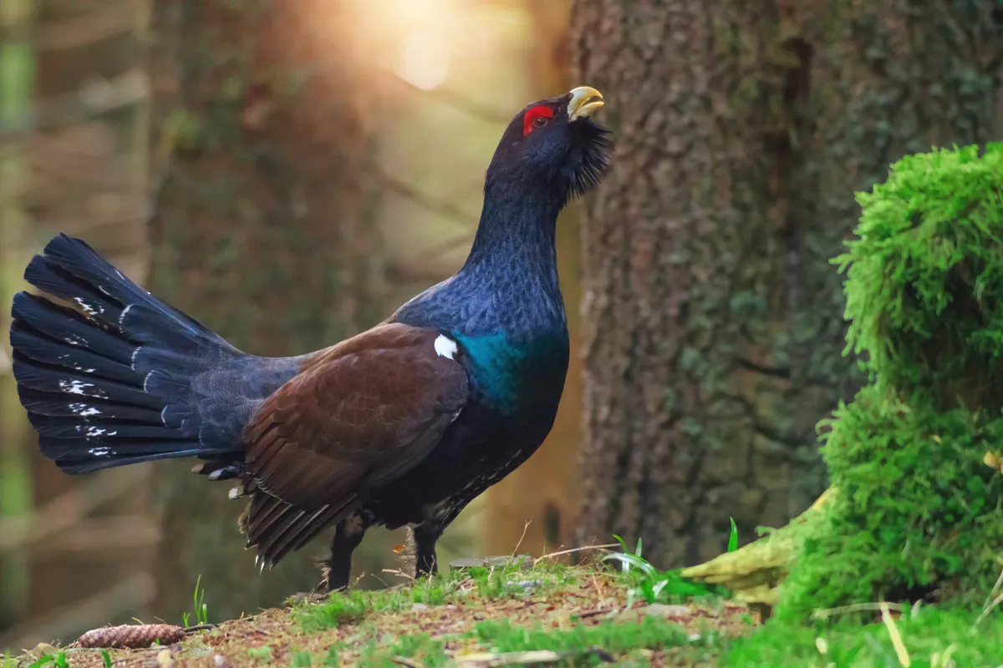
CAPERCAILLIE

Slide 45
Crazy Capercaillie!
capercaillie attacking human - Google Search

Slide 46
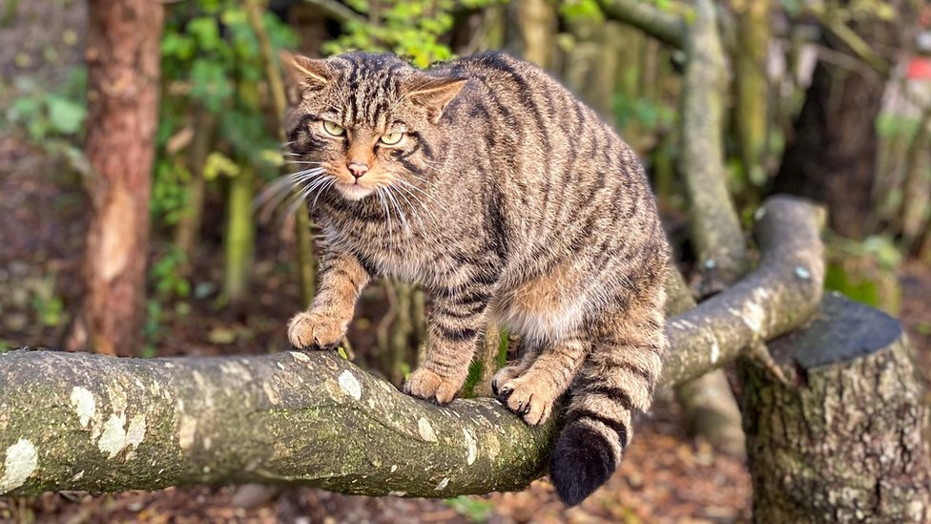
SCOTTISH WILDCAT

Slide 47
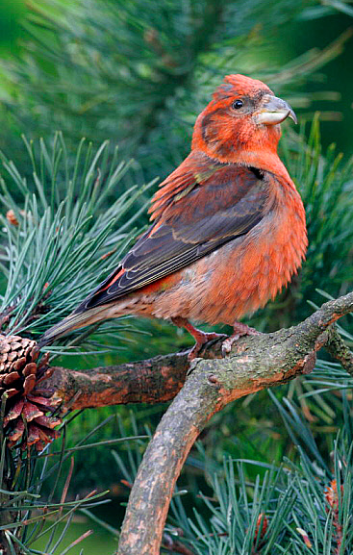
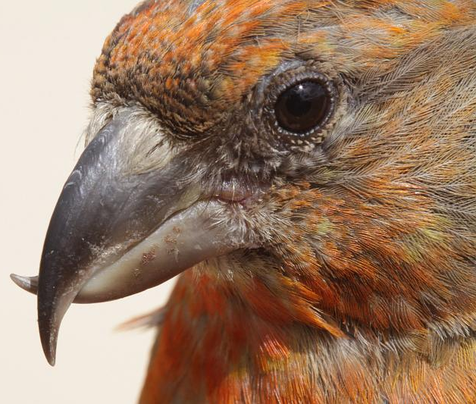
SCOTTISH CROSSBILL

Slide 48
Expedition in the rainforest
What do you need?
Water
Food
Tent
Vaccines
Insect nets
Big boots
Long sleeves and trousers

