Slide 1
Celtic Ecology
Dr Keith R. Skene
Biosphere Research Institute

Slide 2
The Course
Week 1: Introduction
Celtic Origins: From the East
Week 2: Celtic Origins: From the East or West?
Celtic Origins: from the heart?
Week 3: Oral Traditions, the cèilidh house and the expressive arts
Pagan beliefs: the Green World and the sagas
Week 4: The Significance of the Otherworld
Dúthchas
Week 5: The Cheshire Cat, Nationhood and identity: In search of a Celtic Ecology

Slide 3
Housekeeping
Each week, outlines of the lectures, suggested books, papers and websites will be added to the following site (password protected). You should have been sent an email detailing this.
Website: www.biosri.org/celticecology
Password: biosri6
Contact: krskene@gmail.com

Slide 4
Celtic Ecology: An Introduction

Slide 5
Celtic Ecology: An Introduction
Emain Macha

Slide 6
The Ulster Cycle

Slide 7
ARD MACHA (ARMAGH)

Slide 8
Ecology: the study of the home
Historical ecology is a multispacial, multitemporal study of the dynamic relations between humans and their environment
Combines social, economic, political and environmental components

Slide 9
Evidence
Oral History
Archeaology
Scripts
Genetics
Cultural successors
Trade
Linguistic evolution
Ecology

Slide 10
The Celts
The first recorded use of the name ‘Celts’ in ancient Greek was in 517 BC by the Greek geographer Hecataeus of Miletus, who lived near Massilia (now Marseilles) in southern Gaul, using the term Κελτοί (Keltoy)
The Romans referred to the Celts as ‘Galli’, or the Gauls
Another generic term among the Greeks was ‘Galatia’.

Slide 11
Thus, as early as the mid-4th century BC at the very latest,
the term ‘Celts’ had become established as the name used in classical Greek ethnography for barbarian communities inhabiting much of Europe,
from the coast of the Atlantic Ocean, across much of Western and Central Europe (including considerable parts of the Northwestern shores of the Mediterranean Sea)
and down into present day Turkey

Slide 12
The Celts: a major circum-mediterranean group
By 450 BC, the Celts were one of the major circum-mediterranean barbarian groups

Slide 13
But who were the Celts?
Challenging question
Little in terms of written records
What records exist are likely highly revisionist
A hugely contested issue among current academics.

Slide 14
Politicization of the Celts
More recent movements seek to reclaim national identity in a post-colonial world
The search for our origins
And a deeper identity within our past
While others seek to highlight the barbarism of the past, strengthening the belief in the progress of the Enlightenment away from such brutes
And the justification of the appropriation of their land as argued by John Locke.

Slide 15
Castro de Barona, Galicia, Spain

Slide 16
Castro de Santa Tegra, Galicia, Spain

Slide 17
Castro de Coaña, Portugal

Slide 18
Castro de Povoa do Varzim, Portugal

Slide 19
The Hochdorf Chieftain's Grave 530 BC

Slide 20
Agris Helmet
350 BC

Slide 21
Plato (c. 350 BC)
Plato, in his “Laws,” classes the Celts (along with the Scythians, Persians, Carthaginians, Iberians and Thracians!!) among the races who were drunken and warlike
Their attack on Rome in 390 BC is one of the landmarks of ancient history
Much barbarity is attributed to them in the sacking of Delphi in the year 273 BC.

Slide 22
The sacking of Delphi
Detail of a terracotta frieze depicting Celtic warriors plundering a temple
from Civitalba (Marche), Italy. The scene is believed to represent the
sacking of the temple at Delphi by Brennos’ army.

Slide 23
Strabo’s early observations on Celts (c. 10BC)
“All of the Gauls, who are called both Galli and Galatai, are absolutely mad about war. They are high spirited and quickly seek out a fight, but on the other hand, they are sincere and not at all malicious. [. . .] They also possess a lack of seriousness and a love of boasting along with a great affection for ornaments. They wear golden jewelry such as necklaces and bracelets around their arms and wrists, while the upper classes wear dyed clothing decorated with gold. Because of their lightness in character, they are both unbearable to be around when they are victorious, and panic-stricken when things go against them.”

Slide 24
Who were the Celts?
The Celtosceptics:
Professor John Collis, University of Sheffield (1994): “There was no cross-European Celtic people. There was no broad-based Celtic art, society, or religion. And there were never any Celts in Britain.”
Micheal Morse (2005)“The Celts are, and always were, a creation of the human mind”

Slide 25
Peter Ellis (1990): “The Celts were the first European people north of the Alps to emerge into recorded history. At one time they dominated the ancient world from Ireland in the west to Turkey in the east, and from Belgium in the north, south to Spain and Italy”

Slide 26
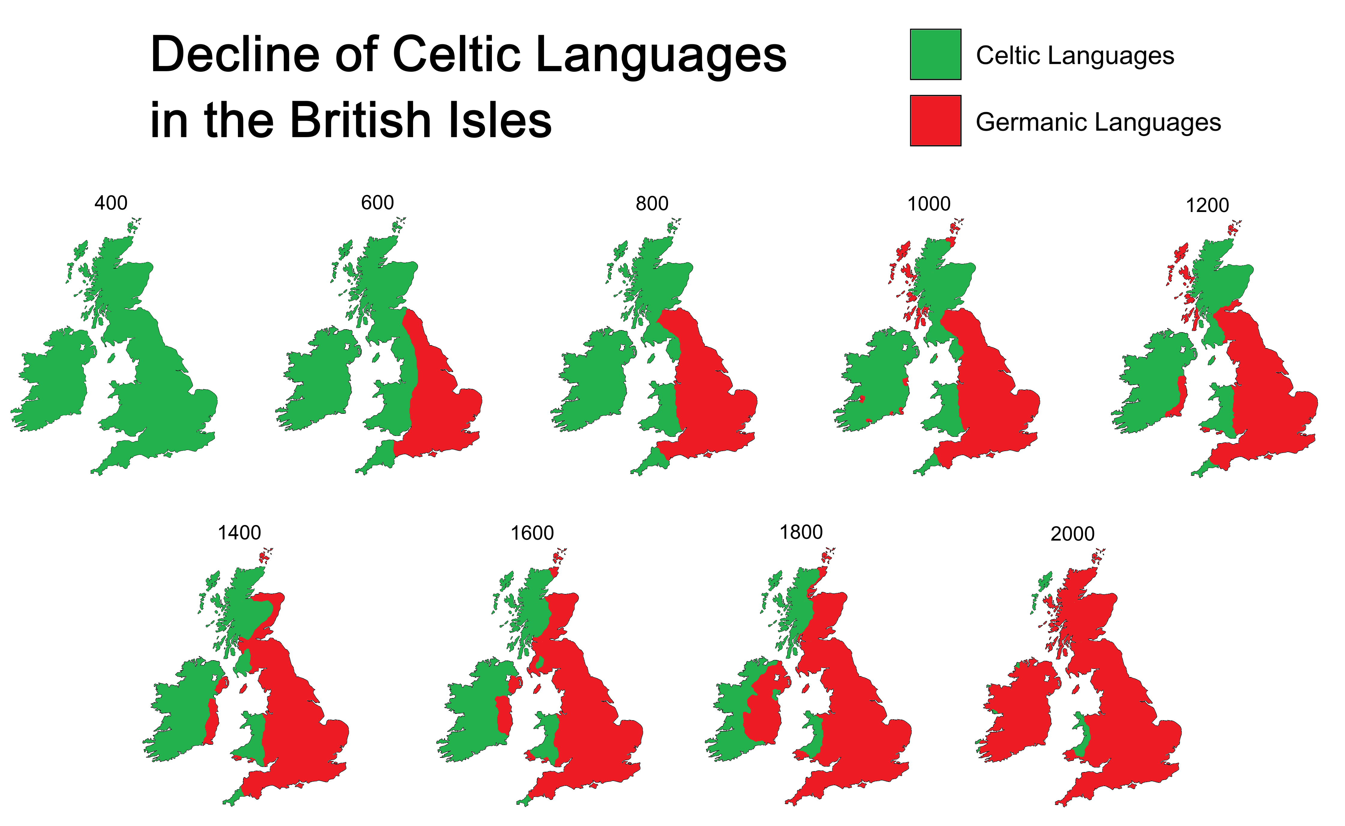

Slide 27
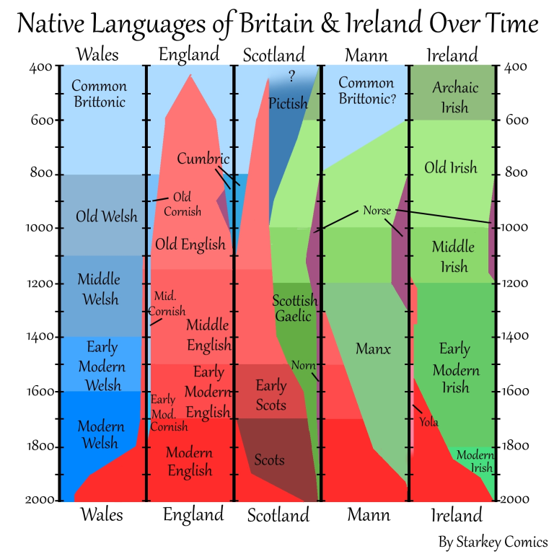

Slide 28
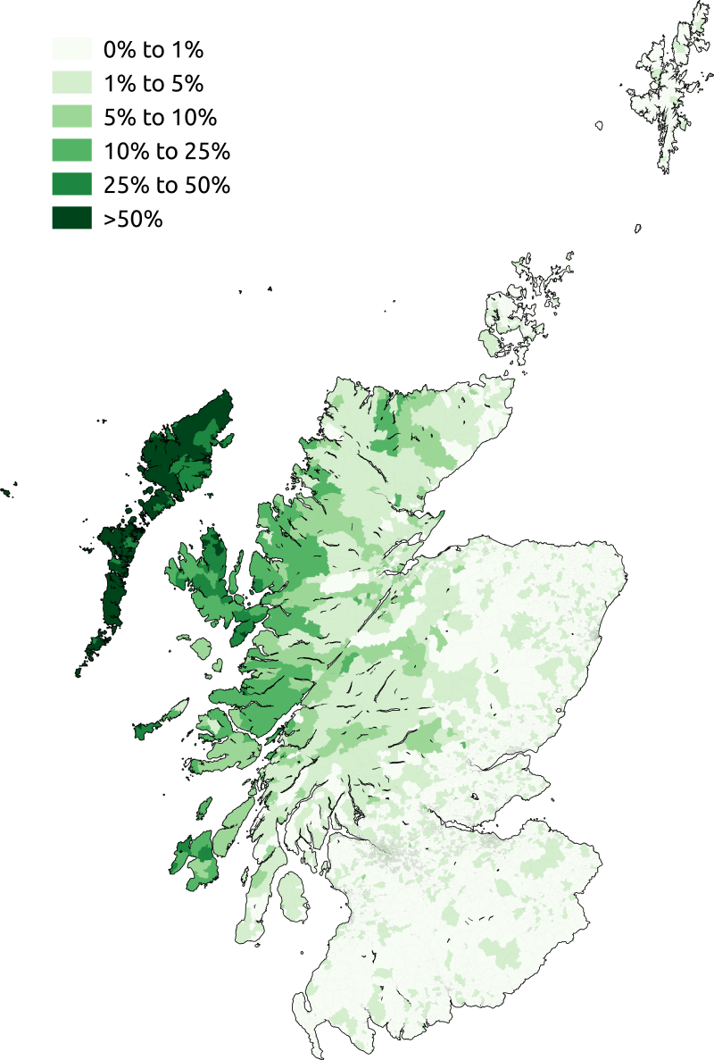
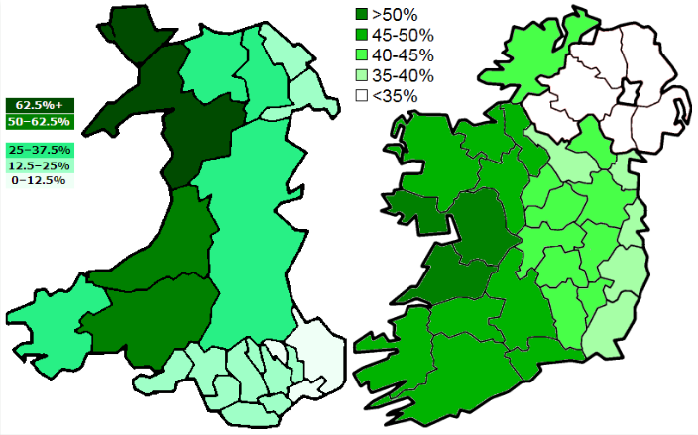

Slide 29
Importance of the Celts across Europe: Plato in the first and Aristotle in the second half of the 4th century BC already refer to ‘the Celts’ as one as the main barbarian peoples of the ancient world
Ptolemy reports that Alexander the Great met ambassadors of the Celts on the lower Danube in 335 BC.

Slide 30
A Pluriverse
Many different art styles, habitats and languages
At what level do we look for the Celts?
What is the unit of culture?
Unified by a common essence or a common enemy?

Slide 31
The toutâ
Tribes composed of up to 3000 people with king, poet, justice and priest and seer
Around 100 of these in Ireland
Across the entirety of Europe, huge regional variation, just as today

Slide 32
Trade
Trade links led to artifact, language and cultural diffusion
The Celts cannot really be viewed as a uniform, monolithic, unchanging people
Emergent dynamic processes, not some museum exhibit
Present as well as past

Slide 33
Ecological Pluriverse

Slide 34
Trade routes

Slide 35
Distribution of the Celts by 270 BC

Slide 36
Discussion and break
The Kavanagh Charter Horn, County Carlow, Ireland

Slide 38
Week One Lecture II Origins
Dr Keith R. Skene
Biosphere Research Institute

Slide 39
Distribution of the Celts by 270 BC

Slide 40
Where did they come from: the three theories
From the East From the West From the middle!

Slide 41
Origin theories: from the East

Slide 42
1. From the East
Origin from East: defined as people that spread from Germany and the Alps between 1600 BC and 100 BC
An early Indo-European people.

Slide 43
Eastern Origins
Celtic archaeological finds from across Western Europe resemble earlier finds in Austria and Germany
East origin worked with the idea of civilization spreading West
and with the Proto-Indo-European origin of language in Europe.

Slide 44
HALLSTATT

Slide 45
Hallstatt three thousand years ago
An important salt-mining site and Bronze- to Iron-Age cemetery in Austria
The oldest salt mines in the world

Slide 46
Homeland of the Celts
Evidence related to grave goods associated with early Celtic identity
And later distributed across more western territories
The Hallstatt culture was the predominant Western and Central European archaeological culture of the Late Bronze Age (Hallstatt A, Hallstatt B) from the 12th to 8th centuries BC
And the Early Iron Age (Hallstatt C, Hallstatt D) from the 8th to 6th centuries BC

Slide 47
Hallstatt salt mine
1,300 burials with Celtic-style grave goods
Salt preserved organic material

Slide 48
The Strettweg Cult Wagon from c. 600 BC was found as part of a princely grave of the Hallstatt culture in Strettweg near Judenburg, Austria in 1851.

Slide 49
The Hochdorf Chieftain's Grave

Slide 50
La Tène
Origin from East: “La Tène,” the designation for the Iron Age after c.450 BC
Named after a submerged site on Lake Neuchâtel in Switzerland
Very few Hallstatt but more numerous LT artifacts are found in the British Isles and Ireland.

Slide 51
‘lake-dwelling fever’
Low water levels throughout Switzerland in 1850s
Discovery of Neolithic village at Meilen, Lake Zürich in 1854

Slide 52
La Tène

Slide 53
Panarama of the eastern edge of Lake Neuchâtel and La Tène, painted by Jean Henri Baumann in 1850

Slide 54
Hansi Kopp, November 1857
Extremely low water levels
11 years after Hallstatt discovery
Hans Kopp fishing for antiquities
at La Tène. An engraving after a
drawing by Louis Favre, 1865.

Slide 55
Iron, not bronze: A new Age
Hansi Kopp: ‘we have fallen on one of the most remarkable sites… bronze is completely absent’.

Slide 56
La Tène art
Influenced by Mediterranean art from Greece and the Eutruscans of Italy
It evolved from the Hallstatt art, dominated by geometric forms and wading birds, to a much more complex reality, with oriental inspiration
Silk from China via the Silk Road appeared
Wind vane from La Tène

Slide 57
The art form of the La Tène Celts is a curvilinear style growing from the palmettes, lotus blossoms, vine scrolls and other motifs from the classical world
but rendered in uniquely original variations of great imagination and at times bewildering complexity.

Slide 58
The style is one of light and shade, of twisting shapes, and of meanings that change in the eye of the observer.
Swirling S-shapes combine to give the impression of a face:
Iron sword scabbard from Filottrano in northern Italy

Slide 59
A small sheet-gold fragment from Bad Dürkheim in Germany
A double face, rendered with extraordinary skill (and humour), is evident
On one side there is a mournful, bearded elder
From the other angle, the old man dissolves, to be replaced by an anxious youth.

Slide 60
Pfalzfeld pillar, Germany
Note the fleshy S scrolls and Large, bloated, leafy crown

Slide 61
Celtic helmet,
Amfreville, France
Ciumes̅ti Celtic helmet, Romania

Slide 62
Found in a cave near Angoulême in 1981,
in debris from a badger burrow
Iron, coated in bronze, coated in gold.
The Agris Helmet, France

Slide 63
Classic triskele motif, Celtic warrior burial at Srednica, Slovenia, 400 BC

Slide 64
Trio of dancing deer, La Tène, Switzerland, 250 BC

Slide 65
Discussion time

