Slide 1
CELTIC ECOLOGY WEEK TWO
Dr Keith R. Skene
Biosphere Research Institute

Slide 2
Reminder: The Course
Week 1: Introduction
Celtic Origins: From the East
Week 2: Celtic Origins: From the East or West?
Celtic Origins: from the heart?
Week 3: Oral Traditions, the cèilidh house and the expressive arts
Pagan beliefs: the Green World and the sagas
Week 4: The Significance of the Otherworld
Dúthchas
Week 5: The Cheshire Cat, Nationhood and identity: In search of a Celtic Ecology

Slide 3
Housekeeping
Each week, outlines of the lectures, suggested books, papers and websites will be added to the following site (password protected). You should have been sent an email detailing this.
Website: www.biosri.org/celticecology
Password: biosri6
Contact: krskene@gmail.com

Slide 4
The story so far…
Ard Macha (Armagh)

Slide 5
Ecology: the study of the home
Historical ecology is a multidimensional, multispatial, multitemporal study of the dynamic relations between humans and their environment
Combines social, economic, political and environmental components
A pluriverse: many worlds in one world
Storied
Peopled
Lived
Dynamic, enfolded and unfolding.

Slide 6
The Celts have been recorded in Greek writing before 500 BC
They are now accepted to have been one of the major groups of people around the Mediterranean and Atlantic coasts for many centuries
But where did they come from?

Slide 8
La Tène culture is thought to have developed when Celtic traders – and warriors - came into contact with Greek and Etruscan influences from south of the Alps
The culture grew and spread in eastern France, Switzerland, Austria, southwestern Germany, the Czech Republic, Slovakia and Hungary.
Etruscan roof tile with the head of a satyr, terra-cotta, 4th century BCE
Note scrolls and Palmate forms

Slide 9
The ancient Celts saw water as the gateway between this world and the next, and it was here that they offered tribute to their gods, using their most precious objects and making human sacrifices
Many key Celtic sites at edge of water.

Slide 10
Changes from Hallstatt (1500-600BC) to La Tène (450-1 BC)
The La Tène culture was more militaristic and its burial sites reveal an abundance of swords, spearheads, shields and protective armour, as well as everyday items such as cauldrons, yokes, and razors
Jewellery could be extremely exquisite
La Tène design work, found on a wide range of objects is more mature and more complex
It includes the elaborate swirling patterns of Celtic knotwork which reached their apogee during this period.

Slide 11
Remember the observations of Strabo:
“a love of boasting along with a great affection for ornaments. They wear golden jewellery such as necklaces and bracelets around their arms and wrists, while the upper classes wear dyed clothing decorated with gold”.

Slide 12
La Tène Art

Slide 13
La Tène demonstrates greater affluence, deeper knowledge of materials and technology, and wider cultural interchange than Hallstatt
Within its new, more confident idiom, it accommodated styles and motifs from Carthaginian, Etruscan, Greek and Scythian art forms, among others.

Slide 14
Increased female burials
Often with weapons
High status grave furniture

Slide 15
All this was founded on growing Celtic wealth acquired from control of trade routes across the Continent
allied to lucrative exports of salt, tin and copper, amber, wool and leather, furs and gold
Copper from Ireland formed an important contribution to the Bronze Age along with tin from Cornwall.

Slide 16
The Atlantic Façade commercial zone
Trade in tin between Ireland and Galicia was already established during the late Neolithic
These ancient connections continued during the Bronze Age, when a well-defined socio-cultural and commercial zone, called the Atlantic Façade, included Ireland, the Isle of Man, Scotland, Wales, the Cornish Peninsula, Armorica (Brittany) and Galicia in Spain, and lasted for at least three millennia.

Slide 17
Key copper deposits in Ireland

Slide 18
Copper Coast: the Birth of the Bronze Age in Ireland

Slide 19
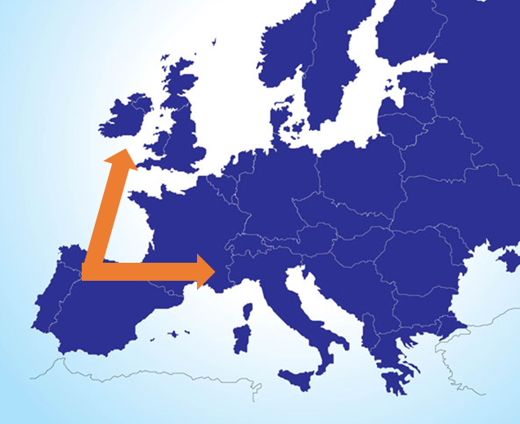
Origins 2. From the West

Slide 20
The Hallstatt (From the East) idea is counteracted by the awkward evidence for eastward Celtic movements in the historical period
Thus the obviously Celtic ethnic, place- and personal names of Galatia in Turkey are clearly due to the Celts’ documented eastward migrations of the third century BC

Slide 21
Also, Julius Caesar was adamant that the Volcae Tectosages had migrated eastwards across the Rhine from Gaul
No ancient author claims that the Boii were indigenous to Bohemia. Instead, Tacitus relate that they crossed the Rhine from the west.

Slide 22
From the West
A newer theory of "Celts from the West" suggests that Proto-Celts arose earlier,
Celtic was the lingua franca of the Atlantic Bronze Age coastal zone and spread eastward
It is argued that those who have inhabited Ireland for the last three millennia do not share a common heritage with the Central European Celts of the Hallstatt or La Tène civilizations.

Slide 23
Despite the adoption of La Tène art styles, archaeological evidence for large-scale Iron Age migrations into the British Isles has been singularly lacking
In Ireland, La Tène artifacts are relatively rare and are almost always of indigenous manufacture rather than of external origin.

Slide 24
Remember the earliest mention of the Celts in literature?
Hecataeus of Miletus (6th century BC)
Gaulish Mediterranean coast

Slide 25
The Pillars of Hercules
Herodotus refers to the Celts as living in the far West of Europe, beyond the Pillars of Hercules (the Strait of Gibraltar)
This is supported by Avienius in Ora Maritima.

Slide 26
Avienius: Ora Maritima
Ora Maritima means ‘Sea Coasts’, written around 400 BC
He quoted from a much earlier author of a sailing manual called Massilliot Periplus, thought to date to 600 BC, mentioning a land occupied by a people called the Celts.

Slide 27
“The Oestrymnian gulf gapes open for its inhabitants, In which the Oestrymnian islands spring up, Lying over a wide area and rich in deposits Of tin and lead. Great is the energy of the people here, Proud their character, pragmatic their skill. All things are connected to affairs of business. They cleave the tempestuous sea, And the current of the Ocean abounding in monsters, with woven boats.”

Slide 28
Avienius on Ireland (Hierni) and Coracles
“But, in a miraculous thing, they always fit out
Vessels from hides stitched together,
And often travel through the immense sea in a skin.
Then from here it is two days’ journey by boat to the Holy island [Ireland] –
So the ancients called it.
This island lies as an expanse of ground amid the waves,
And the people of the Hierni cultivate it all over.”

Slide 29
Genetics
Bryan Sykes finds that the DNA of those in Ireland can be linked to several maternal clans and primarily one male line he labelled Oisin.
He identifies the Irish as primarily Celtic in terms of their genetic origins, these Celts do not share common ancestry with those Celts who occupied central Europe and who were thought to have come to Ireland beginning around 500 BC.

Slide 30
DNA: Early and West
Instead, the Irish have a much longer ancestry on the island
With its major genetic markers established probably at the end of the last ice age, somewhere around 6000 to 8000 BC
The Younger Dryas.

Slide 31
Dramatic genetic shift around beginning of Bronze Age in Britain
Uncertain why
Disease?
War?
Environmental catastrophe?
Sampling bias?

Slide 32
Rapidly changing field
Ness of Brodgar discovery
Continuing DNA evidence
Rapidly evolving climatic data
Potentially many more sites

Slide 33
Discussion time and Break

Slide 35
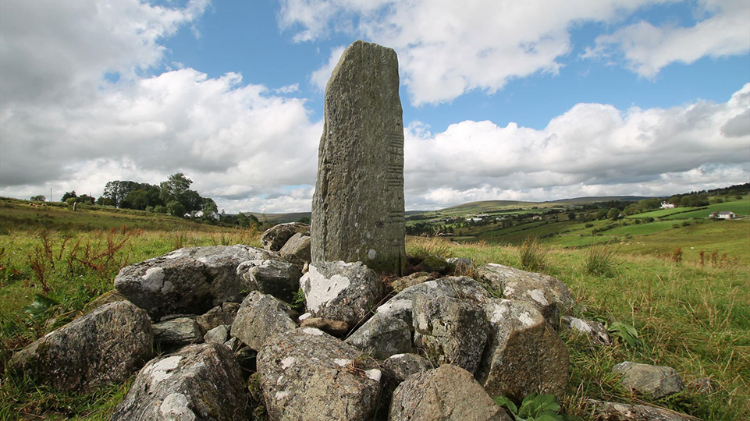
Week 2: Lecture Four
Dr Keith R. Skene
Biosphere Research Institute

Slide 36
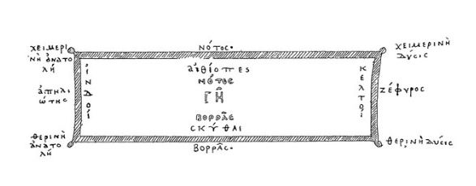
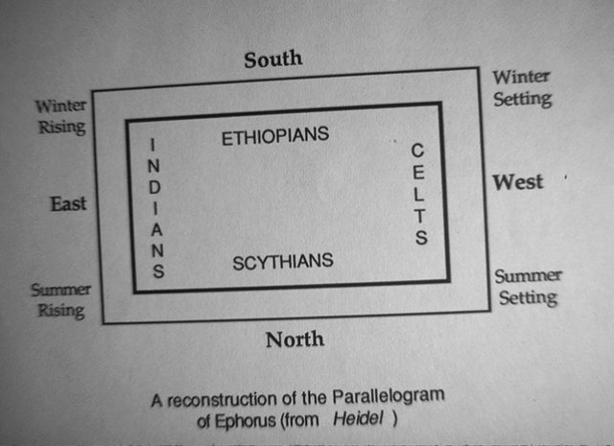
Ephorus (350 BC)
Map of Ephorus in the fourth century BC in which the peripheries of the Greek world are populated by four symmetrically arranged barbarian peoples:
Scythians in the north
Indians or Persians in the east
Ethiopians or Libyans in the south
Celts in the west

Slide 37
Linguistics
Celtic languages spread from South Iberian Peninsula to Scotland, including British Isles and Brittany (France)
Current Celtic-speaking populations must be considered Atlantic Celts
Also, translations had been made from Tartessian (Southern Portugal) to ancient Celtic (Gaelic) languages such as Irish, Scottish and Welsh
Possible split as early as 3200 BC (i.e. well before Hallstatt)

Slide 38
P- and Q-Celtic languages
The surviving insular Celtic (as opposed to the extinct continental Celtic) languages are usually subdivided into two groups on the basis of a single consonantal shift
Welsh, Breton, and the extinct Cornish language are referred to as “Brythonic,” or “P-Celtic,”
whereas Irish, Scottish Gaelic, and the extinct Manx language are thought to be more archaic and are referred to as “Goidelic,” or “Q-Celtic”
P Q

Slide 39
Q-Celtic

Slide 40
P-Celtic

Slide 41
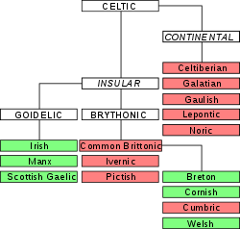
Insular/Continental argument

Slide 42
Ogham stones

Slide 43
The Iberian Peninsula
the Hispano-Celts were, for a long time, practically excluded from the Celtic world
since archaeological finds from the Hallstatt and La Tène cultures were scarce in this area, and did not provide enough evidence for a cultural scenario comparable to that of Central Europe.
The presence of a Celtic language in the Iberian Peninsula was definitively confirmed by the Botorrita bronze tablets, which are considered the most important texts in any Celtic dialect.

Slide 44
Botorrita Bronze Tablets (200 BC)

Slide 45
Planning dispute!!
1. "Regarding a well-wrought boundary structure, the senators of Tocoitom and of Sarnicios [have agreed/decided that] [it is] not permitted"
2. "[that it] be demolished or destroyed or broken apart by violence."

Slide 46
Evidence: Archaeology v linguistics
Shift from archaeological to linguistic studies showed Celtiberian and Lepontic languages (Italian lakes) were the oldest inscriptions
The undoubted status of the Celtiberians of Hispania as Celtic, demonstrated by inscriptions such as the Botorrita bronzes
As well as their clear differences from the La Tène Gauls,
has helped to define the conception of Celt by emphasizing its essentially linguistic character.

Slide 47
Tartessians 900-500 BC

Slide 48
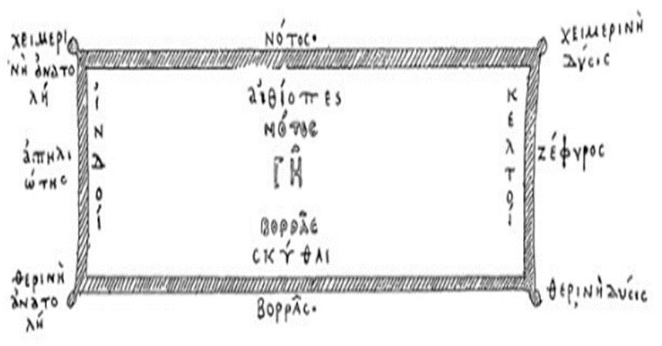
Avienius
Ora Maritima
Ephorus

Slide 49
“Invoking the divine Lug of the Neri tribe, this funerary monument for a noble Celt, He remains fixed, unaltered within.”

Slide 50
The Bible states that Tartessos was the merchant of silver, iron, tin, and lead (Ez. 27, 12)
“"Tarshish was your merchant because of your many luxury goods. They gave you silver, iron, tin, and lead for your goods.”

Slide 51
Sacrificial pit of horses covered in a tumulus
https://journals.plos.org/plosone/article?id=10.1371/journal.pone.0293654

Slide 52
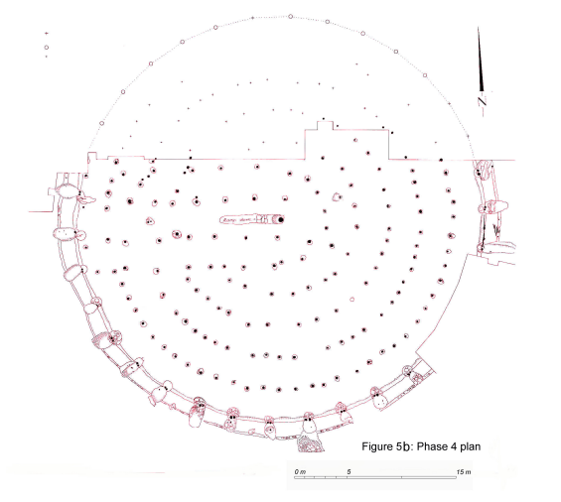
Emain Macha
Large wooden structure constructed
Then filled with limestone
And burnt then covered in soil and turf

Slide 53
Same pattern at Tara and Duún Ailinne

Slide 54
The end of Tartessos
A tsunami, around 500 BC
Tartessos rumoured to be Atlantis

Slide 55
Origins: 3. Celts From the Heart
A new theory, ‘Celts from the Heart’ (Patrick Sims Williams (2020)), suggests that proto-Celts arose from Bronze Age Gaul and then spread in different directions.

Slide 56
Celtic from the heart hypothesis
Celtic presumably emerged as a distinct Indo-European dialect around the second millennium BC, probably somewhere in Gaul
whence it spread in various directions and at various speeds in the first millennium BC,
It gradually supplanted other languages, including Indo-European ones.

Slide 57
During the first millennium BC, Celtic spread into eastern Iberia (probably well before the time of Herodotus)
Into northern Italy (as first evidenced by the Lepontic inscriptions in the sixth century)
Into Britain, and into Ireland and also towards the east,
eventually reaching Galatia in Turkey in the third century BC.

Slide 58
Expanded timeline
By 5000 BC an Italo-Celtic dialect of Neolithic Proto-Indo-European reached southwestern Iberia
Atlantic Celtic origins now suggested around 3000 BC, spreading to west through Maritime Bell Beaker culture around 1000 years later
But maybe much earlier
The recolonization of western Europe from an Iberian refugium after the retreat of the ice sheets ∼15,000 years ago could explain the common genetic legacy in the area.

Slide 59
Early Human movement

Slide 60
870 000 years ago:

Slide 61
Climate-driven movement
During the glaciations of the Quaternary, over the last 1.6 million years, significant migrations of both humans and non-human species were central to survival.

Slide 62
Post-glaciation
The Mediterranean area was a refuge for human populations during the Last Ice Age that also received Saharan people and culture
After the ice retreat, populations coming from the Basque region went northwards to North France and British Isles
Multiple genetic marker systems indicate a shared ancestry throughout the Atlantic zone, from northern Iberia to western Scandinavia, that dates back to the end of the last Ice Age.

Slide 63
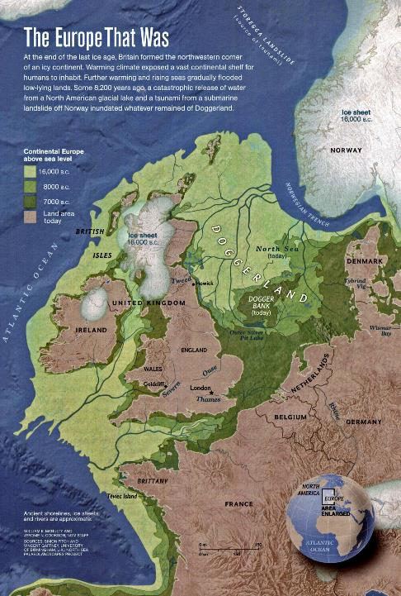
Orkney land bridge 7000 BC
Scotland/Ireland land bridge
7000 BC
Dogger Bank
Continental land bridge
7000 BC
Ireland/Europe land bridge
16 000 BC

Slide 64
Lebor Gabála Érenn (literally "The Book of the Taking of Ireland")
the Milesians, or sons of Míl, are the final race to settle in Ireland
They represent the Irish people
The Milesians are Gaels who sail to Ireland from Iberia (Hispania) after spending hundreds of years travelling the earth.

Slide 65
Stone of Scone
The book of Leinster theory that the stone was transported from ancient Egypt via the Iberian Peninsula or Celtiberia to Ireland by Scota, the daughter of an Egyptian Pharaoh, who was also the wife or mother of Goídel Glas, an ancestor of the Milesians.

Slide 66
Scota and Gaedel Glas travel from Egypt to Ireland

Slide 67
The stone has been associated with Lia Fail of the Hill of Tara, which was used as an Irish High Kings' Inauguration Stone
Scota along with a band of Irish warriors later invaded Scotland taking her Royal seat with her.
Ultimately it was confiscated by Edward I of England.

Slide 68
Baldred Bisset
Medieval Scottish lawyer Baldred Bisset put forward the alternative version that Sota had sailed directly to Scotland with the stone
Establishing Scotland as an ancient and rightful nation.

Slide 69
While highly contested, the point is that the story relates to the Iberian peninsula and the Milesians as an important part of the History of Ireland.

Slide 70
Later mass migration
Later migration event: Celtic immigration to northwestern Iberia during the fifth century AD At the time when the Angles and the Saxons arrived in Britain
for reasons that have not yet been determined, several Celtic tribes from the south of the island emigrated to the Armorican peninsula (Brittany)
and some of them even farther to the northwest of the Iberian peninsula where they landed in the westernmost coast of today's province of Asturias.

Slide 71
Summary
Celts from the West, East or Centre?
Many ancient people
Unified by art, gods, religious practices, otherworld, linguistics, genetics and beliefs
Western origin favoured but definite important presence in centre and East, including Turkey and Scythia.

Slide 72
Discussion

