Slide 1
Lecture 9 Celtic Ecology: Stepping back for the bigger picture
Dr Keith Skene
Biosphere Research Institute

Slide 2
The Journey So Far
The Celts: A Pluriverse
Many Worlds and One World
Diffusion of art, ideas, beliefs and practice
Resonance across environment, economics and society
Integration necessary, not an optional extra.

Slide 3
Impact of Environment
Existential and central
Survival relied on maintenance of Nature and community
Not a luxury
Non-linear
Social and economic impacts
Driver of political power shifts (Minoan tsunami)
Seas could disappear, lands turn to ice.

Slide 4
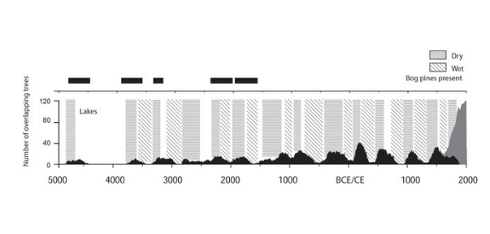
Caledonian forest density over time with differing rainfall levels
Industrial forestry

Slide 5
Impact of Community
Existential – banishment meant death
Protection, nutrition, resilience
Specialization and unification

Slide 6
Impact of Economics: flow, globalization, interpretation and transition
Not passive
Trade routes as diffusive canals of cosmology, custom, culture, genetic, linguistics and practice
Importance of interpretation through cultural context
Embedded economics (Skene, 2022; 2023)
Relational economics
Pluriverse thinking (Oarga-Mulec and Skene, 2024 in press)

Slide 7
ART as HeART
Conveying complexity
Spatial and temporal cohesiveness
Cosmological integrity
Emergence
Narrative
Repository and reinforcement

Slide 8
John Muir
The nineteenth century Scottish emigrant and environmentalist, John Muir
Considered national parks as places apart from areas of everyday human activity
Nature minus people (other than tourists)

Slide 9
San bushpeople cleared from the Kalahari

Slide 10
Maasai evicted from Serengeti

Slide 11
Bernard Grzimek excluded the Maasai from the Serengeti plains, claiming “A National Park must remain primordial wilderness to be effective. No man, not even native ones, should live inside its borders”

Slide 12
Apatani tribe

Slide 13
Tiger conservation

Slide 14
Santhal people

Slide 15
By dissecting and denying indigenous practices relating to the land (hunting, fishing, building, making, celebrating)
and through separation and re-education of language,
the cyclical inheritance of identity, value, meaning, one’s sense of context, being and empowerment is broken.

Slide 16
Noam Chomsky, Jonathon Porritt and Ghillean Prance:
“Tribal peoples have managed their lands sustainably for generations. Forcibly removing them usually results in environmental damage. Such removals are a violation of human rights. The cheapest and quickest way to conserve areas of high biodiversity is to respect tribal peoples’ rights. The world can no longer afford a conservation model that destroys tribal peoples: it damages human diversity as well as the environment.”

Slide 17
Ecologist Frank Fraser Darling
Honed his conservation ideas of man-and-nature or ‘human ecology’ among the Gaelic-speaking crofters of Wester Ross
famously describing the Highlands as ‘a devastated terrain and that any policy which ignores this fact cannot hope to achieve rehabilitation’
West Highland Survey: An Essay in Human Ecology

Slide 18
West Highland Survey: An Essay in Human Ecology
1942, the wartime Secretary of State for Scotland, Thomas Johnston, asked him to run an agricultural advisory programme in the crofting areas of the Scottish Highlands and Islands, in order to solve the ‘Highland problem”.
He hired five young Gaelic-speaking Highlanders to interview the crofters in Gaelic

Slide 19
He viewed the Highlands as a super-organism
the organic and inorganic constituents of which had achieved a delicate equilibrium over centuries

Slide 20
The devasted environment was the primary reason why there were now few people and why there was a constant economic problem
He contended that modern capitalist society disrupted and destroyed this stability through deforestation, the concept of private property, and the market economy

Slide 21
He used the Survey to criticize modern culture and to idealize traditional rural life
For rehabilitation he prescribed conservation as 'applied ecology' to regain eco-stability and cultural evolution to withstand the conforming pressure of modern society.

Slide 22
In the Survey, Fraser Darling found evidence that traditional Gaelic culture had evolved to cooperate with the natural environment
for the benefit of the whole biotic community
This ensured equilibrium and the health of the greater environment.

Slide 23
Soil as the glue
But the crime of sheep and timber was less for turning the crofters off their land than for destroying the soil
Soil as the basis of Gaelic civilization: their politics, their culture, and their subsistence.

Slide 24
The Disruption: 1745 and all that
Following the Jacobite defeat at Culloden
A combination of capitalism and the concept of private property destroyed the clan system and the region's equilibrium
By way of timber, sheep, and kelping, modern Britain re-ordered the Highland economy and society after 1745
But did so in a manner which seriously damaged the region's ecological equilibrium.

Slide 25
Fire and Tooth
Ultimately, Fraser Darling claimed that 'the combination of fire and tooth is invincible’
By comparing soils of sheep farms to cattle pastures and the few remaining bits of old-growth forest,
He revealed how sheep and fire destroyed the soil by simplifying the vegetation and promoting erosion
And leading to human population collapse.

Slide 26
Dùthchas as a necessity, not a choice
Because of the poor nature of the land, he argued that community viability depended upon cooperation:
The system was one of essential cooperation by people living near the fringe of possible human existence
Man is essentially a social animal, and where life has to be lived and subsistence mainly gained from land round the dwelling
sociality becomes a necessity.

Slide 27
Footnote
Frazer Darling’s BBC lectures in 1969 are thought to be the starting point of Britain's green movement.

Slide 28
Today’s large, almost ‘empty’ estates and depopulated glens are the product of these human and animal experiments
While they may appear ideally suited to ‘return to the wild’
a basic knowledge of Gaelic placenames reminds us that this is a landscape that is ‘peopled and historied’

Slide 29
While environmentalists may conceive of these lands as a form of ‘wilderness’
full of potential as Protected Areas, especially in the urgent drive to revitalise biodiversity and for climate change mitigation,
many Gaels throughout the Highlands and Islands have a different social and cultural framing,
reinforcing native connections to land and the formations of meaning from a particular and rooted sense of place.

Slide 30
The land, nature itself, is animate; and plant, animal, human and spirit are interconnected
Historically, and in such cultural terms fàsach (wilderness or undomesticated space) was that designated space of explicit interconnection.

Slide 31
Wild Land Map, 2014
Part of the most recent National Planning Framework, the Wild Land map series was published by what was then Scottish Natural Heritage
Unwittingly echoing the cultural erasure inherent in imperial mapping projects, the series played upon damaging stereotypes which have been imposed upon Gaels and the Gàidhealtachd for centuries

Slide 32
Andrew Bachell, then head of operations, SNH
“Wild land is an incredibly valuable asset for Scotland. It makes an important contribution to our tourism industry and images of wild places also help support Scotland’s world wide reputation as a beautiful and impressive country. It makes a crucial contribution to our quality of life and we know that most Scots consider wild places to be important to them. Wild land also supports biodiversity and is often associated with our most impressive wildlife.”

Slide 33
If we think of the scattered settlements and small populations of the Gàidhealtachd in comparison with large environmental institutions and their governance responsibilities (such as NatureScot)
the difficulty in sustaining communication with environment professionals and scientists working in the landscape comes into focus.

Slide 34
Traditional Ecological Knowledge (TEK)
long term, place-based and interconnected ways of knowing.
“Any understanding of the meaning of TEK is acceptable only so long as it plays the role of bringing different people working for different institutions closer to a degree of mutual respect for one another’s sources of knowledge.” Kyle Whyte, 2013.

Slide 35
TEK stands in sharp contrast to the discourse of development and the erasure of people’s aspirations, needs and rights within their cultural landscapes, which has underpinned environmental planning in post-war Europe
Such as the silo-thinking neo-colonialism and reductionism of the Sustainable development goals

Slide 36
Dùthchas as TEK
Dùthchas has dimensionality as a putative total field of understanding embracing landscape, a sense of geography, a sense of history and a formal order of experience in which all these are merged.

Slide 37
Déirdre Ní Mhathúna
“Embodied knowledge, from within the Gaelic heartlands, articulates that dùthchas as a distinct and richly nuanced worldview is not yet reconciled with the meta-narrative of conservation and sustainability in the light of climate change
Further research is essential if we are to unlock the full potential of the Gàidhealtachd as both landscape and homeland.”

Slide 38
The Cheshire Cat: Celtic Art and Nature
The “Cheshire (cat) style”, as it was termed by Paul Jacobsthal, since they reminded him of the Cheshire cat ― a wonderful character from Alice’s Adventures in Wonderland by Lewis Carroll that appears and disappears at will and finally melts away leaving only a grin in his wake.

Slide 39
The Cheshire style displays most prominently the tendency Celtic artists had towards ambiguity,
towards creating blurry, elusive images that,
being dreamily enigmatic and vague, constitute the charm of Celtic art

Slide 40
Crescentic plaque from Llyn Cerrig Bach, Anglesey

Slide 41
The key feature of Celtic art:
its tendency towards reverie and creating phantom-like, elusive images hovering on the border between dream and wakefulness.

Slide 42
Symbolism
Symbolism was second nature to Celts
Their visions were woven from symbols;
those symbols―graceful, unusual and dreamily enigmatic―were embodied within Celtic art and folklore
The awareness of the local and regional culture, so deeply rooted in Celtic mentality, and the affection for it, did not wane even in the territories conquered by Rome
rather they lay dormant during the Roman period.

Slide 43
Post-Roman persistence of Celtic art: Sutton Hoo Burial 7th Century AD

Slide 44
Life affirmation
Michell (2005), writing on the Nēhîthâwâk (Cree) of Canada, observed that: “To live properly includes the goal of living in harmony with Nature for the sake of the community’s survival”.

Slide 45
Deborah Rose (2005) sums up the system-based understanding at the heart of indigenous thinking as follows:
“Rather than humans deciding autonomously to act in the world, humans are called into action by the world
The result is that country, or nature, far from being an object to be acted upon, is a self-organizing system that brings people and other living things into being, into action, into sentience itself.
The connections between and among living things are the basis for how ecosystems are understood to work, and thus constitute law in the metaphysical sense of the given conditions of the created world.”
See website reading list for link.

Slide 46
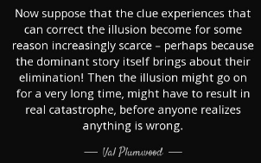
See also Bird’s article on Val Plumwood

Slide 47
Danford Chibvongodze (2016) writes that “The conservation of the environment in African societies rests upon a deliberate and conscious dove-tailing of cultural and social identities with the natural and wildlife environment.”
Central to this is the integrated, local, emergent nature of traditional knowledge
Traditional knowledge is utilitarian and landscape-based
As is culture.

Slide 48
A beginning and continuation
Summing up:

Slide 49
The Celtic Legacy
Extrapolated into the modern day through Western religion
A template for environmental harmony
A celebration of the arts (ART AS HEART)

Slide 50
Missing links: re-imagining the Otherworld
So much is different
Yet so much is the same: economics; environmental, cultural and technological change
The search for identity
The Existential threats
The failure of the Modern Age

Slide 51
The failure of the Modern Age
The cult of the Individual
From more-than-human to less-than-human
Supply chains in the mist: hiding the environmental and social costs of our lifestyles
Homogeneity and the cult of selection
Progress, the philosophy of the rectilinear and the cult of legoland
The Garden of Eden complex.

Slide 52
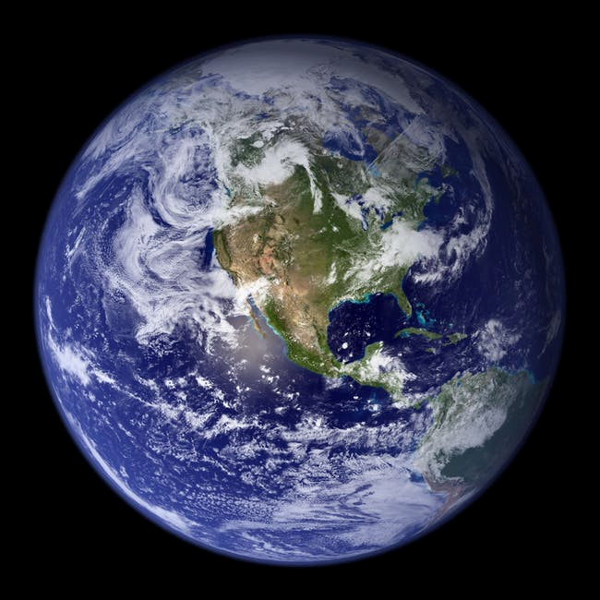
SOIL EROSION
CLIMATE
DESTABILIZATION
SALINIZATION
GLOBAL
BIODIVERSITY
COLLAPSE
EUTROPHICATION

Slide 53
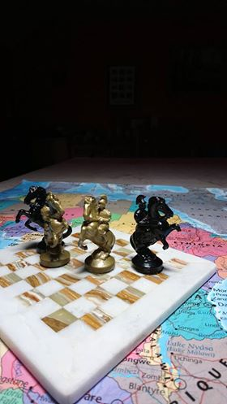
MALTHUS’ HORSEMEN
OF THE APOCALYPSE
FAMINE
DISEASE
WAR
MODERN HORSEMEN
OF THE APOCALYPSE
CLIMATE DESTABILIZATION
POLLUTION
DIVERSITY COLLAPSE

Slide 54
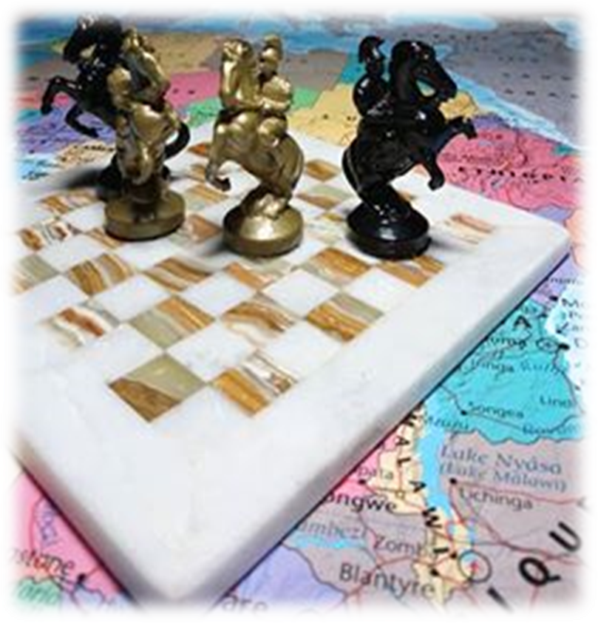
MALTHUS’ HORSEMEN
OF THE APOCALYPSE
FAMINE
DISEASE
WAR
MODERN HORSEMEN
OF THE APOCALYPSE
CLIMATE DESTABILIZATION
POLLUTION
DIVERSITY COLLAPSE
FAMINE
DISEASE
WAR

Slide 55
Key points on Celtic Ecology
The Earth system: the ultimate arbitrator
Community: a collective empowerment through engagement with each other and with the Earth system
System theory: embracing emergence through feedback
System theory: Embracing sub-optimality through trade-offs
System theory: embracing non-linearity through resilience
System theory: embracing crisis through self-organization.

Slide 56
The misappropriation of Nature
Skene, K.R. (2021). Sustainability policy and practice: Is Nature an appropriate mentor? Environment, Development and Sustainability, pp. 1-19.
Chaos and order co-exist in Nature
The Earth system as a powerful, non-linear, emergent whole
It self-organizes, shape-shifts and continually communicates
Operating across space and time
Celtic ecology recognized its centrality, timelessness and power.
The foundations for any hope of addressing the current challenges.

Slide 57
Pluriverse thinking

Slide 58
ECOLOGY AS A COMPASS
Humanity as embedded, diffusive, enfolded, unfolding and dynamic
Embracing the more-than-human as human
Rejecting the less-than-human as human
Chaos and order as an integrated whole
The integrated totality: everything is everything.

Slide 59
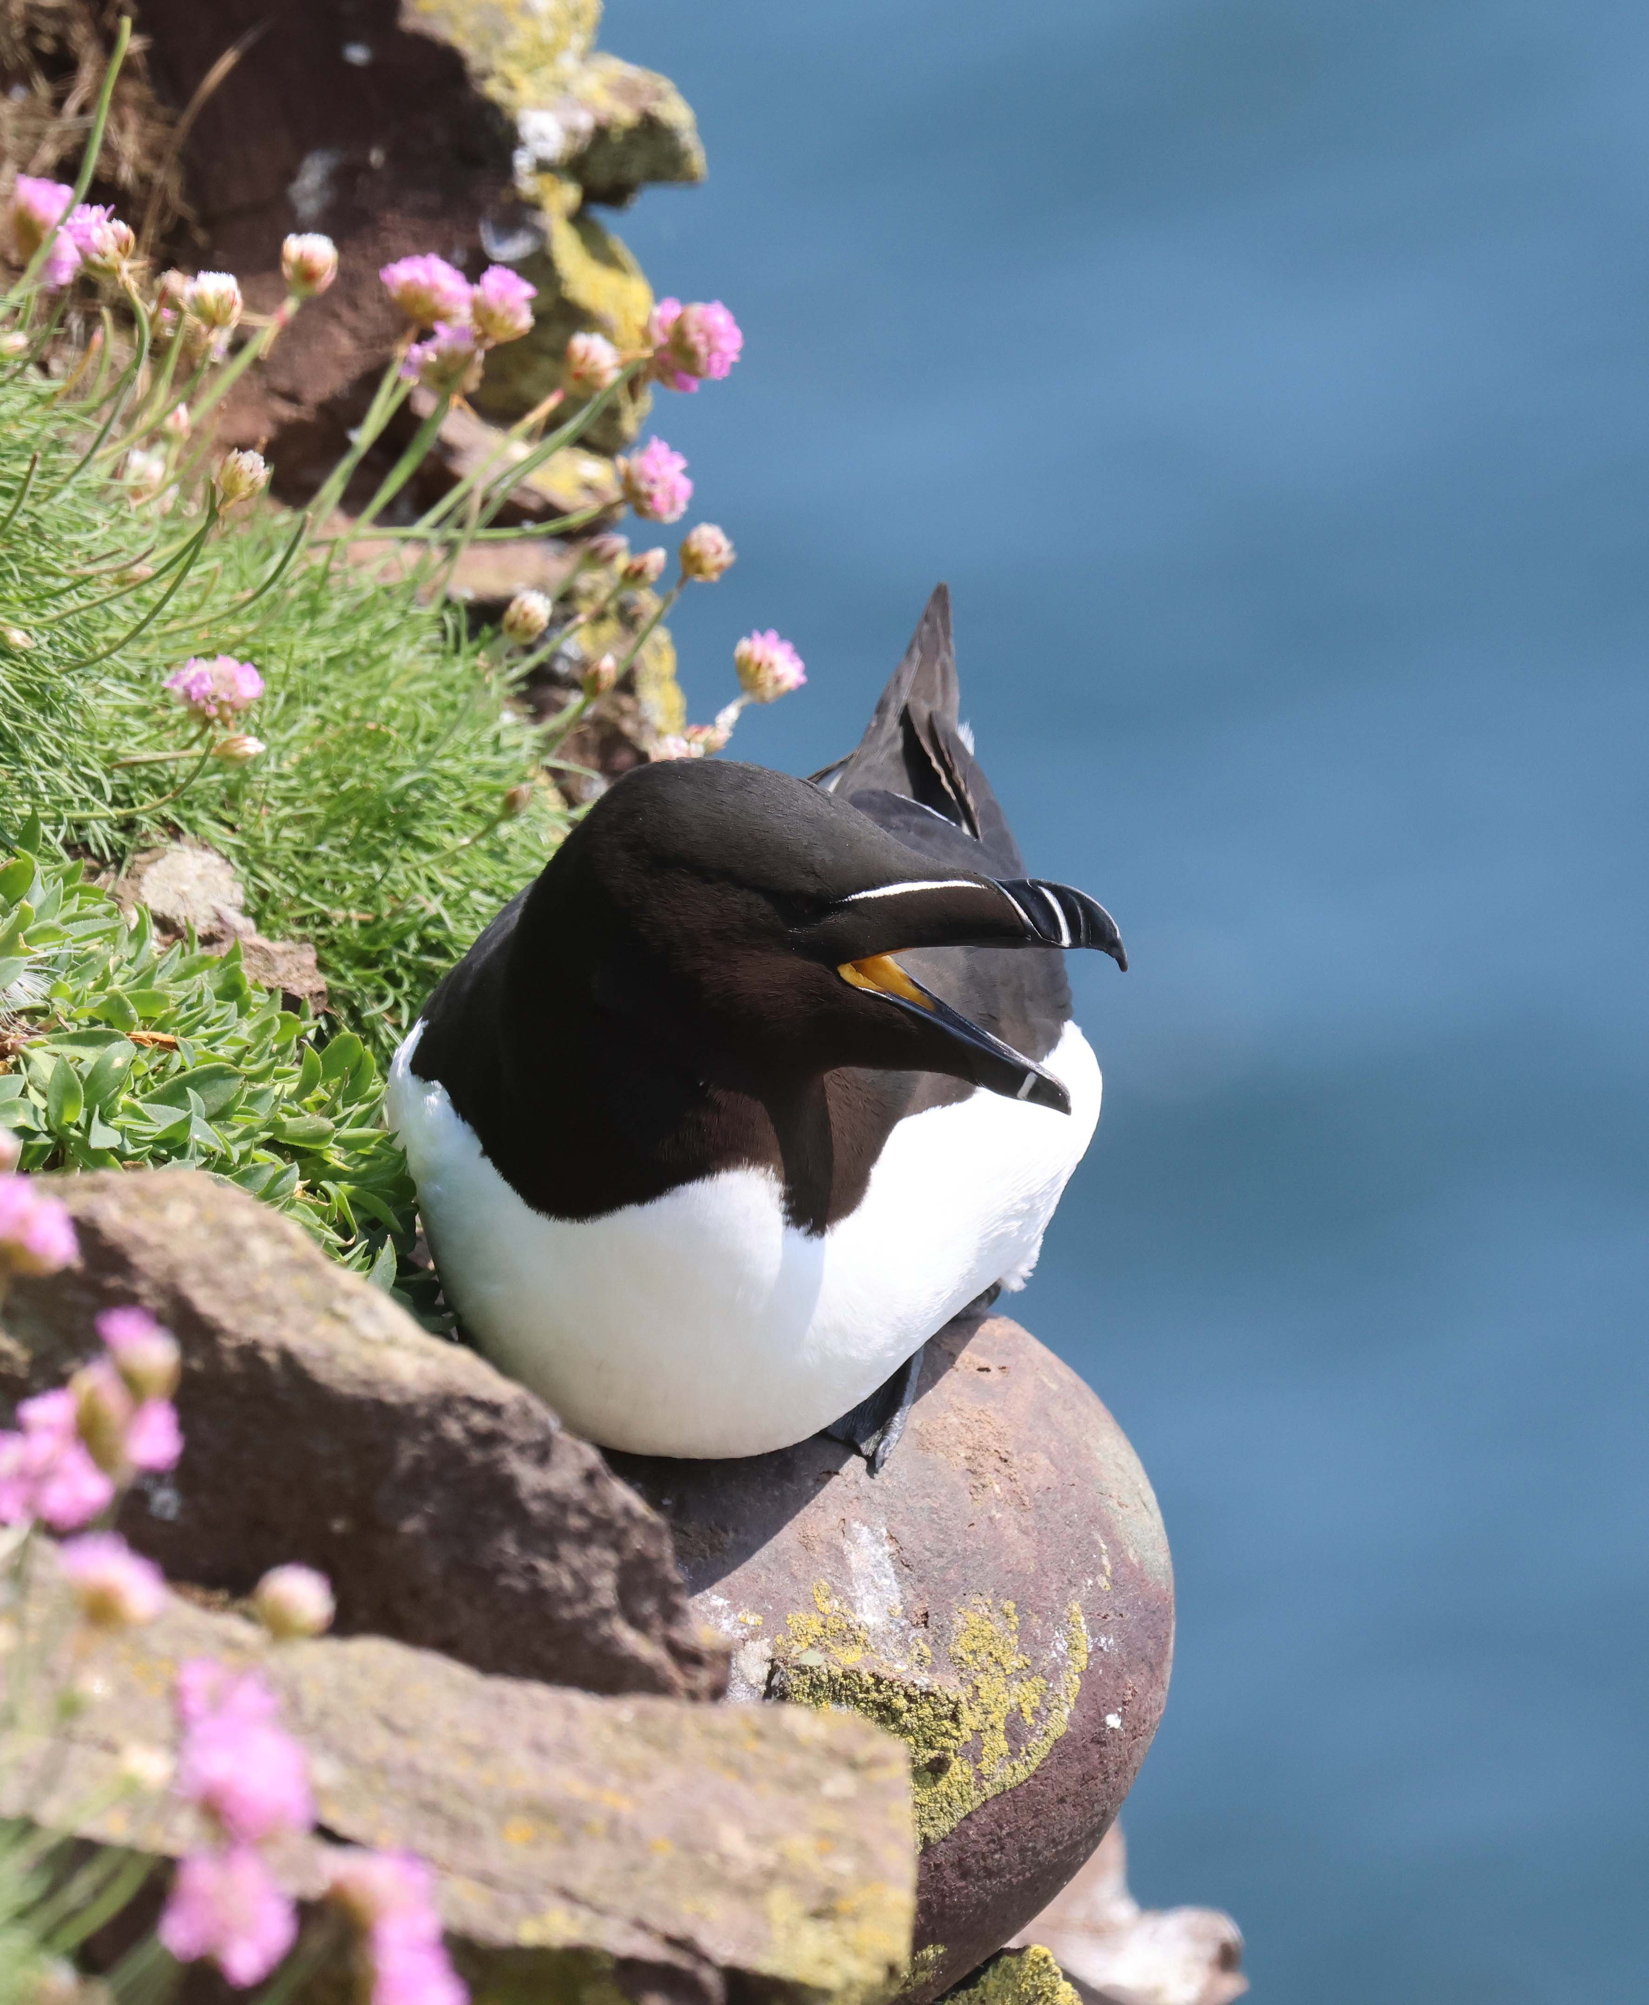
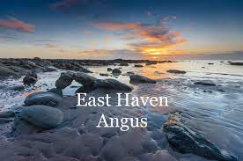
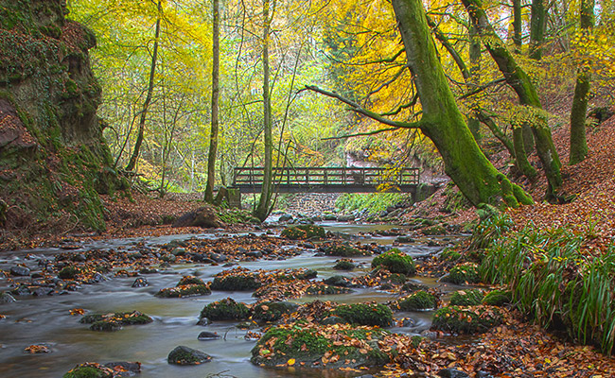
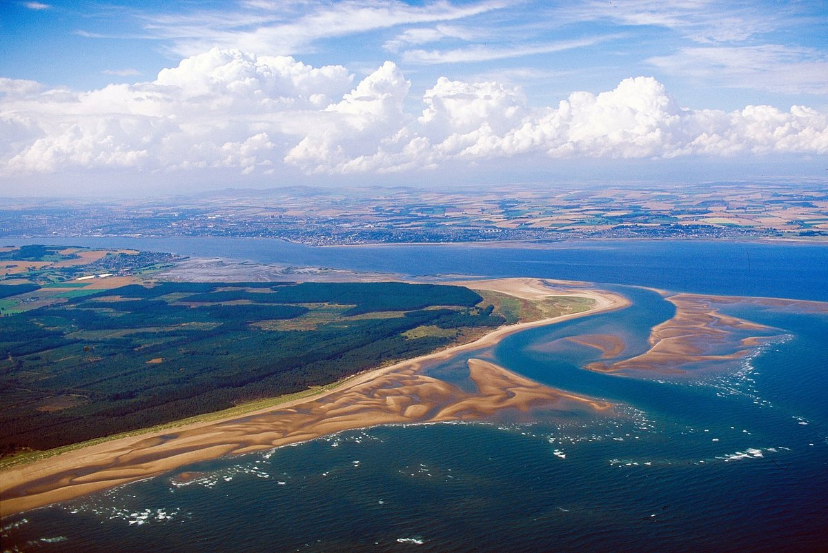
Thank you!
A whole range of summer field visits are planned for the month of June (see Course Website)
Hope to see you at some of these.
Fowlsheugh
Den of Alyth
Tentsmuir

Slide 60
Discussion

