Slide 1
WEEK FOUR The Otherworld and Dùthchas
Dr Keith Skene
Biosphere Research Institute

Slide 2
LECTURE SEVEN THE CELTIC OTHERWORLD

Slide 3
Key elements of Celtic Ecology
Multidimensional and complex
We see the framing of social dialogue moving beyond the anthropocentric to a place of ecocentrism
The integration of the triskelion where everything is within everything and a pluriverse of existence both temporal and spatial exist
Akin to yin and yang

Slide 4
Celtic Otherworld
Home of powerful ancestors
Communication with the otherworld focused on the many portals
Samhain, Beltaine, bodies of water, caves, forests, large stones
Poems and songs formed the means of communication
Wisdom and the precedents of life were found in the Otherworld

Slide 5
George William Russell Call of the Sidhe

Slide 6
Described by Maureen Ní Bhrolicháin as “A perfect realisation of this world. A place without death, disease, war and old age”
The gods, the heroes and the dead lived in a state of perpetual youth
A pagan Heaven
But much more than that.

Slide 7
The Otherworld
Sometimes seen as a parallel universe, reaching into this world as fog or dramatic weather changes
Sometimes beyond the Western (Atlantic) seas
Or beneath the water
Many of the sagas, songs and poems relate tales of voyages or adventures into such a place.

Slide 8
The ancient Otherworld is portrayed often as being around us at all times, yet imperceptible to most people
The Voyage of Bran is an example, emphasising the parallel nature and co-existence.

Slide 9
Abundance of Harvest
The otherworld is depicted as abundant in food, trees heavily laden with fruit and perfect fields of crops
An earthly leader could be judged on the harvest
A plentiful harvest meant his relationship with the otherworld was good
A famine would indicate otherwise and could lead to the toppling of the leader.
Land of the Forever Young by Arthur Rackham, 1920

Slide 10
Nature across both worlds
Thus, Nature signalled the integrity of the leader
It represented the spiritual as well as the physical
And was a bridge across both worlds
An entire set of additional dimensions.

Slide 11
Seasonal differences
The Otherworld was six months out of sync with the present world
So Samhain here would be Bealtaine there
And vice versa
Visitors in the myths would bring back food from the opposite time of the year, such as summer fruits in Winter.

Slide 12
Thin veils
Certain times of the year were looked on as periods when the two worlds came close together
At these times the Otherworld could be entered by passing through a hollow hill, especially at liminal times of year such as Samhain and Bealtaine
The magical barrier, the Fé Fiada, is not actively concealing them.

Slide 13
Liminal spaces in cinema
The Shining (1980)

Slide 14
Fé fíada
This magical mist could render people invisible or appear as animals
Again, here, nature would take on a greater significance
Druids and the Tuatha Dé Danann could control it

Slide 15
Tuatha Dé Danann
The folk of the Goddess Danu
Early invaders who took control of Ireland
Supernatural beings

Slide 16
The Riders of the Sidhe, by John Duncan (1911), McManus Art Gallery, Dundee.

Slide 17
John Duncan (1866-1945)
Born in Hilltown, Dundee
Studied at Dundee School of Art (Dundee High School) he would work with Patrick Geddes and became a major artist in the Celtic Revival.
The Riders of the Sidhe used egg tempera techniques
John Duncan’s daughter Binty recalled: “Not only did the house stink but we ate meringues for breakfast, lunch and dinner.”

Slide 18
Tuatha Dé Danann and the Fomerians
Tuatha Dé Danann, the earliest people of Ireland with magical powers, were adopted as fallen angels in medieval Christian writing, not all bad or all good
The Fomerians, their enemy, represented the destructive forces of nature
Here again, nature takes on multiple representations, integrating the natural and supernatural world.

Slide 19
Chaos and Order
Chaos creates order
Order creates chaos
An energetic Yin and Yang

Slide 20
Incantations of protection
Gave 24 hours of protection
Magical, empowering “spells”
Would later be adopted into Christianity
For example the Breastplate of St Patrick, or the Deer’s Cry
A fascinating crossover between Pre-Christian and Early Christian beliefs
Emphasis on ‘today’ throughout the prayer.

Slide 21
Adopted Incantations
This power would be adopted by Christianity, applying to the saints
In the celebrated prayer-poem ‘The Deer's Cry’
attributed to St Patrick
the Saint turns himself and his companion, St Benén, into wild deer on their way to evangelize Tara
The enemies who wished to ambush them saw only a deer with a fawn.

Slide 22
The double motif of transformation and invisibility is also present in the Middle Irish Life of Patrick
According to this text, Patrick’s blessing calls forth a dícheltair, “a covering, concealment, disguise, invisibility, an invisibility spell.”

Slide 23
The four great festivals
SAMHAIN
BELTAINE
LUGHNASADH
IMBOLC

Slide 24
A long history across the Celtic world: Coligny

Slide 25
The Coligny Calendar
A fragmentary bronze inscription found at Charmoux near Coligny, France, outlines winter and summer holy days on a combined 62-month lunar and solar calendar

Slide 26
Dating back to 50 BC
A bronze plaque, some five feet by four feet, it was a significant structure
Deliberately destroyed, likely by the romans
Cut into many small fragments and buried along with a destroyed statue, likely of Lugus (Lugh)

Slide 27
Rediscovered, in 1897, by a Monsieur Roux
Sixty percent of the original structure has been recovered (around 150 fragments)
A lunisolar calendar

Slide 28
Details of the Calendar
12 months of 29 or 30 days, with a leap year every four years
Each month divided into full or new moon phases (15 days of each)
The four great Celtic festivals are marked on it
Samhain, Imbolc, Bealtaine and Lughnasadh
Linguistic similarities between Irish Gaelic and Gaulish writing on the calendar.

Slide 29
A similar fragment had been found in the waters of a stream feeding into the Lac d' Antre, at Villards d'Heria in the Jura, in 1807

Slide 30
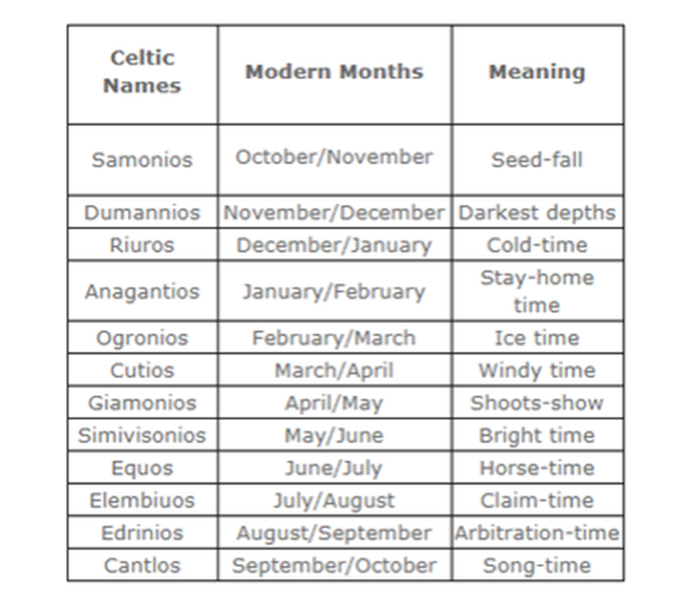
Irish Sam – end of summer
Samhain festival
Irish gam – end of winter
Irish: Eid - fire

Slide 31
Coligny – evidence of proto-celtic?
Dr Cathy Swift: Linguistic similarities point towards a pan-celtic linguistic identity *see reading list
Gaulish and early Irish share a vocabulary
Major challenge to the Celto-sceptics

Slide 32
Samhain (Sow-n)
The Celtic New Year
Fervent dancing and sacrificing marked the Samhain festival in November each year, the gateway from Summer to Winter in the Druidic tradition
In Scotland, farmhands would run around farm boundaries carrying flaming torches to drive evil spirits away as this gateway marked the period closest to the otherworld.

Slide 33
Samhain, South Uist, 1932

Slide 34
Mummers in Ireland

Slide 35
the first day of November
This date is also important in many other cultures, commemorated in various ways as the Day of the Dead (Día de los Muertos) and Hallowe’en,
the Christian Church adopted this day as All Saints’ Day.

Slide 36
Cailleach, Ruler of Winter
Cailleach was the despotic ruler of wintertime, reigning from Samhain (the first day of November) to Bealtaine (the first day of May)
As her time came to an end, she transformed into a moist rock until her awakening the following Samhain
Brid took over as Queen of summer

Slide 37
Scottish tradition
On the night of Samhain, Cailleach captures Brid, Queen of Summer, in a cave in Ben Nevis
Her own son, Angus, frees Brid in the spring and they reign together as King and Queen of summer until Cailleach captures Brid again, in a cycle of seasons, imprisoning and liberation.

Slide 38
Most of Nature hibernates but will it awaken?
The coming winter is heralded by Nature
It’s significance operates fundamentally across all of the Celtic ecology and spirituality
No guarantees: Younger Dryas ice age in oral memory

Slide 39
Imbolc (im-elg)
‘Ewe’s Milk’
St Bridget’s Day, 1st February
Halfway point between Winter solstice and Spring Equinox
Marked the beginning of the agricultural year
And the end of winter
Christian equivalent is Candlemas - the presentation of the Christ child at the temple in Jerusalem, forty days after his birth.
Both linked with light

Slide 40
The Gaelic goddess Bridget or Brid
Goddess of poetry, healing and craftsmanship and of motherhood, passion and fire
A Triple Goddess:
Maiden – Inspiration and poetry
Mother – Midwife and healer
Crone – Hearth fires, smithies and crafts

Slide 41
Imbolc
Clooties

Slide 42
Celtic traditions at Imbolc
People spent time watching hedgehogs (to see one was a good weather sign),
Preparing and eating special food
Making straw girdles and caps.

Slide 43
Imbolc celebrations
Putting red ribbons on their houses (‘Brigit’s cloak’),
making special Brigit’s crosses and straw dolls, called Brideog,
Visiting sacred springs (prohibited by St. Patrick),
and singing protective charms, often lasting for 24 hours.

Slide 44
Hedgehogs, bears and Groundhogs
All associated with weather forecasting
If seen, it meant a good spring ahead
Groundhog day – 2nd February
Festa della Candelora (Bears in Italy ) – 2nd February

Slide 45
Bad weather augured well
Cailleach would make Brid’s day a sunny one
To allow her to gather fire wood, and live longer, delaying spring

Slide 46
Bealtaine (Byel-tin-uh)
Early May
The beginning of summer
The second close proximity between the world and the otherworld
A major portal
More fire!

Slide 47
Important marker for farming
Onset of mackerel season
Turf cutting began
Cattle neutering
Transhumance (cattle moved to pasture)
Fear of disease and theft of health and luck, from Otherworld,
and of changelings

Slide 48
Changelings
Babies taken to serve fairies and swapped with old fairies who needed caring for!

Slide 49
The terrible fate of Bridget Cleary
Her husband, Micheal, claimed she had been swapped for a changeling
And murdered her by immolation in 1895
An Irish nursery rhyme reads, "Are you a witch, or are you a fairy
Or are you the wife of Michael Cleary?"

Slide 50
Sacrifices at Beltaine
Whole herds of cattle would be sacrificed and their blood burned
Centred around Cruachan, ancient capital of Connemara and the Cave of Cruachan, gateway to the otherworld

Slide 51
Maypoles
Germanic origins
Coincidental with Bealtaine celebration

Slide 52
May Day was common in urban areas and embraced joy and celebration
Bealtaine was common in rural areas and embraced fear and hope, centring around purification of people and animals

Slide 53
Lughnasadh (loo-nahsah)
Assembly of Lugh
1st August
Dedicated to the god Lugh
Celebration of skills involving skill competitions such as horse racing
Horse trading also important
Hiring of help for harvest to come
Centred around Emain Macha, where the King’s stables were located (Macha, goddess of horses)

Slide 54
King’s stables
Originally the site of a water cult with evidence of sacrifice
Became used to water horses and wash chariots of the king
Dates from around 1000 BC.

Slide 55
Lughnasadh
Wedding of the sun god Lugh to the earth goddess, causing crops to ripen
Flour from the first fruits of the harvest was used to make bread which was sacrificed to ensure successful harvest
The festival is also known as Lammas
Christian equivalent: Loaf Mass Day

Slide 56
Ould Lammas Fair, Ballycastle

Slide 57
Lammas Fair, St Andrews

Slide 58
Lammas weddings or handfasting
Handfasting weddings in Kirkwall, Orkney
Long Lammas celebration (11 days)
Couples married on Lammas day would enter into a temporary union for one year,
and the following August would decide whether to make the union permanent or to separate.

Slide 59
Persistence and global aspects to these key festivals
Tightly linked community, ecology and seasonality
Fun, practical and with serious undertones
A model for sustainability?

Slide 60
Discussion and break

Slide 63
Lecture 8 Dúthchas
Dr Keith Skene
Biosphere Research Institute

Slide 64
Gaelic
The term ‘Gaelic’, applied to the collective identity of the Highlands and Islands and to Ireland
Defined not only by the historic and continued use of the Gaelic language
but by the region’s distinct social and economic structures, relationship with nature and cultural heritage
This is summed up in the word ‘dùthchas.’

Slide 65
Dúthchas (dogh-hass): merger and emergence
The native Gael who is instructed in this poetry carries in his imagination not so much a landscape,
nor a sense of geography alone,
nor a history alone,
but a formal order of experience in which these are all merged
An emergent property
an existential sense of being in place.

Slide 66
Emergence
A key property of the Earth system
It cannot be built
No legoland approach
More than
Less than
And different from
The parts.

Slide 67
Crofter and world-renowned knitwear designer Alice Starmore describes dùthchas:
“a feeling of belonging, of where everything is linked, completely linked.
Where you belong to the land,
and the land belongs to you – there is no distinction.
It’s like a hand in a glove.
Everything fits in, and your culture is part of that as well,
and everything you know that’s around you;
every part of life that’s around you is all interlinked and interdependent,
and it’s all about ancestry, knowing where you’ve come from
and that you are a continuation of all that.”

Slide 68
Dúthchas
More recent writing emphasises:
Ethics
Responsibility
Native title
Yasmin Davison

Slide 69
The Dùthchas Project
A demonstration project funded by the European Union for the period January 1998 – April 2001
The report explained that it was named after the “historical Gaelic term, Dùthchas speaks of strong, united, self-sufficient communities who actively look after their people, their heritage and their environment – the essence of sustainability”
http://www.duthchas.org.uk/

Slide 70
Dúth: Earth or Land
The word exists both as Dúthchas in Scottish Gaelic and as Dúchas in Irish Gaelic
As a Gaelic ontology and methodology,
it stresses the interconnectedness of people, land, culture,
and an ecological balance among all entities,
human and more-than-human
A true Celtic ecology

Slide 71
Dúthchas can be considered an example of culture-specific
words
As conceptual tools that reflect a society’s past experience of doing and thinking about things in certain ways
While helping perpetuate these ways.

Slide 72
Reciprocity
It can be understood as a cultural, ethical and reciprocal relationship with place
It is an indigenous cultural concept, representing an expanded place-based way of knowing
The idea that the land we live in and belong to is not just a landscape, but a deeply peopled, storied place, is integral to Gaelic an Indigenous understandings of the world

Slide 73
Responsibility
Identification with place and community leads to tangible conduct and action
Motivated by a sense of ethics, respect, and responsibility for said place and community to maintain ecological balance
Ethical relations

Slide 74
Dr Micheal Newton, 2019:
These ideas “encode, transmit, and reinforce particular ways of thinking about the relationship between people and nature
These elements in Gaelic culture encourage particular ways of ‘reading the landscape’ and perpetuate Gaelic ecological ideals and a sense of place and belonging for the individual and the community
These factors have shaped Scottish Gaelic culture and made it indigenous to its habitat in the Highlands and Islands”

Slide 75
Dúthchas predates the formation of the United Kingdom and is an extension of Gaelic law and land governance
a system of customary law or native title associated with traditional clan society and collective rights

Slide 76
The inheritance of land and heritable trusteeship,
encoded and transmitted through Duthchas,
affirms dynamic and complex kin- and land- based relationships that bond people, extended kin and community together beyond biological ties alone.

Slide 77
Seán Ó Tuama (1985):
“There is a sense in which place finally becomes co-extensive in the mind, not only with personal and ancestral memories, but with the whole living community culture Community becomes place, place community.”

Slide 78
Dúthchas, is not monolithic, static, parochial nor inward-looking
It is inclusive and fluid, with an eye to the future, sustainable communities, and generations to come.

Slide 79
James Oliver (2021):
“Dúthchas is that ontological dynamic of:
embodied experience and emplacement (on the ground)
and complex entanglement (in the mind)
with relationships of belonging and dwelling, heritage and inheritance, a human ecology with place.”

Slide 80
The Earth System as Dúthchas
SUB-OPTIMAL
EMERGENT
NONLINEAR
SELF-ORGANIZING
INTERCONNECTED
CONSTANT CONVERSATION

Slide 81
The Earth System as a Social and Ecological Pluriverse
DÙTHCHAS
Sami
Celts
Tuaregs
Ogiek
Plains Indians
Maasai

Slide 82
William McTaggart: Harvest Moon (1899)

Slide 83
William McTaggart: Harvest at Broomieknowe (1896)

Slide 84
William McTaggart: The Sailing of the Emigrant Ship (1895)

Slide 85
Ecological Imperialism
From Clearances to the Balmoralization of the Highlands
Wilderness had always had humans but now would be rid of them
Danger of ‘green’ projects such as the Lewis Wind Farm following in the same steps

Slide 86
The Highland clearances and Dúthcas
The essential wholeness of the community and landscape create a tension theoretically with individual identity
This is explored Yeats’ poem ‘Among School Children’:
“How can we know the dancer from the dance?”

Slide 87
It is this which the clearances destroyed
Neil Gunn (author of Silver Darlings), in Butcher’s Broom, wrote:
‘Already, as a community, cohesion had gone. They were stragglers after a battle rather than a simple people moving to new lands.’
‘Without a territory to belong to, and without faith in the persistence of their traditional values, the individuals became just that: individuals, no longer connected by the same spirit, Dúthchas’.

Slide 88
Imperial conservation
The issue of place is quite central to this decolonizing framing because, in the
Gaelic culture of the Highlands and Islands, place and land are central to
identity formation and reproduction
Place does not become a particular issue until powerful forces, such as the legal,
technical discourse of institutional conservation, represent place as natural space
through a process of survey, evaluation and designation.”
Toogood (2003: 162)
Toogood, Mark (2003) ‘Decolonizing Highland conservation’, in Adams, William and
Mulligan, Martin (eds), Decolonizing Nature: Strategies for Conservation in a
Postcolonial Era, Earthscan, London. pp.152-171.

Slide 89
The significance of community land buyouts now becomes clear
Fiona Mackenzie argues that they are ‘...visible evidence of a place-based movement in the Highlands and Islands antithetical to dominant discourses of globalisation.’

Slide 90
John MacInnes (1930-2019)
John MacInnes observes that for hundreds of years Gaelic history has been a dialectic which never seems to reach an acceptable synthesis
Perhaps community land buyouts are one example of such a synthesis.

Slide 91
The Gaelic world is rooted in dùthchas,
a territorial attachment to a specific location and its history,
so strong that the culture cannot even be understood fully without having witnessed, if not inhabited, the environment which inspired it
Centralized government policy, be it from London, Edinburgh or Dublin, is surely no way forward in terms of decision making involving landscape, habitat and conservation/sustainability.

Slide 92
Norman MacCaig: A Man in Assynt (1969)
“Who possesses this landscape?
The man who bought it or
I who am possessed by it?”

Slide 93
Fonn's Dúthchas: Land and Legacy by James Hunter

Slide 94
Urban Dúthchas?

Slide 95
DISCUSSION

