Slide 1
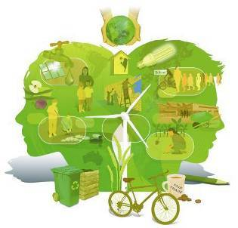
Transforming Humanity
How do we change direction?
WEEK FOUR
Dr Keith Skene
Biosphere Research Institute

Slide 2
An overview

Slide 3
A new model for transition: Cornerstones.
CENTRALITY OF SYSTEMS THINKING
INFORMATION
EDUCATION
FACING DOWN THE BARRIERS
LANDSCAPE/
CULTURE
FUNCTIONAL SOCIETY
INCENTIVIZATION
INDIGENOUS THINKING
POSITIVE MESSAGING

Slide 4
The Earth System is the Only System We Need
Perfectly functional
Tried and tested over 3.4 billion years of inquisition

Slide 5
The Earth System is the Only System We Need
Perfectly functional
Tried and tested over 3.4 billion years of inquisition

Slide 6
The importance of a functional society
A functional society, contextualized within the Earth system
Such societies, the indigenous or First Nation peoples, already exist

Slide 7
The economic activity emerges from a functional society

Slide 8
Three initial steps
Reduce our disturbing behavior
Trust the Earth system
A societal transition means re-integration
- A cultural re-birth within the landscape

Slide 9
Sustainability cannot be political
Politics is dogmatic
Politics divides
Sustainability requires togetherness
United around the environment
The Earth system is not political.

Slide 10
Sustainability issues require a separate government of national unity, all-inclusive, and pluralistic – it’s that important

Slide 11
Eight essential support structures
1. Civil society incentivization
2. Training in how to team build
3. Infrastructure provision e.g. micro-hydropower units for local stream
4. Supportive technology
5. Reformed education system: system theory and 50% sustainability-based
6. Significant green tax on non-compliant industry
7. Poverty-related barriers to sustainable living addressed
8. Co-design, co-production and co-dissemination at national and regional level for all citizens: ownership and accountability.

Slide 12
Full ecological footprints of all supply chains
Essential for accountability in consumerism
Essential for accountability in production
Essential for accountability in design

Slide 13
Midas, King of Phrygia

