Slide 1
Transforming Humanity
How do we change direction?
WEEK TWO
Dr Keith Skene
Biosphere Research Institute

Slide 2
The spread of transition
Transitions are not thought of as emerging from a single point,
and diffusing outwards,
but rather they occur in different locations, and modulate into a significant change
These ideas are difficult in terms of differences in starting points, cultures and geo-political heterogeneity across the planet.

Slide 3
What kind of a transition - a sustainable future?
In attempting to envisage what kind of a transition is needed, we must first identify what the goals of such a transition are
What are we transitioning towards and from?
?
?
What does this destination actually look like?
Economic, social and environmental?
How do we get there?
Do we have to leave from the same station?

Slide 4
Starting points differ
!Kung – hunter gatherers
Kenyan shamba– agrarian
Indian nail factory – industrial
American agriculture - technological

Slide 5
Different departure stations
HUNTER
GATHERER
AGRARIAN
INDUSTRIAL
TECHNOLOGICAL

Slide 6
The One Path Approach
HUNTER
GATHERER
AGRARIAN
INDUSTRIAL
TECHNOLOGICAL
A
SUSTAINABLE
FUTURE

Slide 7
The Sustainable Development Goals

Slide 8
What is the right path?

Slide 9
Issues with development
Arturo Escobar: “ Development can be described as an apparatus that links forms of knowledge about the Third World with the deployment of forms of power and intervention resulting in the mapping and production of Third World societies”
https://www.theguardian.com/global-development/2012/nov/05/arturo-escobar-post-development-thinker

Slide 10
Jean Marc Ela, Cameroonian sociologist
“ Africa is not against development. It dreams of other things than the expansion of a culture of death or an alienating modernity that destroys the fundamental values so dear to Africa…Africa sees further than an all-embracing world of material things and the dictatorship of the here and now, that insists in trying to persuade us that the only valid motto is “I sell, therefore I am”. In a world often devoid of meaning, Africa is a reminder that there are other ways of being”
From: Ela, J. (1998) Western development has failed: looking to a new Africa. Le Monde Diplomatique, October 1998. https://mondediplo.com/1998/10/06africa

Slide 11
Dr Vandana Shiva

Slide 12
Maldevelopment
“What is referred to today as ‘development’ is actually ‘maldevelopment’. It is designed and driven by external forces for the profits and control of external agents and actors. The World Bank generates $3 of business for western companies for every dollar it lends to the Third World for ‘development’. ‘Development’ allows $500billion to flow out from the Third World to the rich West in interest and debt payments and low prices for Third World products, while $50billion goes in the opposite direction as development aid.”

Slide 13
“It is time to move beyond the fictions and illusions of economic growth which siphons wealth from the poor to the rich, and take into account the reality of ecological catastrophes and social disintegration that have been unleashed by ‘development’ processes and which leave the poor poorer.”

Slide 14
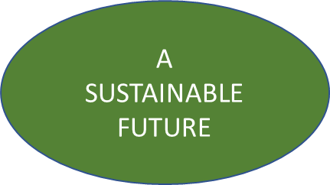
A Different Perspective
HUNTER
GATHERER
AGRARIAN
INDUSTRIAL
TECHNOLOGICAL

Slide 15
Different Destinations (Pluriverse)
HUNTER
GATHERER
AGRARIAN
INDUSTRIAL
TECHNOLOGICAL
A
SUSTAINABLE
FUTURE
A SUSTAINABLE
FUTURE
A
SUSTAINABLE
FUTURE

Slide 16
A Localist pluriverse
Here, the landscape informs the culture and the economic activities
Example: Territorialism (Alberto Magnaghi)
- place-consciousness
Relates to Patrick Geddes’ concept of bioregions
Which in turn was inspired by Frederic Le Play’s concept of Lieu, Travail, Famille.

Slide 17
Localism as an indigenous cultural narrative
Culture emerges from our biogeographic landscape
It is our response to this landscape that truly represents our culture
Each of us responds differently to a given landscape
But we are unified by our individual resonances with that landscape.

Slide 18
Astronaut’s perspective
Sachs uses the term “astronaut’s perspective” (Sachs, 1999; p. 83) to refer to a global approach for sustainability
From a transformation viewpoint, the socio-ecological problem is rooted in the economic and power structures of our society and in the way humans interrelate with nature.

Slide 19
Home perspective
Small scale, local, community base approaches are best
E.g. Schumacher’s “Small is Beautiful”
This resembles Sachs “home perspective” where the stress is on developing sustainable local livelihoods and radically restructuring the development patterns of the North (Sachs 1999)

Slide 20
Vandana Shiva (2008) refers to the key to the transition as being from oil to soil, increasingly emphasising localism
These writers all call for a diverse economy that has a strong base on communities.

Slide 21
Who should manage transition?
Is it the state and the modern church that is neoclassical economics, driven by popularity and growth,
or should this revolution be led by the civil society?

Slide 22
Le Play, Geddes and Magnaghi
Civil society, properly rooted in culture and landscape
Adam Smith pre-dated all of these, with the ultimate emergent management concept that would be claimed by many afterwards.

Slide 23
Adam Smith (1723-1790)

Slide 24
Origins of the Current Economic Model
Adam Smith (1723 – 1790)
1759 The Theory of Moral Sentiments
1776 The Wealth of Nations
Social wellbeing in resonance with economic freedom.

Slide 25
Virtuous self-interest
Adam Smith (1776)
“It is not from the benevolence of the baker that we expect our dinner, but from their regard for their own self-interest”
The invisible hand (moral sentiment)

Slide 26
The invisible hand as a social construct

Slide 27
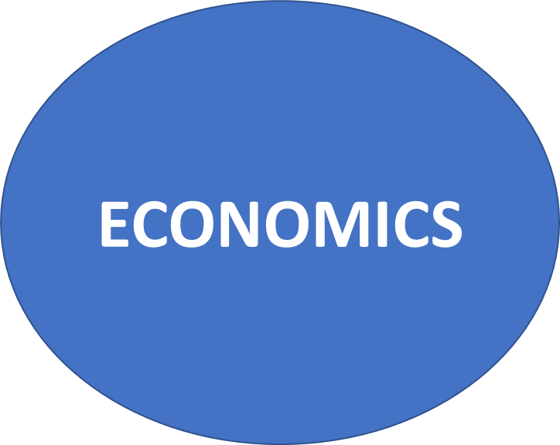
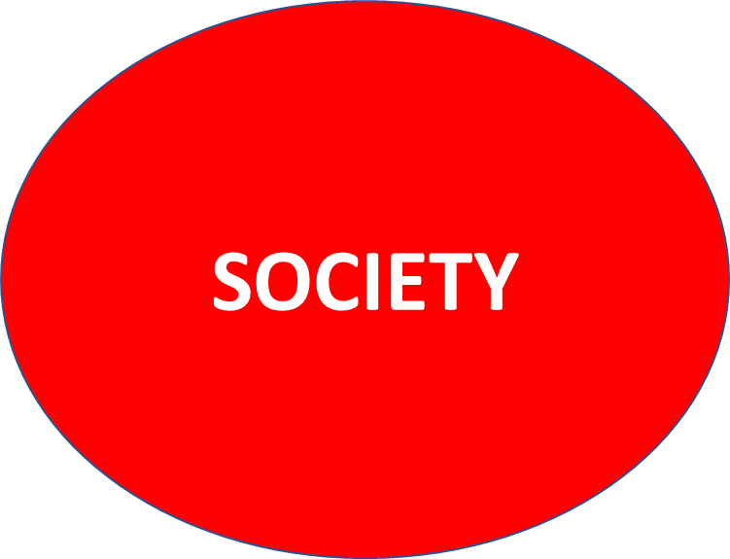
Management of the transition to an enlightened future
would emerge from a functioning society

Slide 28
The invisible hand as a social construct

Slide 29
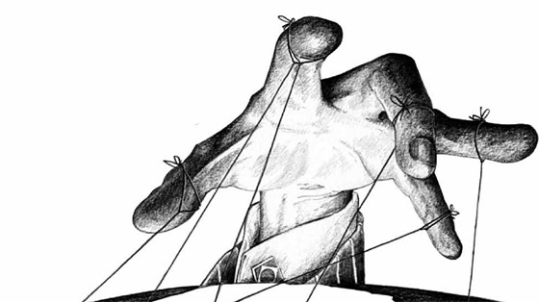
The scissors of societal collapse
A FUNCTIONAL SOCIETY
The Free Market Economy

Slide 30
Invisible hands of Smith, Le Play and Magnaghi
SOCIETY
FAMILY
LANDSCAPE
ECONOMY
WORK
CULTURE
Smith Le Play Magnaghi

Slide 31
Alasdair MacIntyre
Argued that we do not have individual rights at our foundation but that we are irreducibly social animals

Slide 32
Ethics of care
The answers to moral questions emerge from interpersonal interactions, rather than from the individual.
Carol Gilligan

Slide 33
Ubuntu: a Sub-Saharan Philosophy
Interdependence is a reality for all
The primacy of the individual in relation to the collective cannot be assumed.

Slide 34
Buen Vivir – an Andean Approach
Wellbeing can only exist within the community
and the concept of the community includes nature.

Slide 35
For Indigenous people, sustainable development emerges from a systems approach that includes environment, society and economy

Slide 36
The tripartite invisible embrace
Economics grounded in a healthy functional society
A healthy functional society grounded in landscape
Where culture is an emergent property of the Earth system.

Slide 37
Arne Naess 1912 - 2009
‘We may be said to be in, and of, nature from the very beginning of ourselves. Society and human relationships are important, but our own self is much richer in its constitutive relationships.’
Naess, A. (2008: 82) The Ecology of Wisdom (2008: 82)
Notes:
SENTIENT
1. having the power of sense perception or sensation; conscious
n
2. a sentient person or thing

Slide 38
Albert Schweitzer 1875 - 1965
‘Man does not make ethical progress by assimilating instruction with regard to accommodations between the ethical and the necessary, but only by hearing ever more clearly the voice of the ethical element. We must never let this sense become dulled and blunted.’
Schweitzer 1923: 69
Notes:
Famous biocentrist, german, a philosopher, theologian, concert organist, physicia, medical missionary and winner of the Nobel Peace Prize.
He understands that power as will-to-live, an impulse toward life that he assumes is present in every living being, and the same in all, but consciously only felt in some.

Slide 39
Nature is the ultimate source of all value.
What is valued is what ultimately determines ethics.
Ecological Issues: An introduction Patrick Curry 2006 Polity Press

Slide 40
A theory of societal transition
Re-integrating humanity
Re-awakening culture
Re-connecting society
Re-purposing civil society

Slide 41
The Andean Approach

Slide 42
Buen vivir
A new movement, but with foundations in ancient indigenous values, meaning ‘living in a good way’.

Slide 43
Buen vivir
Wellbeing can only exist within the community
and the concept of the community includes nature

Slide 44
Contextualizing our existence

Slide 45
The individual is relational, defined by their interconnectedness to others, socially and environmentally.

Slide 46
The key is harmony, both with each other and with our environment
Central concepts include sustainable degrowth, environmental accounting, austerity (i.e. using less of the Earth’s resources) and more local production.

Slide 47
Society is in resonance with its landscape (the environment), and the individual is in resonance with both
Culture is born out of landscape.

Slide 48
Helbing et al. (2016): “Pluralism and participation are therefore not to be seen primarily as concessions to citizens, but as functional prerequisites for thriving, complex, modern societies.”

Slide 49
As Conway and Singh (2011) put it: “Notions of the pluriverse imply multiple ontologies, multiple worlds to be known — not simply multiple perspectives on one world. Universalist discourses and globalist projects are grounded in a unitary ontology and imperialist epistemologies which assume that the world is one, that it is knowable on a global scale within single modes of thought, and is thus manageable and governable in those terms.”

Slide 50
The significance of cultural diversity
Since culture emerges from landscape
Then a healthy planet will produce diverse landscapes and cultures
Separation of humanity from their local landscapes delivers monocultures, a symptom of this malaise
Thus cultural diversity is a consequence of connectivity, an essential pre-requisite for the tripartite invisible embrace.

